Slide 1
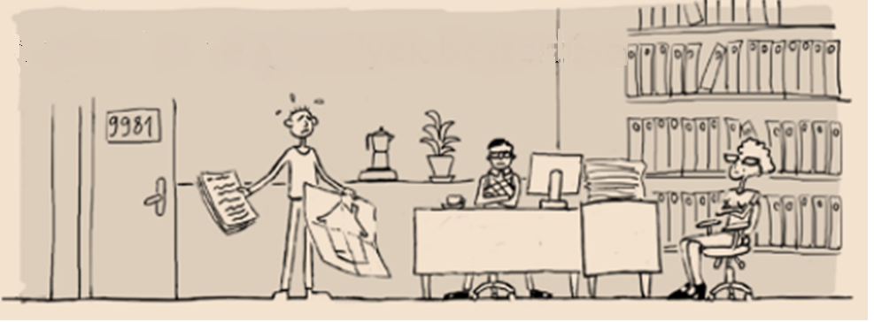
One-stop-shops: building renovation made easier
Benigna Boza-Kiss
Central European University/European Commission JRC
GreenDependent Institute
International Institute for Applied Systems Analysis

Slide 2
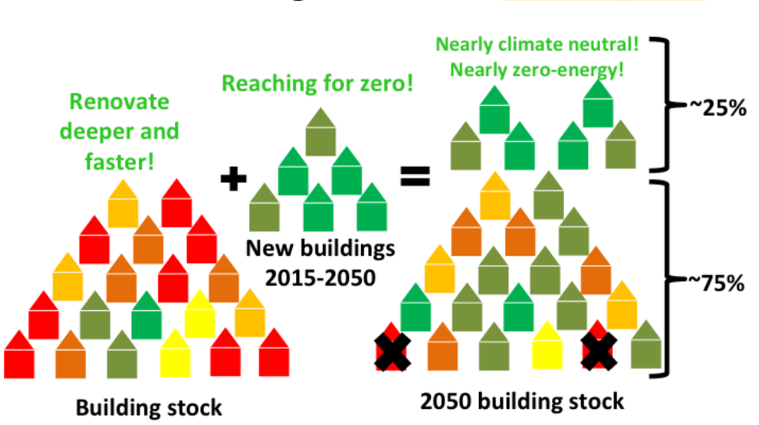
Renovation of residential buildings
Source: COHERENO project, 2015
Notes:
Art 9: New buildings, NZEB, January 2021 (2019 public buildings)
Construction rate: ca. 1% of the building stock per year, resulting in a total of max. 10% -> Most buildings in 2030 are already built today, and 75% of those in 2050
Focus on exsiting buildings must grow, 90% must be renovated deeply or demolished by 2030 = rate of 3% / year
Critical challenge: private homes

Slide 3
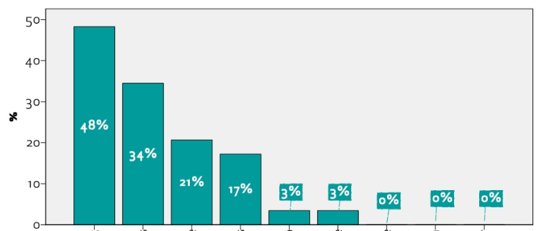
Willingness / Plan
Hungarian data, 2015
Plans to renovate in the next 5 years
Windows and doors
Heating system
Other
Passive/shading
Facade, walls insulation
Rooftops
Hot water system
RES installation
boiler
Source: Energia Club, 2015: Refurbisment at our doorsteps
Notes:
Data: Hungary, representative survey, 2014. This was an annual survey for a few years, but stopped in 2015.
Around 20% plans renovation. Own realization ca. 50%, 48% windows, external walls 34%.

Slide 4
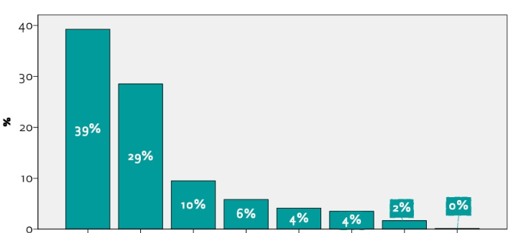
Assistance
Hungarian data, 2015
Where will you collect information from to decide on „WHAT”?
Own research
Craftsman from an earlier engagement
Other
Internet
Property manager
NGO
Family, friends, neighbours
Professional engineer
Energia Club, 2015: Refurbisment at our doorsteps
Notes:
Data: Hungary, representative survey, 2014. Citizens that are interested in renovation, but do not engage for a reason. Reasons include: lack of finances, lack of confidence, afraid of hassle.
Over one third (34% in 2015, 36% in 2014) of the renovation were carried out by the owners themselves (family/friend, but no professional involved).

Slide 5
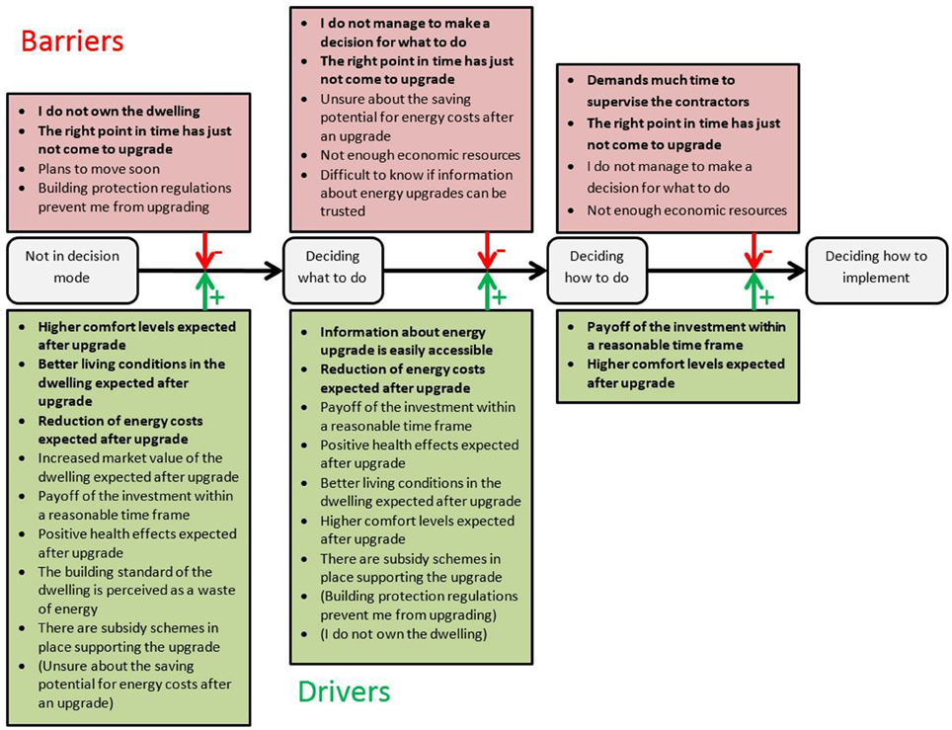
Barriers and drivers at various stages of decision making
Source: Klöckner, 2013, https://www.frontiersin.org/articles/10.3389/fpsyg.2016.01362/full#B23
Notes:
Interested citizens often abandon the renovation idea before realizing it. There are critical decision-making stages, where a potential renovation can get discouraged. Many of them could be overcome if the owners were given help through the process and in decision making.

Slide 6
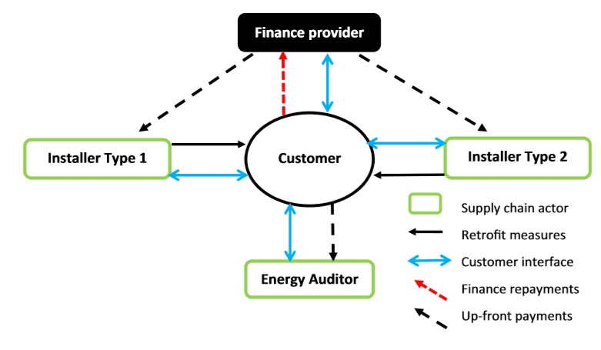
Atomized model
Notes:
The classic renovation model requires the customer to make all major decisions, invest a lot of time and take risks. It is based on the ability of the customer to act as a project manager/organizer in terms of technical, financial and time-management.

Slide 7
Main barriers on three sides
Owners (demand side)
Hassle
Contractors (supply side)
Network
Need for adverts/self-promotion
Financiers (banks)
Lack of understanding of the potential
Lack of technical knowledge
Lack of technical knowledge
Lack of time
Bad experience (own or „neighbour”)
Too many options
Lack of understanding of importance
Too much transaction time/cost
Impact from „bad” contractors (lack of trust)
Difficulty to deal with complaints
Simple and single offer – how to diversify
Lack of experience in evaluating EE projects/clients
Notes:
Besides the customers, there are several other key actors, who all face a number of barriers, which finally block the whole renovation project, or a wider uptake of renovation.

Slide 8
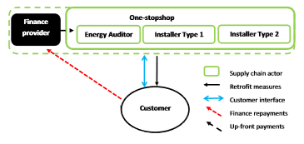
Facilitated model
Notes:
Therefore, a facilitator can help at the micro scale and a more economy-wide scale by intervening at the arrangement and technical/financial/ organizational levels.

Slide 9
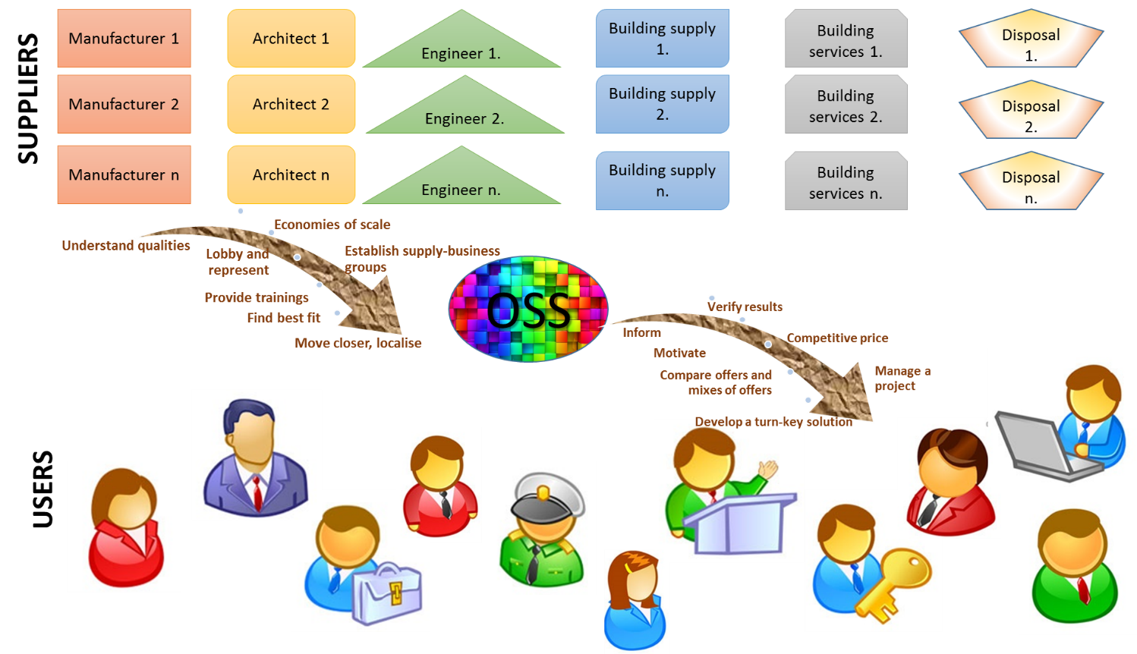
The one-stop shop
Notes:
An OSS service transforms a cumbersome and complex set of decision-making/actions by non-experts into a single entry, customer-friendly offer. The OSS concept means moving away from the classic set-up where asset owners face directly every entry point of a complex renovation value chain with a number of interlocutors, and where the asset owner – who is a non-expert – has to find the best combination of the parts of a complex solution, to a situation where project promoters can benefit from a customer-centred service offer establishing a bridge between the fragmented supply side and the also fragmented demand side.
Provision of complex products and systems (CoPS) rather than individual products or services can reposition businesses, while providing customers more tailored “integrated solutions”

Slide 10
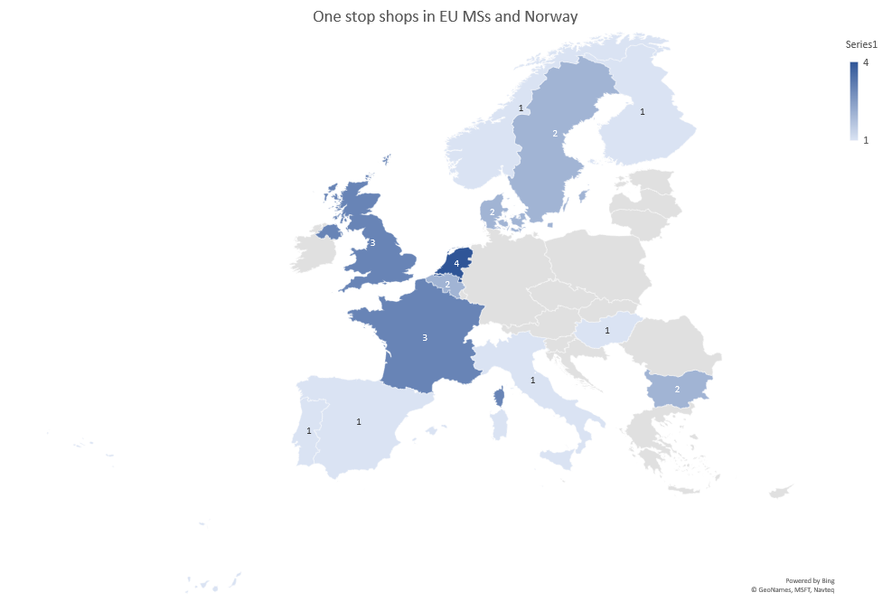
Findings 1)
Identified: 22 OSS, average 2-3 per country
Assumption: ca. 100 OSS across Europe, in all countries
Notes:
EU-wide survey for existing or past OSS in 2018. We have identified 22 working models, 3 are outside EU. Based on OSS interviews, total numbers are around 3-4 times more, around 100 across the EU.

Slide 11
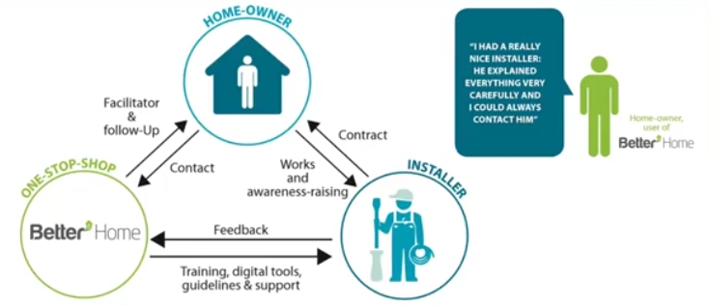
Market driven example: BetterHome
Example 1)
Notes:
Two major types of OSS have been identified.
Example 1) is fully market based, with an aim to better position an existing product, or offer services connected a product. E.g. Danfoss, Grundfos, the ROCKWOOL and VELUX Groups formed BetterHome in DK.
Assists home-owners and installers alike. Renovation packages, client orientation, complain management.
Fragmented market from both points of view (supplier and demand).
Financial organisations: associated with the OSS. (customers are redirected to associated banks)

Slide 12
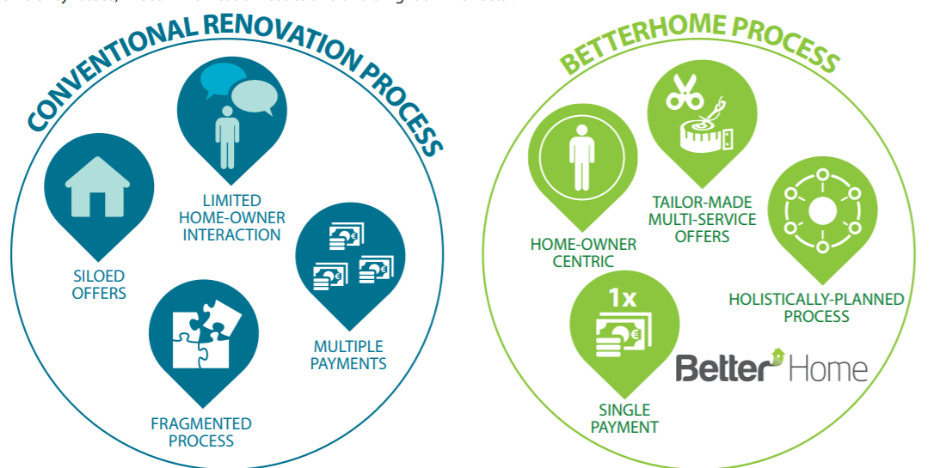
Market driven example: BetterHome
Example 1)
Notes:
The difference in the service by traditional set-up and BetterHome.
Service orientation, comfort. Savings are usually rather low (15-20%), simple measures are preferred.

Slide 13
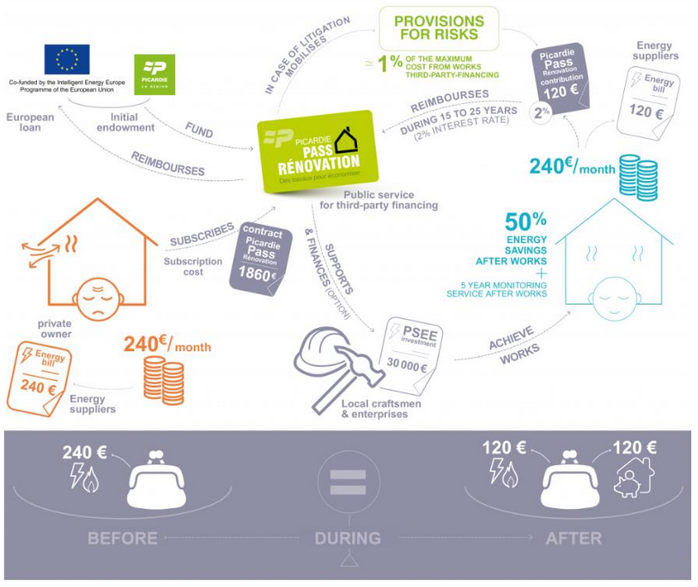
Local authority initiative example: Picardie
Example 2)
Notes:
Example 2) Motivated by other reasons, based on public targets and public budget.
Several French, Dutch examples.
In Picardie:
The ambition is to renovate 2000 residential homes over a 3 year period with 50 to 75% energy savings, the creation of 33 direct jobs and 650 indirect jobs in the construction sector.
Over the next 5 years, 10,000 renovations per year, with €300 million investment and the creation of 3,500 jobs in the construction sector.
An integrated service: local offerings of advice and works, thermal audit and advice to households, financing solution, accompanying homeowners during and after the works.
Thus, the following initiatives were taken:
Creation of an Energy Information Space = network with 15 advisors
Management of contractors by local actors (e.g. Globe 21, MEF of Vermandois)
Regional experiment with zero interest rate loans for energy efficiency and renewable energy investments for residential homeowners (10.000 cases in 4 years)
The financing of the implementation is usually based on third-party financing (where 85% of the energy cost savings are used for reimbursing the investment costs, and 15% remain with the end-customer), which can be combined with white certificates, and grants.
The foreseen financing need for the SPEE is €58 million for 2000 projects:
€50 million for the works
€8 million for the operations (agency, renovation technicians, pilot sites, first loss guarantee fund)
The Picardie Pass Renovation receives public funding from:
ELENA subsidy: €1.8 million covering overheads
Picardie Region allowance:
€8 million covering initial renovation projects
European Investment Bank loan: €23.5 million
Furthermore ELENA technical assistance
As opposed to example 1:
Deeper and broader renovation, more developed financing, more expensive and focus on public good (CO2), comfort is less importance.

Slide 14
Owners (demand side)
Hassle
Contractors (supply side)
Network
Need for self-promotion
Financiers (banks)
Lack of understanding of the potential
Lack of technical knowledge
Lack of technical knowledge
Lack of time
Bad experience (own or „neighbour”)
Too many options
Lack of understanding of importance
Too much transaction time/cost
Impact from „bad” contractors (lack of trust)
Difficulty to deal with complaints
Simple and single offer – how to diversify
Lack of experience in evaluating EE projects/clients
What an OSS can/should offer?
Act as project coordinator
Connect banks to good clients
Tools
Single point of contact
Handle customers (pre and post contracts)
Model contracts and/or act as contractor
Help clients access financing
Best match
Notes:
As opposed to the barriers discussed, the benefits offered by OSS are:

Slide 15
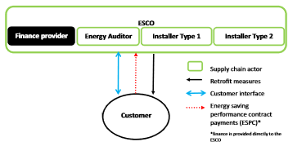
Facilitated model
Notes:
Compare the OSS-facilitated model to an ESCO.
Financing and costs are not as central. Project is not necessarily possible to be covered by the energy cost savings.
Focus on assistance and help for already decided citizens.

Slide 16
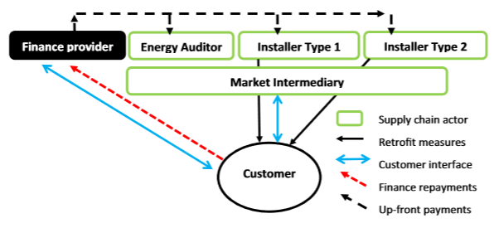
Facilitated model
Notes:
Compare the OSS-facilitated model to an auditor, facilitator, single-person consultant.
Assistance in more aspects, focus on the whole supply-chain, not only at stating off the project. Follow-up, and monitoring. Both demand and supply, even more the financiers are assisted.

Slide 17
European regulation (1)
critical element of the “Smart financing for smart buildings” initiative within the Clean Energy For All Europeans package (2016)
  Member States “to develop dedicated local or regional one-stop shops for project developers, covering the whole customer journey from information, technical assistance, structuring and provision of financial support, to the monitoring of savings.”
  ”The development and replication of these one-stop-shops will be supported at the EU level by an exchange of good practices through Manag'Energy, funding through Horizon 2020, the EU Project Development Assistance facilities, or funding from the European Structural and Investment Funds (ESIF) when relevant.”
30.11.2016. COM(2016) 860 final

Slide 18
European regulation (2)
Directive 2018/844/EU, preamble (#16): improved financing of buildings, and for one-stop-shops to be utilized as advisory and assistance tools.
a new article, Art. 2.a. calls for long-term renovation strategy, as part of which Member States are required to facilitate access to mechanisms, such as one-stop-shops,
According to the revised Article 20(2), “Member States shall provide the information through accessible and transparent advisory tools such as renovation advice and one-stop-shops”.
30.11.2016. COM(2016) 860 final
Notes:
which amends the Directive 2010/31/EU on the energy performance of buildings (EPBD) and Directive 2012/27/EU on energy efficiency (EED).

Slide 19

The value of an OSS
local;
accelerates building refurbishments by informing, motivating, as well as by assisting building owners to follow through energy efficiency investments, by standing beside them from the start to the end;
it can facilitate interested, but not yet committed energy users/asset owners to actually implement an energy saving or other type of sustainable project;
it can ease access to financing and occasionally offer better rates;
based on the above, it can also be one of the tools to increase the renovation rate,
it can also improve the average renovation depth in terms of energy performance, because an OSS walks through the full renovation route.
Notes:
Summary/conclusions

Slide 20
Thank you for your attention
Follow-up:
Please, contact me with information on the OSS in your country.
Any comments on our findings so far are welcome.
OSS workshop in January
OSS report (part 2) is expected around 1 in February 2019

Slide 21
Additional slides

Slide 22

EU building stock & its regulation
Private single residential
EXISTING
Commercial buildings EXISTING
Public buildings EXISTING
Building stock complexity
Social housing
Other special buildings
Public buildings NEW
Commercial buildings NEW
Private buildings NEW

Slide 23
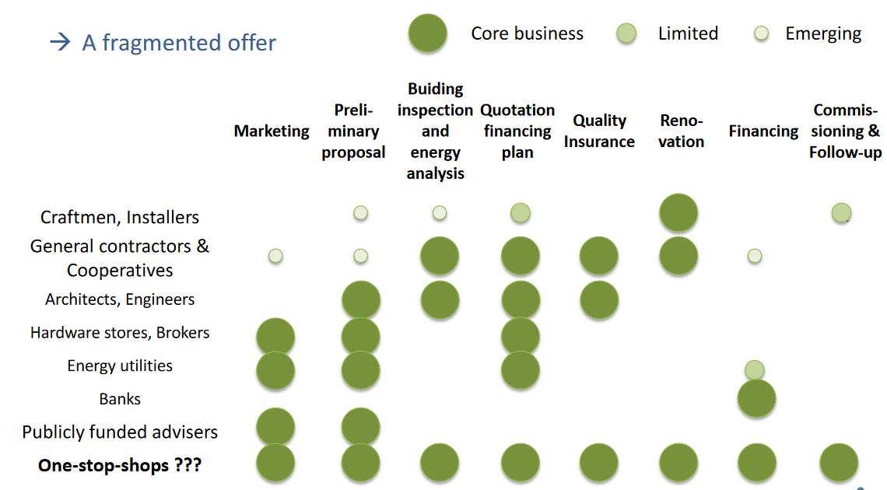
Comparison to others

