Slide 1
Assessing the local impacts of building RES
Lenka Zemková
Faculty of Humanities, Charles University
Institute for Economic and Environmental Policy, FSE, J. E. Purkyně University

Slide 2
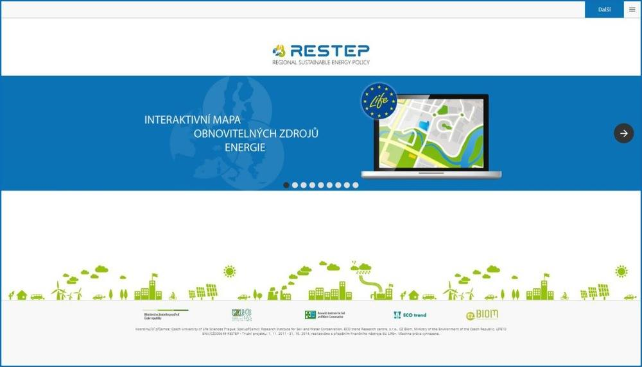
„RESTEP“ project
Interactive map of RES for regional sustainable energy planning

Slide 3
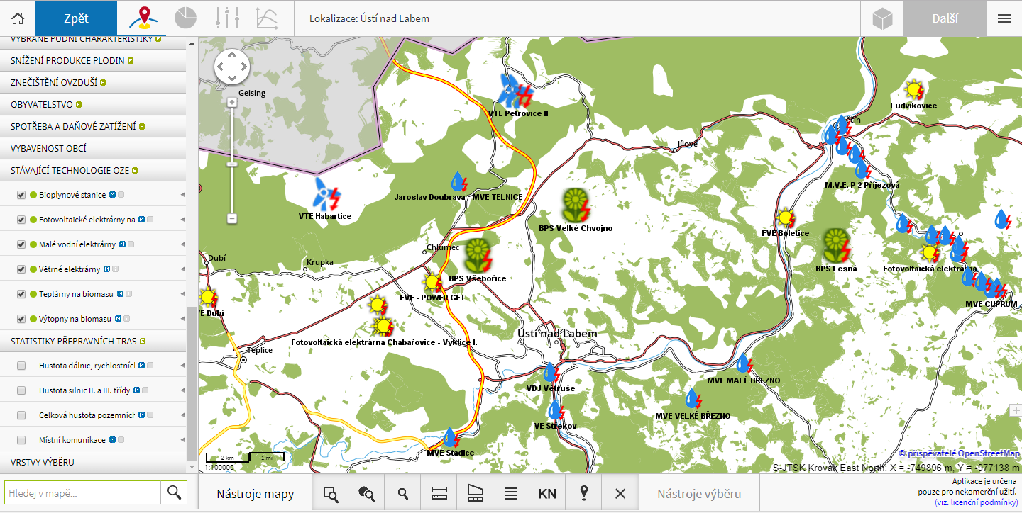
„RESTEP“ project – current RES

Slide 4
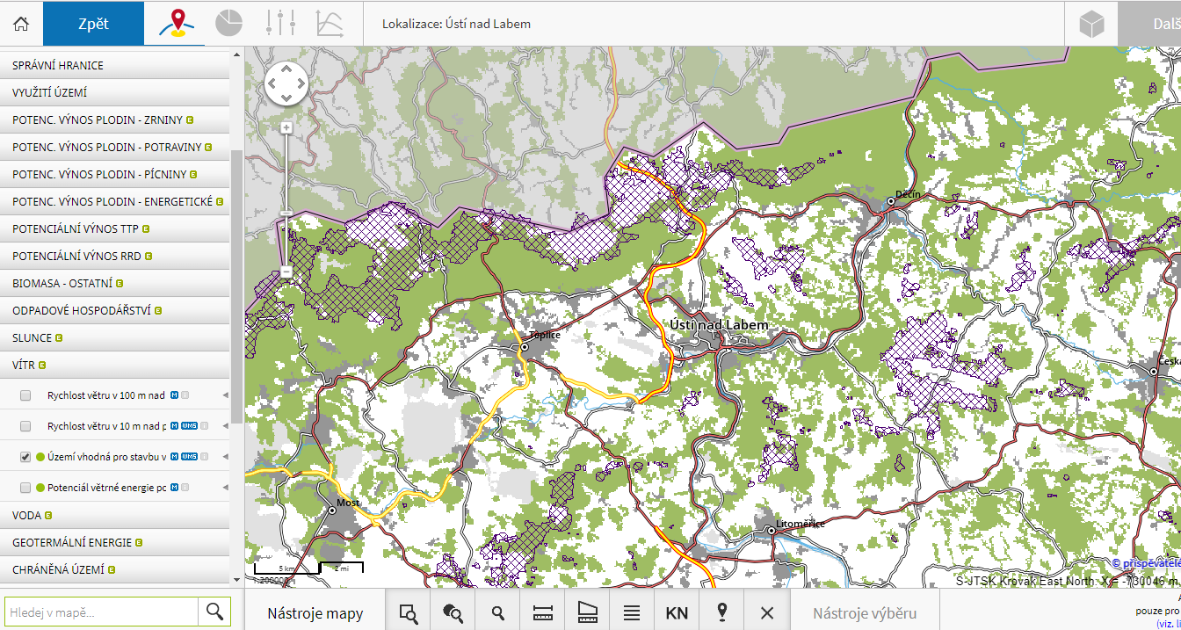
„RESTEP“ project – appropriate areas for wind power plant

Slide 5
Introduction
EU goal of 20% share of renewables in 2020 to mitigate CO2 emissions
Czech Republic committed to the goal of 13%
Decision for mayors: To built or not to built
The complex impact assessment is missing
Quantitative x qualitative point of view
Number of evaluation methods
Increasing demand for a complex tool at regional level

Slide 6
RegioIAF Development
RIA – Regulatory Impact Assessment
EIA – Environmental Impact Assessment
LIA – Local Impact Assessment
    Regional Impact Assessment Framework (RegioIAF)
Renewable energy sources:
  Photovoltaic
  Wind
  Water
  Geothermal
  Biogas stations

Slide 7
Regional Impact Assessment Framework
Brings a complex evaluation framework for mayors (or investors) for decision-making processes
Social, economic, environmental impacts at regional level
Environmental impacts:
  CO2 emission
  Erosion
  Water quality and consumption
  Biodiversity
  Air quality
  Noice
Multi-criteria analysis (better/worse, impact weight)

Slide 8
Primary Impacts: Multi-criteria analysis
Regional Impact Type | Influence degree |  |  |  |  |  |  | Criterion weight | Overall impact
 | NEGATIVE (-) |  |  | No | POSITIVE (+)
 | significant | middle | low |  | low | middle | significant
 | -3 | -2 | -1 | 0 | +1 | +2 | +3
Long-term employment
Short-term employment
Regional GDP
Revenues for the municipality
Costs for the municipality
Environmental impacts
Agriculture/Forestry/Water
Overall impact |  |  |  |  |  |  |  | 100%

Slide 9
Secondary Impacts
Secondary impacts (induced by the primary impacts and may not occur in each case)
  Energy prices
  Business environment
  Infrastructure level
  Municipality development
  Education and human capital

Slide 10
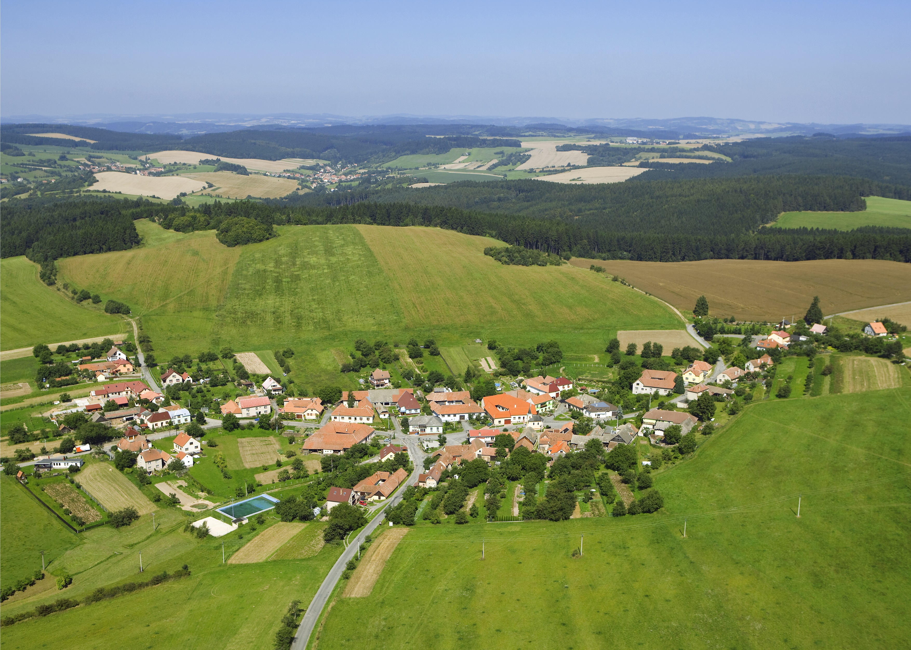
Source: www.kozarov.cz

Slide 11
Conclusions
Increasing demand for complex framework which will help mayors in decision-making process (what will this kind of RES bring to the municipality?)
RIA x EIA x LIA RegioIAF
Multicriteria analysis consisting of all impacts (building and operation of RES)

Slide 12


Lenka Zemková, zemkova@e-academia.eu
Faculty of Humanities
Charles University

