Slide 1
The new faces of electrical power networks coordination
Miroslav Vrba

Slide 2
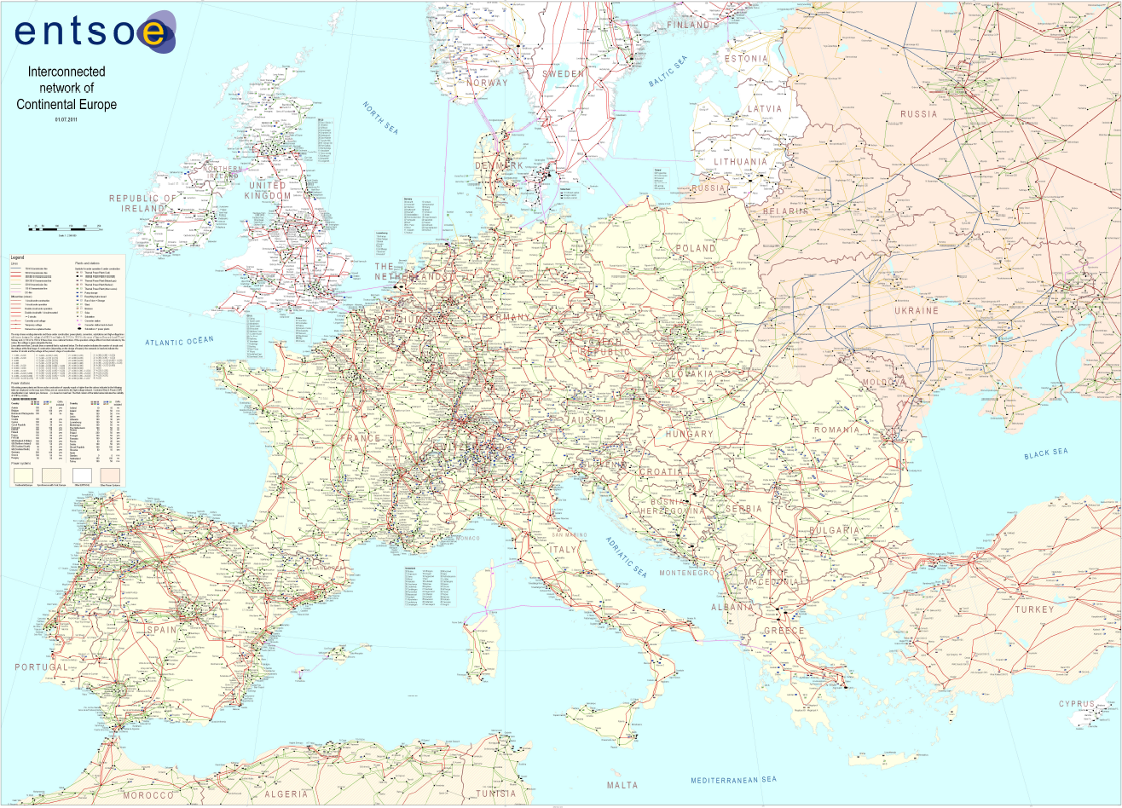
European meshed grid an advantage or disadvantage ?

Slide 3
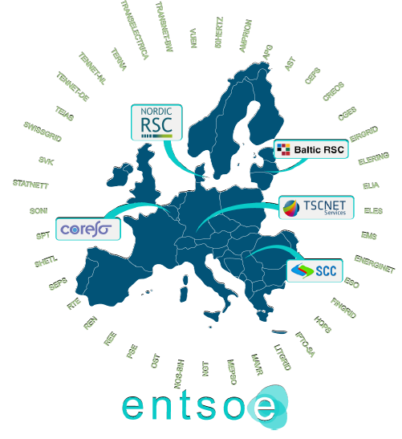
The new faces of electrical power networks coordination

Slide 4
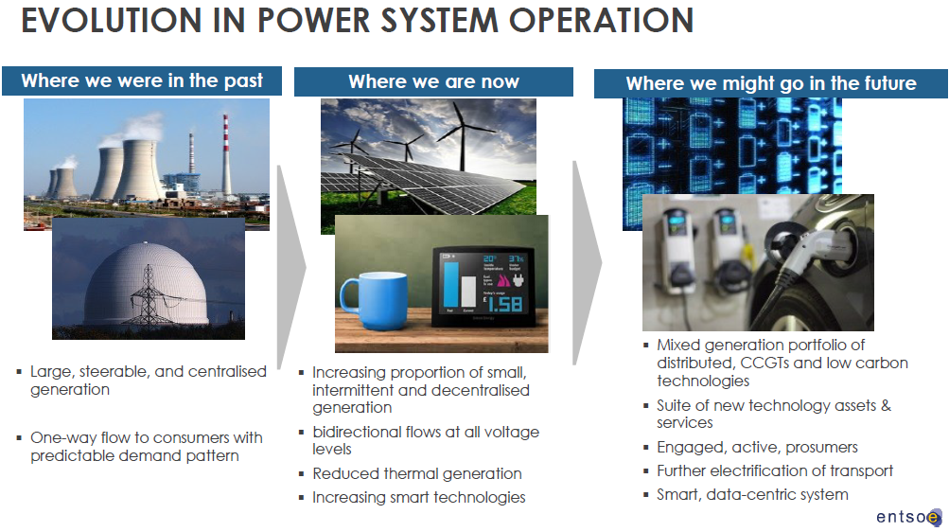

Slide 5
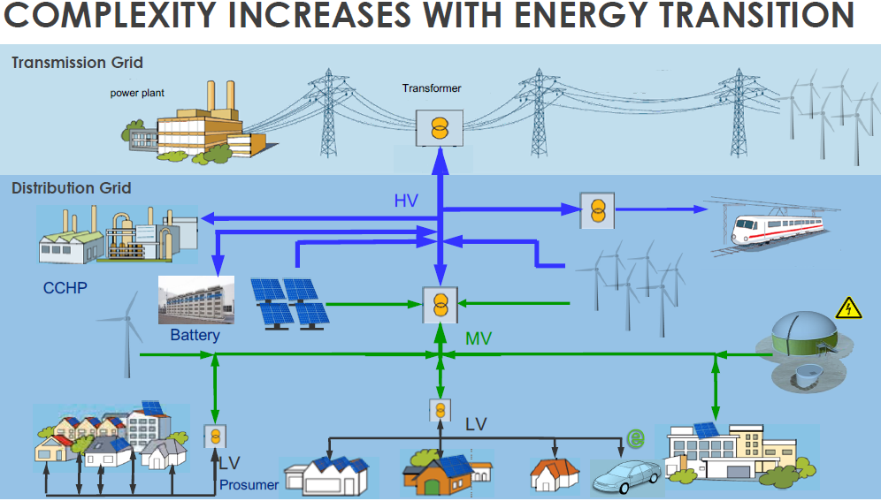

Slide 6
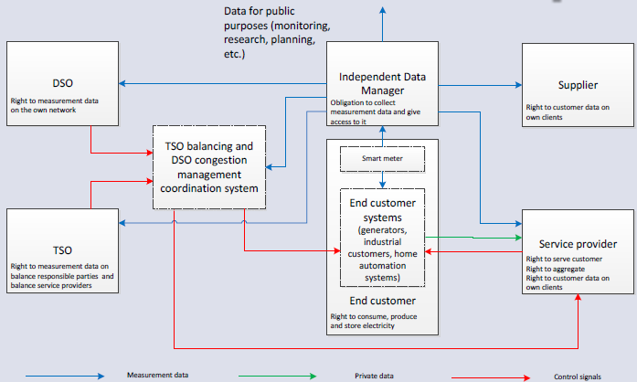
Traditionally and newly needed relationship among market players

Slide 7
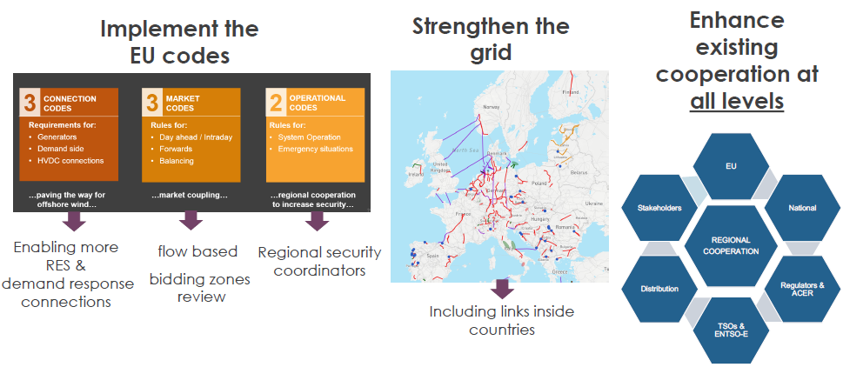
How to tackle compexity ?

Slide 8
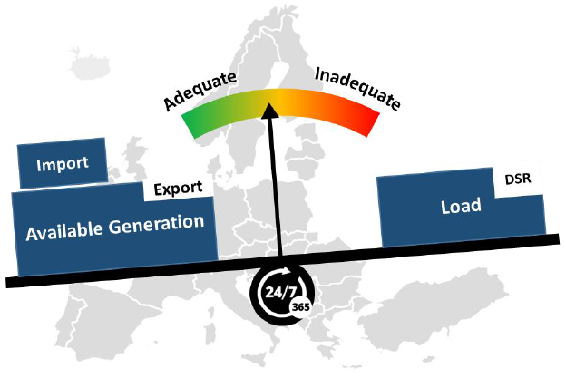
How to keep lights on

Slide 9
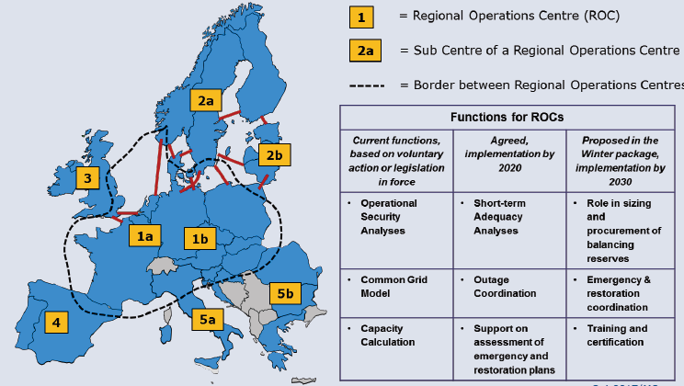
Regional Operational Centre vs Regional Security Coordinators

Slide 10
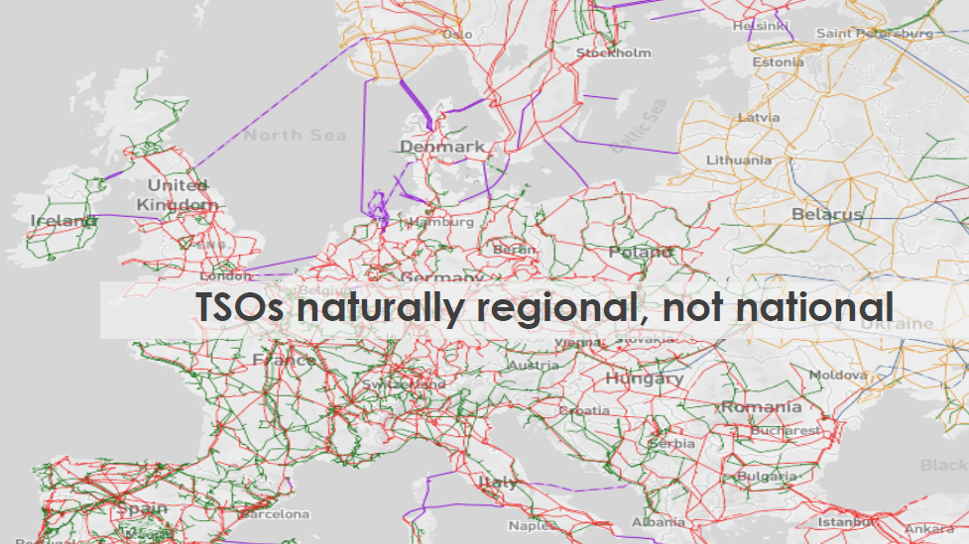
Regional Operational Centre vs Regional Security Coordinators

Slide 11
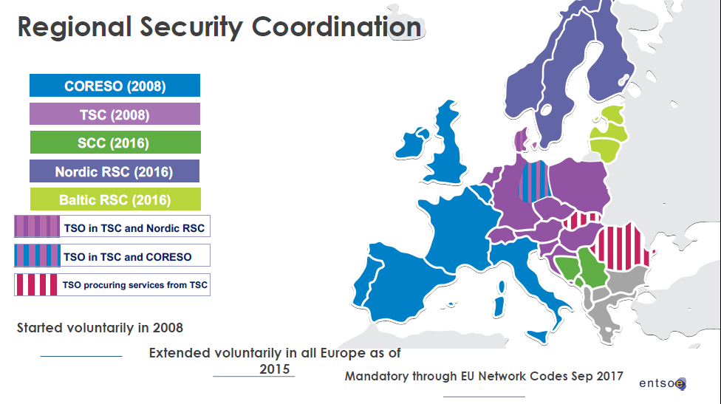

Slide 12
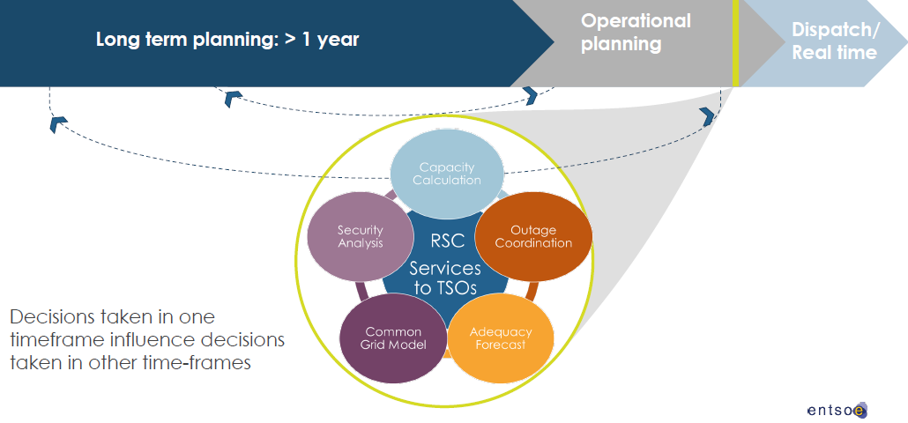
RSCs support TSOs in operational planning

Slide 13
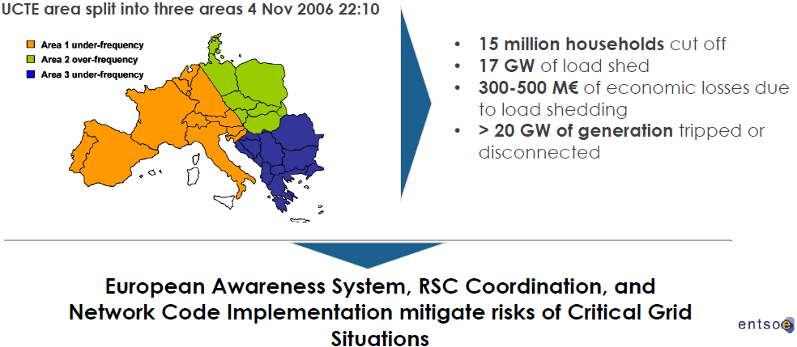
Driving forces: stressed situations

Slide 14
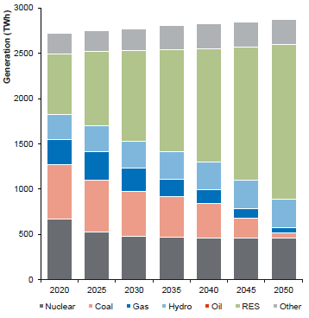
Driving forces: decarbonisation

Slide 15
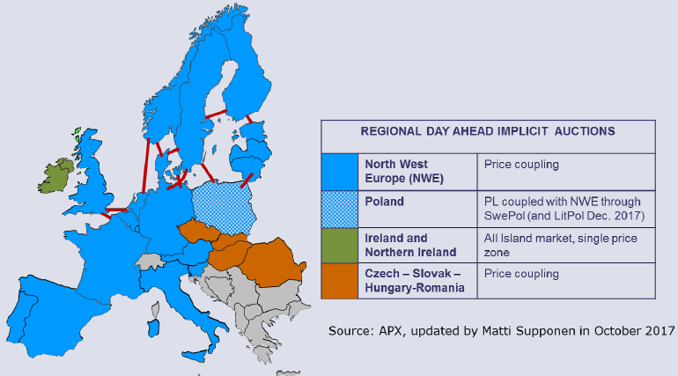
Driving forces: market development

Slide 16


German – Austrian bidding zone – pioneer or relic of European market integration ?
Trade volume DE-AT represents up to 30% of cross-border transactions in the CEE region
Due to unsufficient transmission capacity, up to 70% of traded electricity physically flows through neighbouring transmission systems
DE-AT bidding zone
    forced decrease of tradable cross-border capacities on other borders within the region
    endangers secure operation within the region
In May 2017, Austrian and German Regulators decided to introduce coordinated congestion management on the DE-AT border as from October 2018, but 4,9 GW transfer capacity will be still available for market players for exchanges between Austria and Germany
Unsufficient transmission capability of the bidding zone
Flows jeopardizing security of supply in neighbouring countries
+
Discrimination of market participants outside the zone

Slide 17
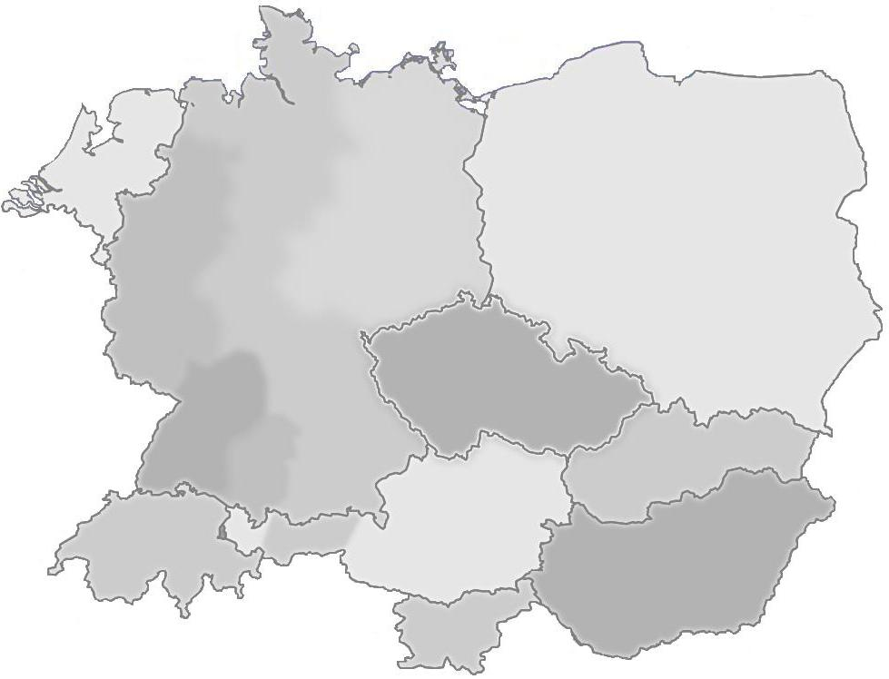
Driving forces: congestion management
Generation surplus
TenneT:
Internal redispatching up to 600 MW
Reconfiguration in substations: Conneforde, Landesbergen, EmdenB, Pleinting, Mecklar, Redwitz
Generation decrease in power plant Irsching to 0 as redispatching with APG
During the day the redispatching was between 300 – 1000 MW
ČEPS:
Reconfiguration in Hradec substation
PSE:
Cancellation of intended works on lines Mikulowa-Lesniow
1700 MW
1350 MW
-830 MW
7570 MW
5700 MW
600 MW
1600 MW
110 MW
3890 MW
710 MW
5100 MW
500 MW
390 MW
720 MW
D-1Balance
1140 MW
-2440 MW
ID Balance
7300 MW
-510 MW
2700 MW
2900 MW
Trades
-1580 MW
-510 MW
During the day the redispatching was between 200 – 870 MW
Redispatching
-4700 MW
During the day MRA was between
640 – 1140 MW
-2800 MW
-2300 MW
Reality
-2300 MW
Demand for imports

Slide 18
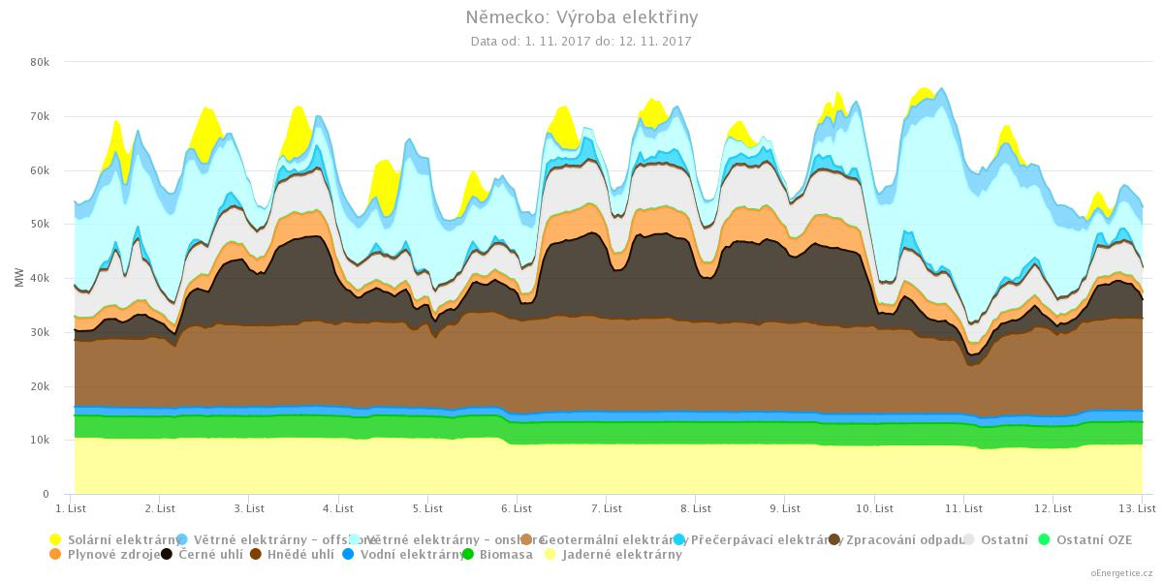
Generation pattern in Germany

Slide 19
The new faces of electrical power networks coordination
Thank you for attention
Miroslav Vrba

