Slide 1
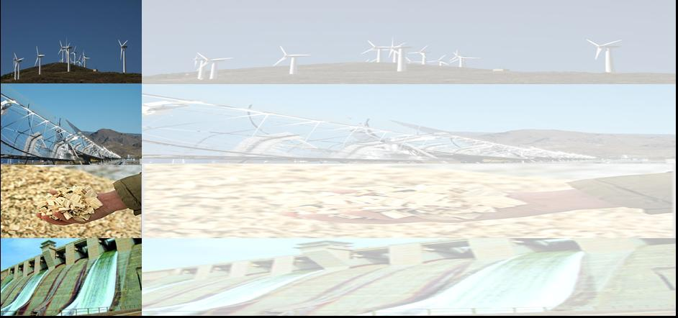
ELECTRICITY MARKET 3.0:
WHERE TO HEAD AFTER LIBERALISATION?
Reinhard HAAS
Energy Economics Group, TU Wien
Praha, 20 November 2017

Slide 2
CONTENT:
1. Introduction: Motivation
2. Method of approach
3. How variable renewables impact
prices in electricity markets
4. The core problem of capacity payments
5. The role of flexibility
6. Subsidizing RES: How long?
7. Conclusions

Slide 3
1. INTRODUCTION
Motivation:
* Climate change → Paris agreements
* Targets for renewables
* Competition & democracy
* Due to the IEA-WEO 2017 will „Photovoltaics the cheapest source of new electricity in most countries world-wide” be

Slide 4
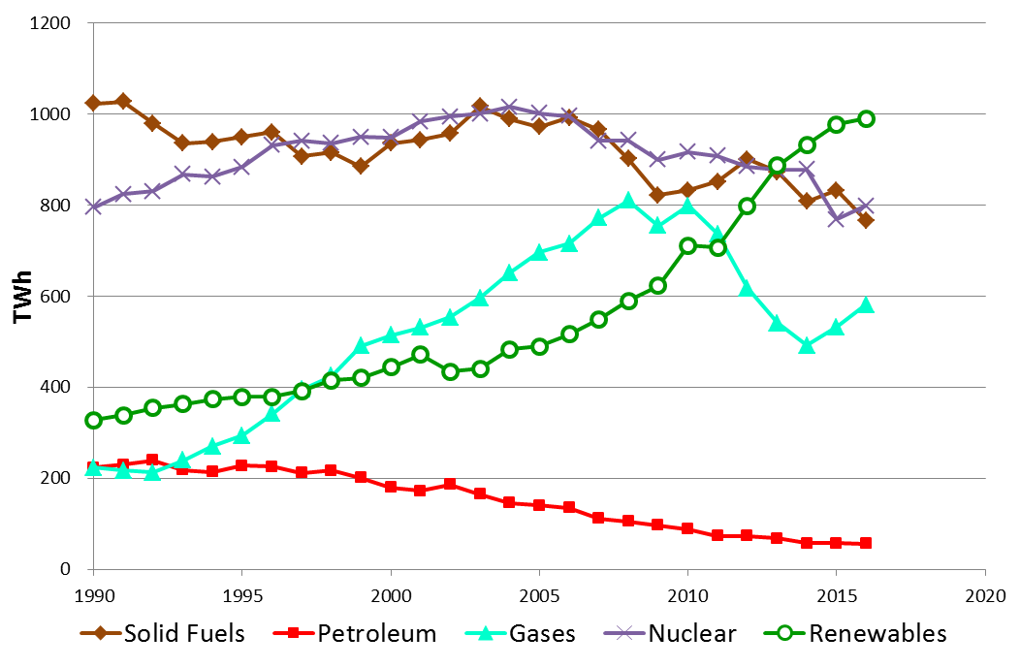
Introduction:
Electricity generation EU-28

Slide 5
How prices come about:
Three periods of market design
before liberalisation
after liberalisation:
old thinking
after liberalisation:
new thinking
Scarcity prices
Average
costs
Price, costs (EUR/MWh)
Long-term
marginal costs
Short-term
marginal costs
Excess prices
time

Slide 6
Old thinking
Demand
Genera-
tion
Grid
Supply
Flexibility options
Storage

Slide 7
Core objective
… to identify the major boundary conditions
for sustainable and democratic future electricity systems
Very important:
Our reflections apply in principle to every electricity system world-wide
…. are based on electricity economic
point-of-view

Slide 8
2. METHOD OF APPROACH
Identification of hourly residual load over a year for various scenarios with large quantities of variable renewables;
Applying a fundamental model to calcuIate hourly residual loads and electricity spot market prices;

Slide 9
Day-ahead electricity markets
Expectation of
prices = Short-term marginal costs
(Short-term marginal costs = fuel costs)
due to huge depreciated excess capacities at the beginning of liberalisation!

Slide 10
3 HOW VARIABLE RENEWABLES IMPACT THE electricity system and PRICES IN ELECTRICITY MARKETS

Slide 11
Example: prices without
and with PV
Demand D_{t}
Costs,Price (EUR/MWh)
Price = System marginal costs
Supply
curve
w/ PV
Price with PV!
Supply
curve w/o PV
PV
MW

Slide 12
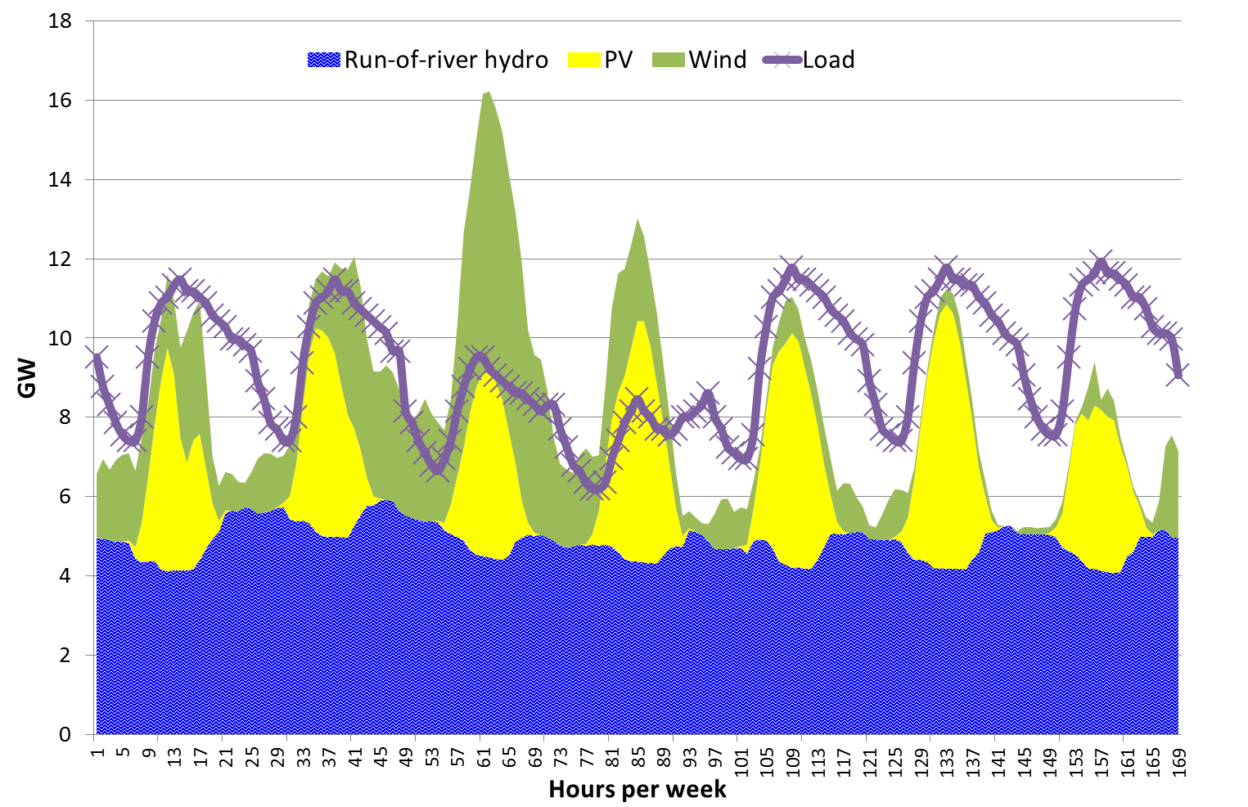
  Supply and Demand
RES Production
< Demand
RES Production
> Demand
Demand

Slide 13
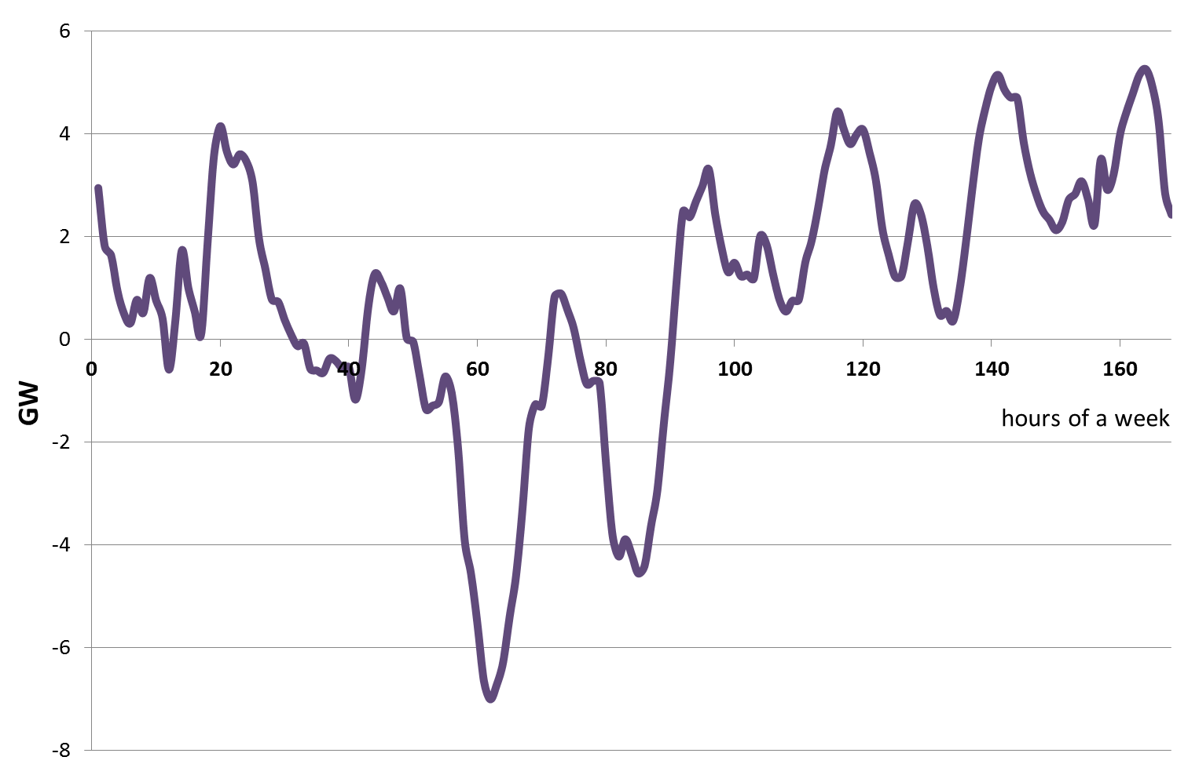
  Key term of the future:
  Residual load
  (base load is “dead”)
Under coverage
Excess electricity
  Residual load = Load – non-flexible generation

Slide 14
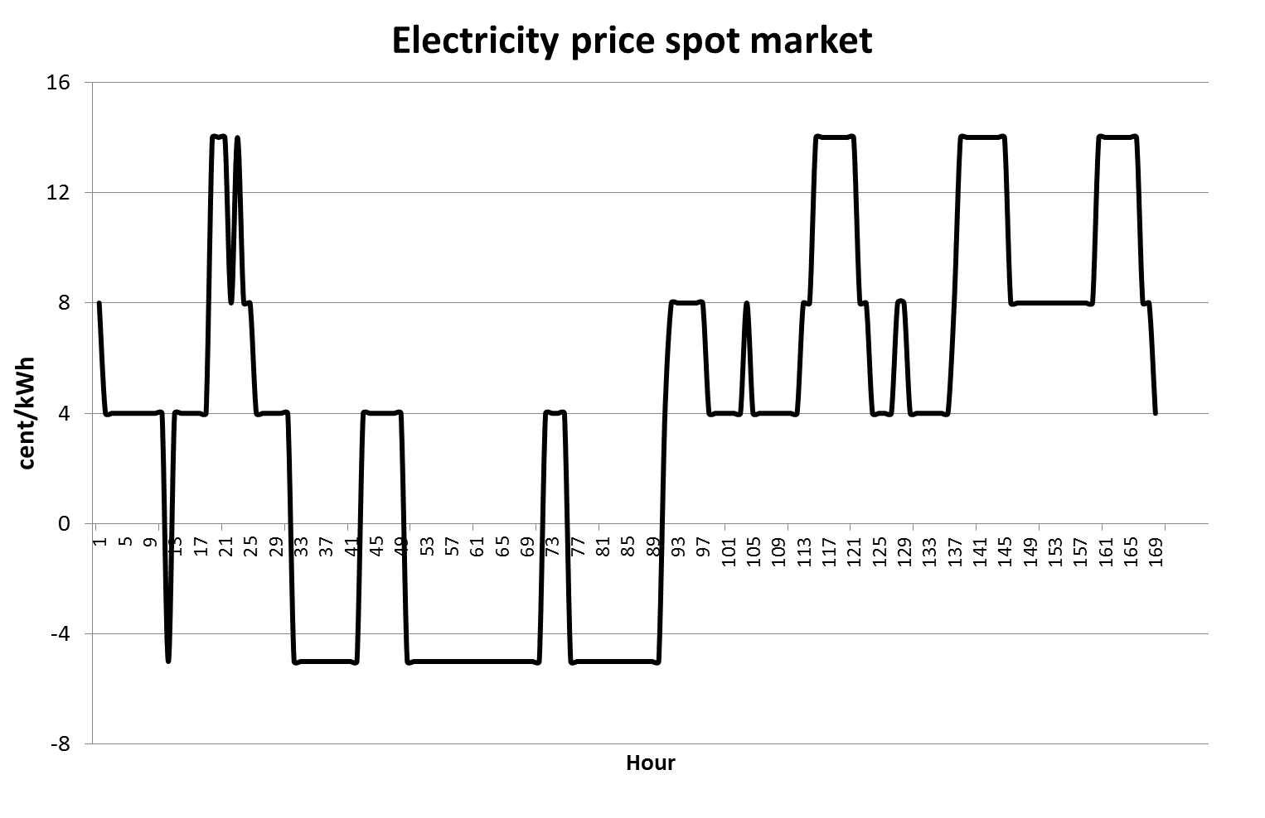
Deviation from STMC-pricing
in spot markets
Scarcity prices
p_{t1}
New price spreads
Low average price (3cents/kWh)
Negative prices
p_{t2}
→ These price spreads provide incentives
for new flexible solutions!!!!

Slide 15
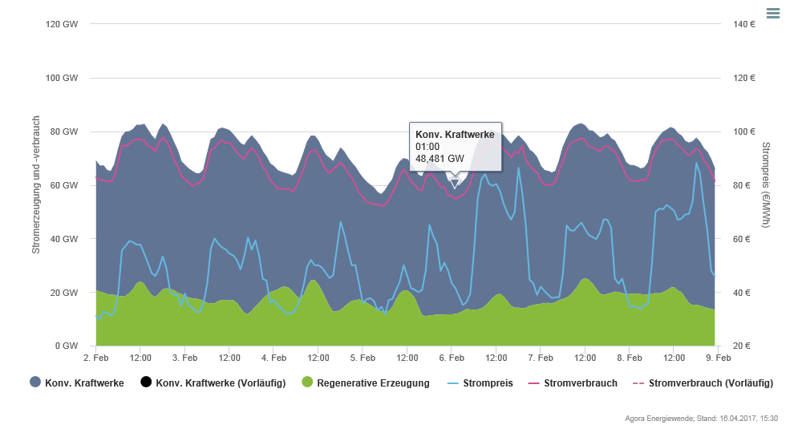
Remark: Cold - dark – Lull („Kalte Dunkelflaute“)
Maximum price: ca. 85 EUR/MWh

Slide 16
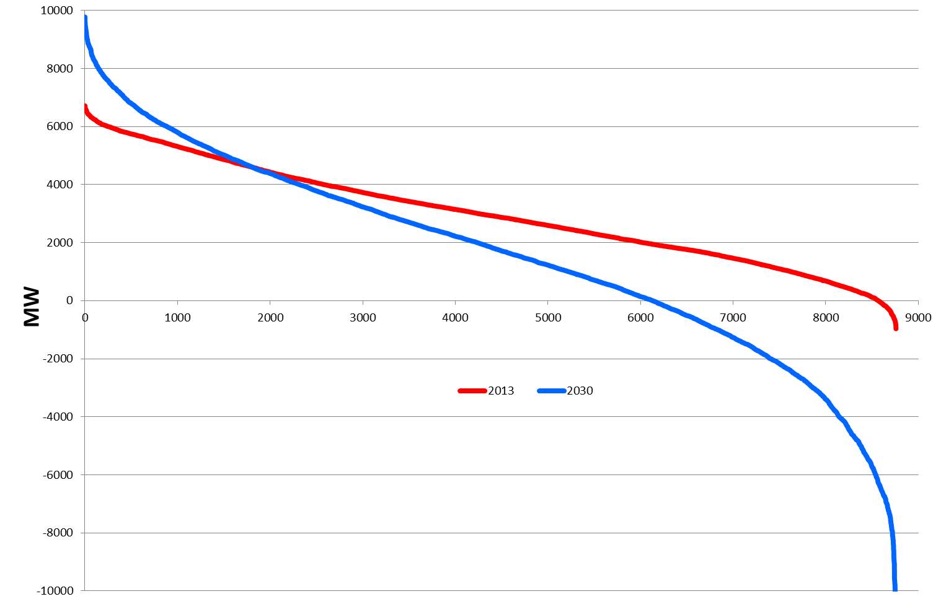
  Classified residual load over a year
2013
Under coverage
2030
Surplus due to excess
generation

Slide 17
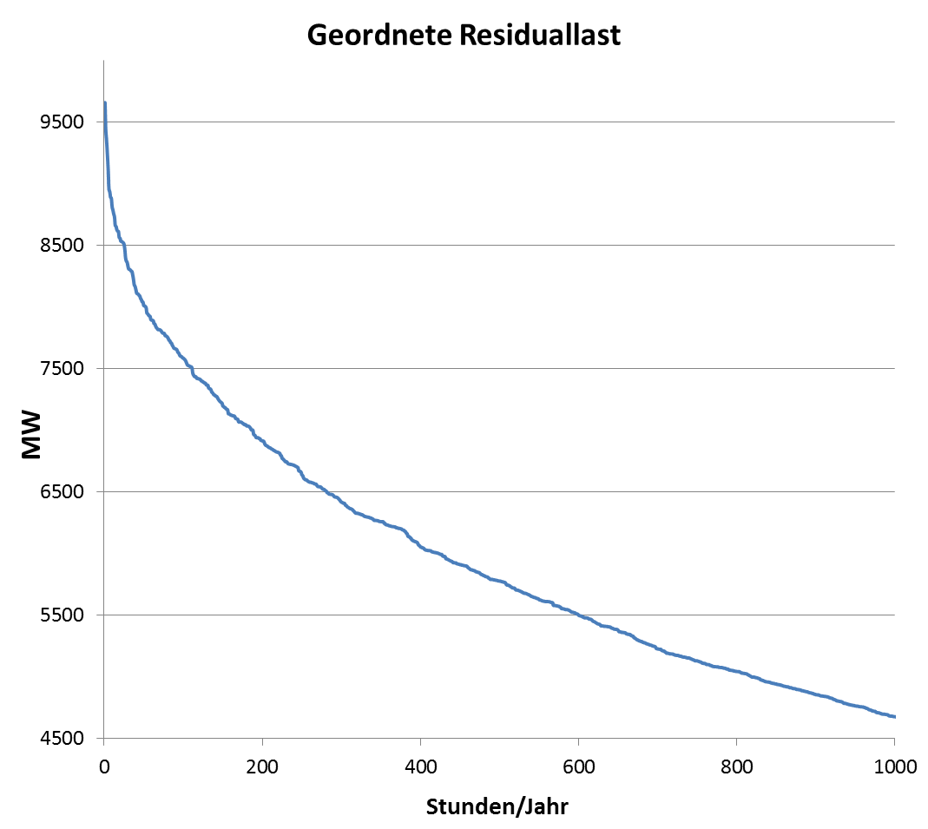
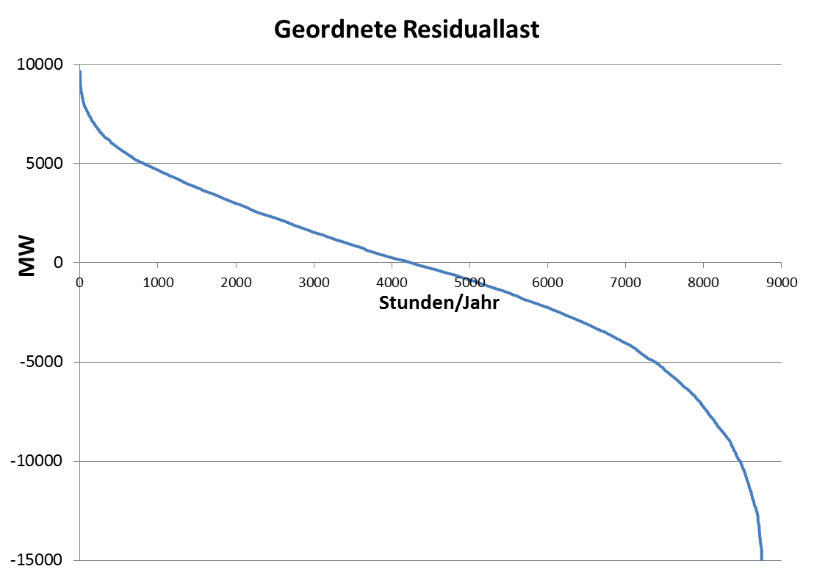
Classified residual load
How to cover
Cold - dark – Lull
(„Kalte Dunkelflaute“) ?
Under coverage
Excess
production

Slide 18
There are two extreme positions:
By a regulated capacity „market“ with STMC pricing?
or
By competition between supply-side and demand-side technologies and behaviour (incl. Storages, grid and other flexibility options) with correct scarcity pricing signals?

Slide 19
4 THE CORE PROBLEMS
OF CAPACITY PAYMENTS
All regulatory capacity payments for power plants destort the EOM and lead to wrong price signals for all other options
Price peaks at times of scarce resource should revive the markets and lead to effective competition
We should strive to retain system resource adequacy by ensuring correct price signals and without capacity payments

Slide 20
5 THE ROLE OF FLEXIBILITY
AND SECTOR COUPLING
FLEXIBLE GENERATION
DEMAND-SIDE
MANAGEMENT
(TECHNICAL)
STORAGES (CENTRAL,
DECENTRAL,
POWER-TO-HEAT)
GRID EXTENTION
DEMAND
RESPONSE
(PRICE SIGNALS)
SMART GRIDS

Slide 21
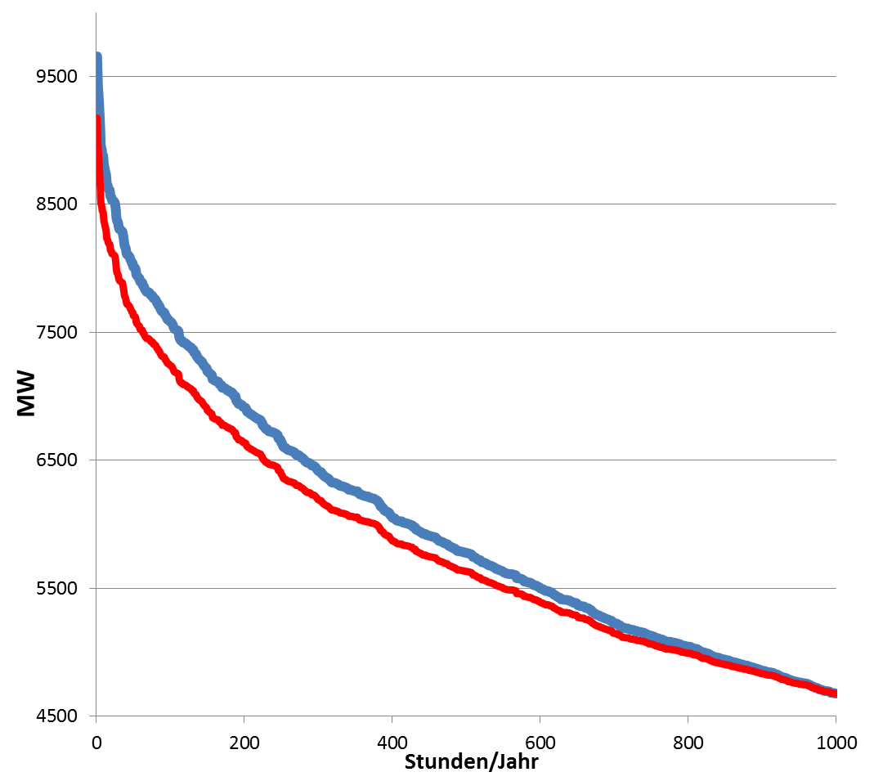
Flexible coverage of residual load
Extension
Transmission grid
Very high prices
(2000 EUR/MWh!)
Load reduction due to
Demand response to prices
Load reduction due to
Demand-side management
technical (e.g. cycling)
Capacity without
ensured payments
Flexible power plants
Storages
Hours/year

Slide 22
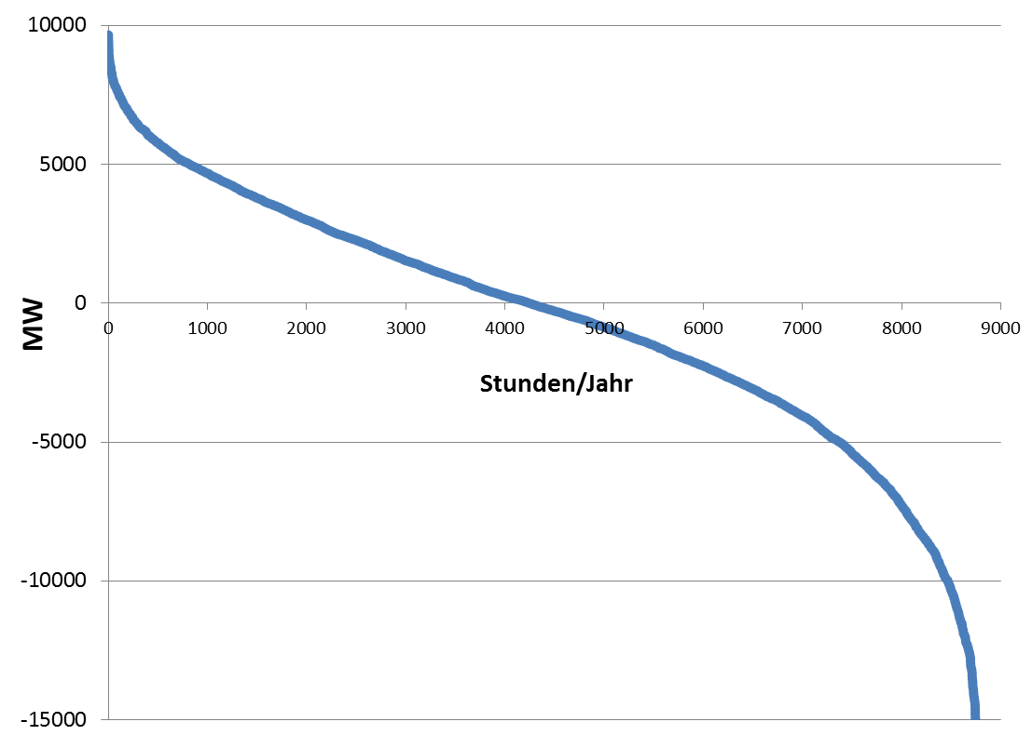
Storing every peak?
Under coverage
Hours/year
Excess capcity
High excess capacity
at very few hours!
e.g. 20% less capacity stored →
1% less electricity stored!

Slide 23
Old thinking
Demand
Genera-
tion
Grid
Supply
Flexibility options
Storage

Slide 24
Electricity market 3.0: Making the
electricity system more democratic
G5
Grid
Balancing
Group/
Supplier
G1
Prosum-agers *)
G3
Flexibility options
G2
G4
STO
STO
STO
*) R. Green

Slide 25
  6. IS THE time for subsidizing
  RENEWABLES over ?
As long there is no price on CO2 …..

Slide 26
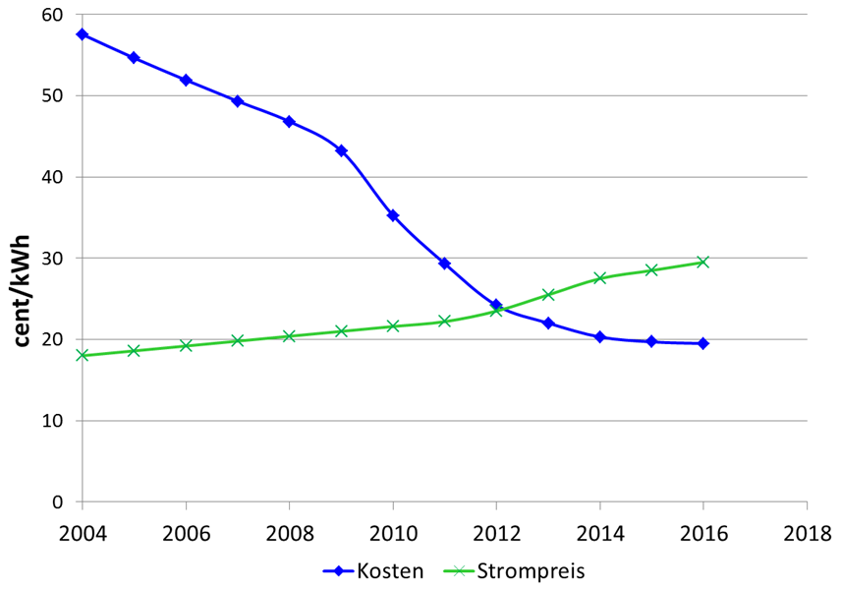
  Grid parity: PV-costs and household
  electricity prices
Costs
Household electricity price
Germany
Austria
Czech Republic
Grid parity

Slide 27
Assessment of Grid Parity
Savings/revenues
Costs
E_{Own} *P_{HH} + E_{Feed-in}*P_{feed-in} > Annuity
Grid parity term
Subsidy still necessary?

Slide 28
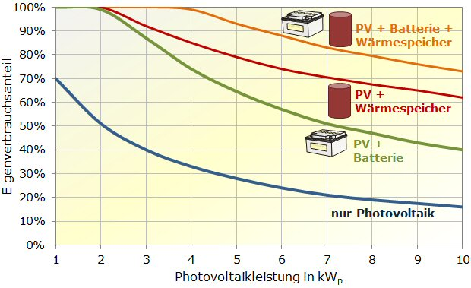
Share of own consumption

Slide 29
Tenant electricity model and Blockchain
PV-System on the roof
Tenant electricity model:
Contracted PV-electricity
Customer 1
Balancing
Group/
Supplier
Customer 2
Customer 3
Meter
Blockchain

Slide 30
Promotion of decentralized PV in Czech Republic
Program is opened for family houses and blocks of flats
Currently 3rd call for family houses includes:
PV systems for power: *below 10 kWp,
* should be connected to the grid
Systems with and without batteries with utilization
of excess electricity for hot water or general own
use are subsidized
Generated power should be used on site of
generation at least by 70%

Slide 31
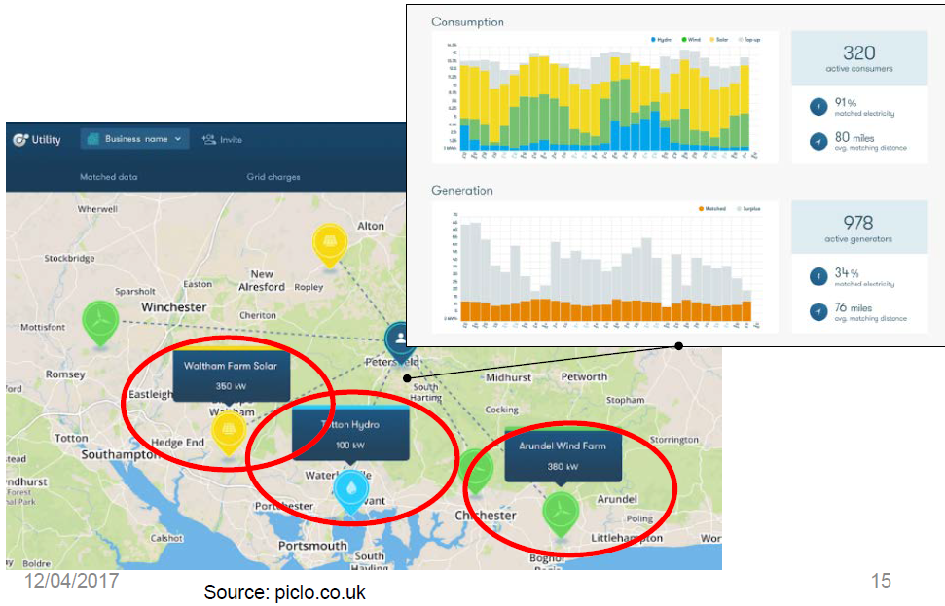
Peer-to-peer

Slide 32
7. CONCLUSIONS
Sustainable electric. system → integration of a
broad technology portfolio & demand-side options!
Larger market areas favourable
Very important: correct price signals (incl. CO2)
most urgent: exhaust full creativity for flexibility
of all market participants incl. decentralised PV
systems
Capacity payments: Any CP will distort the system
towards more conv. and less RES capacity
New key player: Balancing group (Supplier), no
more the generator

