Slide 1





Smart Cities:
State of the Art and Comparison
Lenka Rychterová
Richard Schlesinger

Slide 2
Outline
Goal And Motivation
Methodology
Definitions
The Smart Region Vrchlabí
The Region Hartberg
Smart City projects in the EU-28
Comparison
Conclusion

Slide 3
Goal and Motivation
Goal: On basis of Smart Region Vrchlabí and Region Hartberg compare countries in terms of:
  Smart city concept
  Technology
  Attitude
Motivation for smart cities:
  Cover energy demand
  Guarantee reliable energy supply
  Integrate renewables

Slide 4

Methodology
  Research about projects
  Choose two appropriate projects
  Collect data
  Set criteria for comparison
  Compare projects

Slide 5
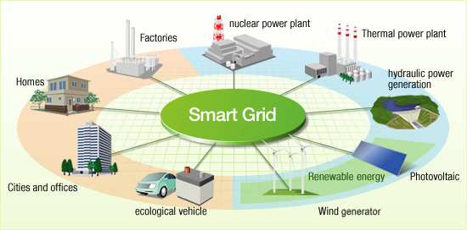
Definitions
„smart“
Smart city/smart region
Shared space
SET plan

Slide 6
The Smart Region Vrchlabí
Reasons for choice
  FUTUR/E/MOTION (2009)
  Proper size
  Potential renewable sources
  Suitable for building the combined heat and power generation units
  Location near the Giant Mountains National Park
  Friendly attitude of town leaders

Slide 7
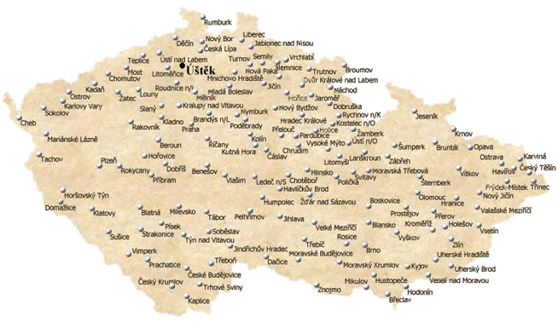
The Smart Region Vrchlabí
Description
  The Gateway to the Giant Mountains
  13 000 residants – only Vrchlabí
  477 meters above sea level
  Regular bus /train transport
  Testing phase
unification to 35 kV
3 cogeneration units
Island operation
electric charging stations
Smart metering

Slide 8
The Region Hartberg (1/5) – Comparable Region
Similar size like Vrchlabí
Common city structure
Pro-environmental inhabitants and town‘s council

Slide 9
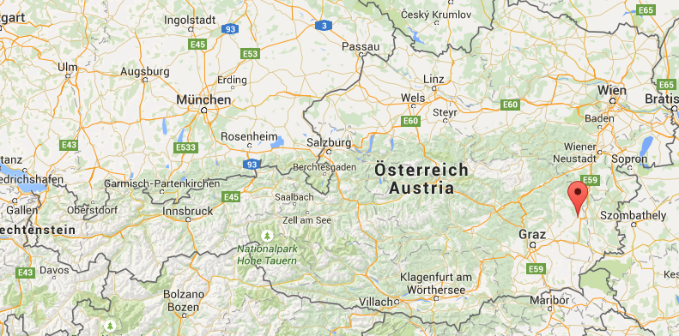
The Region Hartberg (2/5) –
General Overview
Location: East part of Styria
Città Slow member since 2009
Klimabündnis Österreich member since 1992
→ Good basis for smart city project

Slide 10
The Region Hartberg (3/5) –
Smart City Features done
Electricity
Stadtwerke Hartberg only supplies renewables
1000 PV systems installed
13 wind turbines
2 biogas systems – with waste heat Stirling engine
Heat energy
Significant renewable share in heat energy

Slide 11
The Region Hartberg (4/5) –
Smart City Features done
Mobility
PV powered carsharing – car
Carsharing 24/7
Free city bus – spottable with App
Other features
3 Shared Spaces
5000€ subsidy for biomass heating system
Solar cooling system (absorption chiller)

Slide 12
The Region Hartberg (5/5) –
Smart City Features to come
100% public LED lighting
Extend bike lanes to 27 km
Grey water recovery
Subsidising alternative transport technologies
(e-mobility, biofuels)
Active Demand Side Management
Save 73.2 GWh/y (21%) on primary energy demand
Avoid 27 300 tCO2/y emissions (32%)
In general: high involvement of inhabitants
Environmentally conscious people

Slide 13
Smart City projects in the EU-28
Italy (smart metering)
Spain (Castellón, Málaga)
Germany (MERIGIO, MoMa)
France (smart metering, Nice, smart homes)

Slide 14
Comparison (1/3)
Criteria for comparison | Vrchlabí | Hartberg
Number of residents | 13.000 | 12.500
Project initiation | electricity producer ČEZ, a. s. | town council
Ideology to make a Smart Region | Testing the various technologies to cooperate together | "Slow food for better life" as a part of Città Slow - healthy lifestyle
Bicycle paths as a part of the Smart Region | no - 2,5 km | yes - 11 km (27 km planned)
Shared spaces | none | Kirchengasse, the Wiener Straße, the Alleegasse

Slide 15
Comparison (2/3)
Criteria for comparison | Vrchlabí | Hartberg
Renewables | 5 photovoltaic systems - rated power of 86 kVA | 1 000 installed photovoltaic systems
 | 2 small hydro power plants - rated power of 350 kVA | wind park with 13 wind turbines
 |  | solar cooling system
Innovative public transport | 3 distribution stations for electric cars | car sharing - 24/7 internet platform
 | the Peugeot iOn electric car for the use of town leaders | photovolatis charging systém for car sharing
 |  | city bus for free, app to check the current possition
Changes in technology within the Smart Region | unification of the voltage to 35 kV | LEDs for public lighting
 | implementing optical cables and other communication equipment
 | new distribution transformer stations
 | 4900 electro meters
 | island operation

Slide 16
Comparison (3/3)
Criteria for comparison | Vrchlabí | Hartberg
Heating system | two of three cogeneration units with a rated thermal power of 2,611 MW | district heating system based on biomass with 18 MW of rated power
Questionnaire about awareness about the realization of the Smart Region project | yes | no
Questionnaire for ideas and wishes of residents | no | Hartberg 2020 and 2050
Interests of residents | Mainly no | Mainly yes
Primary energy demand reduction by 2020 | no data available | 73.2 GWh/y (21 %)
CO2 reduction by 2020 | no data abailable | 27 300 tCO2/y (32 %)

Slide 17
Conclusion
Concept of smart city is different
  CZ: Mainly technological aspects
  AT: Also social aspects like eliminiation of barriers (shared spaces)
Technological policies similar (renewables, efficiency increase)
Information available
Involvement of inhabitants
Attitude of the people matters (smart meter, recycling, carsharing, e-cars)

Slide 18
Thank you for your attention!

