Slide 1
ECONOMICS OF E-MOBILITY: COSTS, FUELS AND ELECTRICITY PRICES, TAXES AND LEGISLATION
Sara Shafiee, Lenka Zemková
Summer School 2015

Slide 2
Introduction
Benefits: Electric Vehicles can help increase energy security, improve fuel economy, lower fuel costs, reduce CO2 emissions, reduce oil dependence cost, noise pollution coming from transport and increase energy sustainability
Main risk: Low costs may lead to rebound effects
Analysis of the EVs situation in Austria and Czech Republic

Slide 3
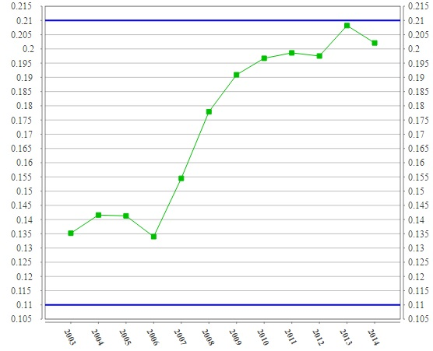
Electricity prices in AU (EUR/kWh)
Data source: Eurostat, 2015

Slide 4
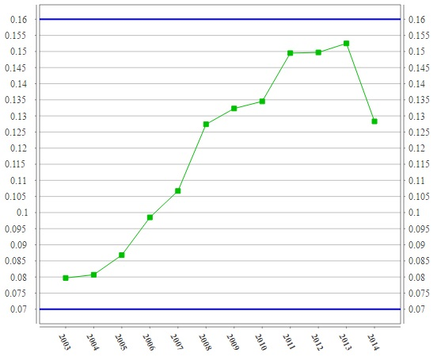
Electricity prices in CZ (EUR/kWh)
Data source: Eurostat, 2015

Slide 5
Fuel prices AU and CZ
Continuous increase in the prices of vehicle fuels according to diagrams due to the increase of fossil fuel prices and significant increase in fuel taxes
There are very similar prices in Austria and Czech Republic

Slide 6
Fuel prices (Petrol and Diesel) in Austria
Source: www.transportenvironment.org, 2011

Slide 7
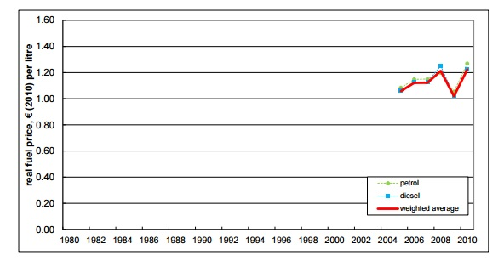
Fuel prices (Petrol and Diesel) in Czech Republic (after entering EU)
Source: www.transportenvironment.org, 2011

Slide 8
Political framework in EU
Motor vehicle fuels are taxed with different rates in EU countries
20/20/20 goals for EU:
Reduction of GHG by 20% (relative to 2005)
Share of renewable energy plus 20%
Energy efficiency plus 20%

Slide 9
Political framework in AU
Greenhouse gas (GHG) emissions reduction as a national priority
Financial incentives and purchase tax credits are offered for new cars with alternative propulsion systems
The rates of financial support are staggered according to the type of vehicle introduced, the level of CO2 reduction achieved and the amount of renewable energy used

Slide 10
Political framework in CZ
No political help for electric vehicles in Czech Republic like in Austria
BUT: Possible financial help in a new subsidy program for up to approx. 7400 EUR (but just for villages in national parks)
Experts recommend free or discounted parking in cities and possibility to use fast lanes during rush hours

Slide 11
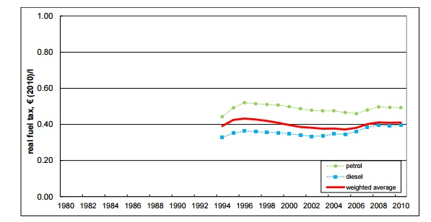
Fuel taxes in AU
Source: www.transportenvironment.org, 2011

Slide 12
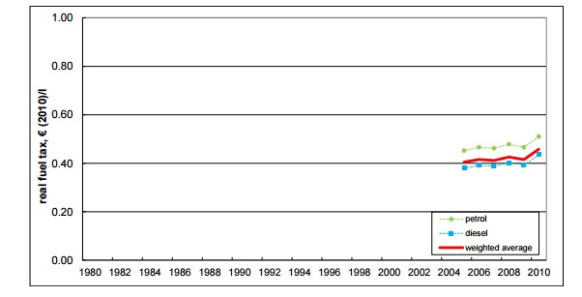
Fuel taxes in CZ
Source: www.transportenvironment.org, 2011

Slide 13
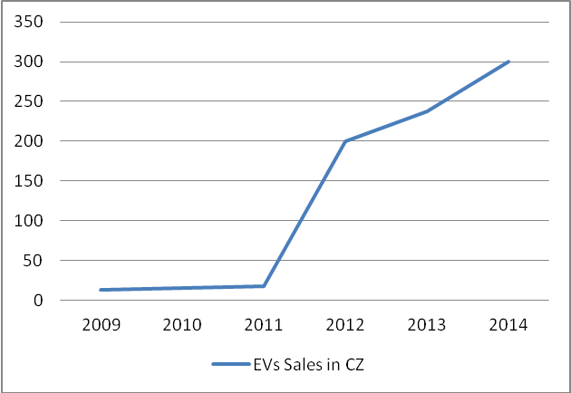
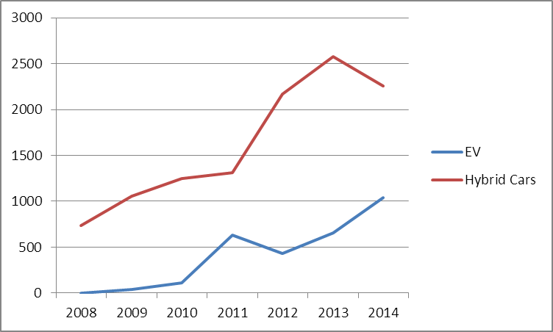
EVs Sales in CZ and AU
Data source: Ministry of Transport, 2013
Data Source: Own Graphic database on Statistik.at, 2015

Slide 14
Conclusions I.
Significant differences in the field of EVs sales in CZ and AU (3 times more) although the electricity is cheaper in Czech Republic
Financial support missing in CZ, the EVs industry is called "in its infancy„
There is a strong political support in AU and this could be a reason of higher sales

Slide 15
Conclusions II.
Strong correlation between political support and amount of Evs
But the reason could also be different environmental behavior, better ecological education…
It could be good to introduce some of non-financial incentives to convince consumers to buy the EV

Slide 16
References
Sikyta, A. 2012. Využití elektromobility v podmínkách ČR. The study for Ministry of Environment of Czech Republic. Available: http://www.ieep.cz/editor/assets/publikace/pdf/5IE431_sikyta.pdf
Ministry of Transport Czech Republic. 2013. Transport yearbook Czech Republic 2013. Available: https://www.sydos.cz/cs/rocenka_pdf/Rocenka_dopravy_2013.pdf
Transport and Environment. 2011. Fuelling oil demand. What happened to fuel taxation in Europe?. Available: http://www.transportenvironment.org/sites/te/files/media/2011%2004%2013%20fuel%20tax%20report%20final%20merged.pdf
Austrian Technological Expertise in Transport, Volume 4, 2010, http://www.bmvit.gv.at/service/publikationen/innovation/mobilitaet/downloads/hybrid_elektrofahrzeuge.pdf
Registrations of new passenger cars by markets. Available: http://www.statistik.at/wcm/idc/idcplg?IdcService=GET_PDF_FILE&RevisionSelectionMethod=LatestReleased&dDocName=043565
The road towar electric mobility and energie economic view on hybrid and electric vehicle technologies and the influence o policies on their, Maximilian KLOESS, Vienna University of Technology 2010 , Available: http://www.eeg.tuwien.ac.at/eeg.tuwien.ac.at_pages/publications/pdf/KLO_PAP_2009_2.pdf
State of the Art Electric Propulsion: Vehicles and Energy Supply, Robin Krutak /Bettina Emmerling, Austrian Energy Agency 2013 , Available: http://www.compett.org/documents/wp_1_report_status_quo_electric_propulsion.pdf

