Slide 1




Economic viability of small PV installations on family houses – the Czech and Austrian case
Bilateral Czech - Austrian Summer School
“Economic, Environmental policy,
and Technical aspects of Energy Systems”
Haik Davtjan, Pavel Peterka
Vienna, June 2015

Slide 2
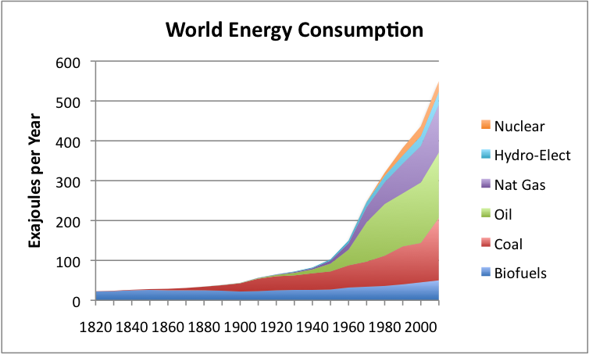

Motivation
Energy consumption is rising – tripple in 2050, fossil fuels still dominant
Increasing the share of renewables
Society - To use green energy. Several motivation factors.
Personally - economical viability

Slide 3
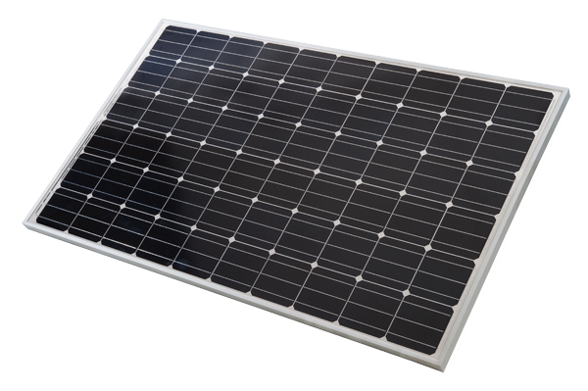
PV Technology
Solar energy directly to electricity
No pollution or hazards
Abundant, no fuel needed
Can be installed on roof-tops
Lucrative for small households

Slide 4
Our Problem and Goal
Price for PV modules has droped a lot
Gird parity reached
Ecomically viable for small households?
Assess the costs
Examine if economically viable
For the Czech Republic and Austria!

Slide 5

Investment costs
Credit and the interest (cost of capital)
Opportuninty cost
Trade off – Higher investment in the beggining can increase future yield

Slide 6
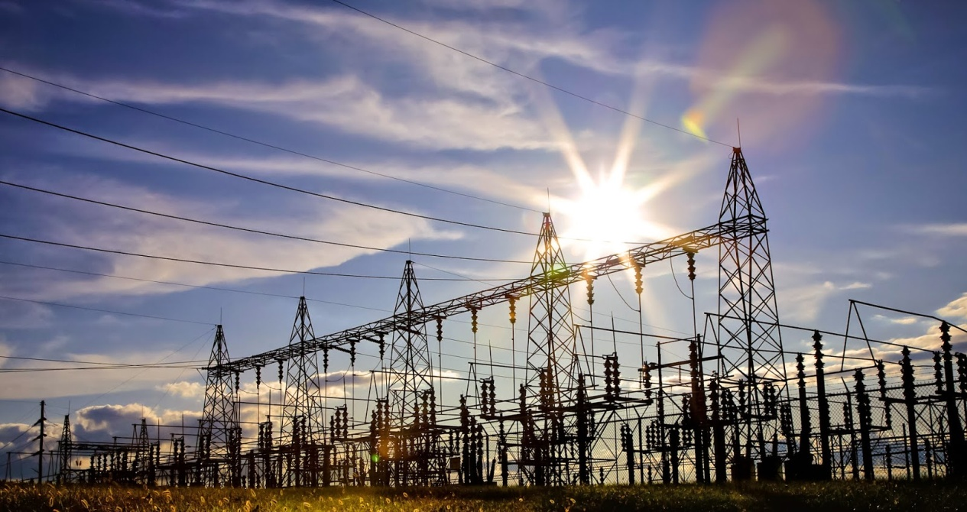
Grid Connection
Upgrade of gird connection nessecary
Household has to pay for it
Grid operator charges (monopolistic, has to be supervised)
Grid operator can cause delay -> loss of profit

Slide 7
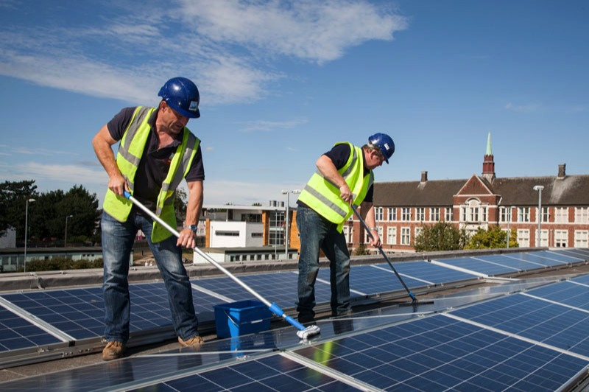
Operation Costs
Maintenance – low maintenance cost
Cleaning eventually necessary
Replacement of components
Regular inspection – malfunctions decrease viability

Slide 8

Legislative
Heterogeneous in Europe
  EU rules for unification
Austria (self-consumption case):
  If VAT refund for investment, it has to be paid for consumption
  Income tax: loss and profit evaluation
Czech:
  Owner is entrepeneur
  License can be interrupted

Slide 9
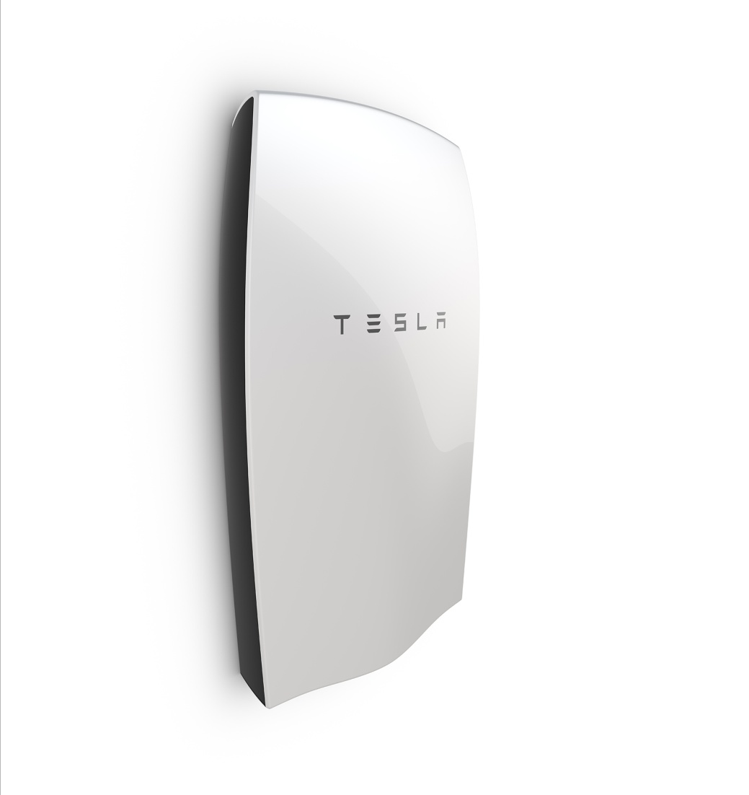
Power Accumulation
Increase in self consumption for profibilty (when net- metering is not present)
Change of demand behavior
Energy Storage
Additonal costs must be considered
Optimal size of storage?
Battery systems are improving

Slide 10
Energy yield
Efficiency given for STC in kWp given
In actual operation variation of
  Solar irradiation
  Angle
  Temperature
  PVGIS (Europen Joint Research Center)
  AT(VIE): 1220 kWh/kWp CZ(PRG): 1130kWh/kWp annually
System losses
Degeneration with time

Slide 11
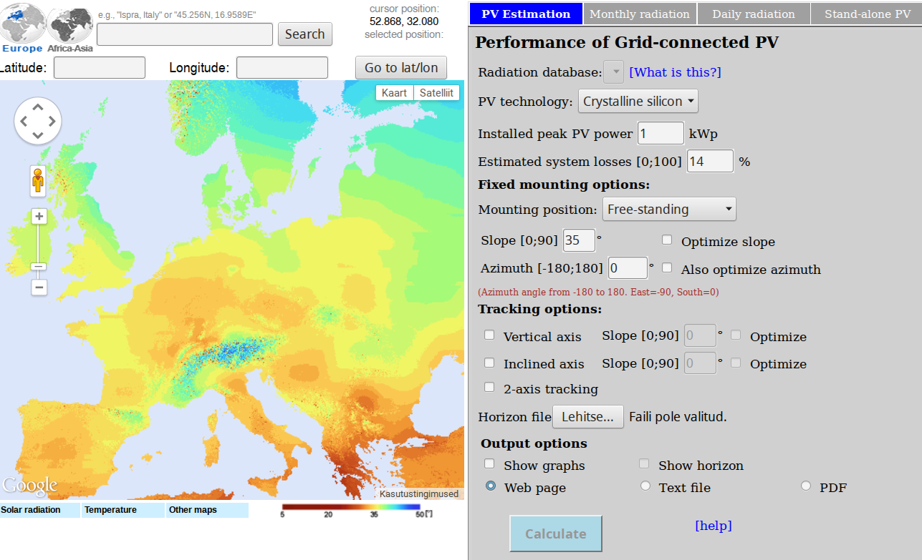
PVGIS

Slide 12
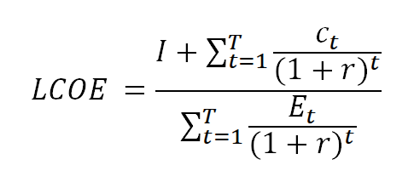
Cost of electricity generation
Levelized cost of energy
Austria: 14.6 cent/kWh
The Czech Republic: 3.92 CZK/kWh
  Grid Parity reached
Viability for 100% self-consumption

Slide 13
Economic viability
Household load profile and supply does not match
PV viability depends on the market price and amout of self-consumption
Feed-In tariffs as supporting mechanism

Slide 14
Thank You for your attention!
Vielen Dank für die Aufmerksamkeit!
Děkujeme za pozornost!

