Slide 1
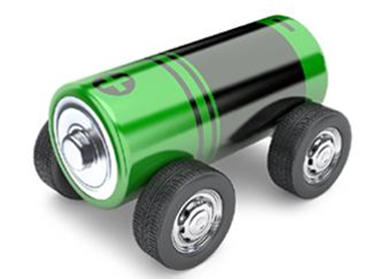
E-MOBILITY:
A comparison of infrastructure, number of vehicles and lessons learned from model regions and pilot projects
Czech-Austrian Winter and Summer School
Vera Ellmeier, Tereza Pudová

Slide 2
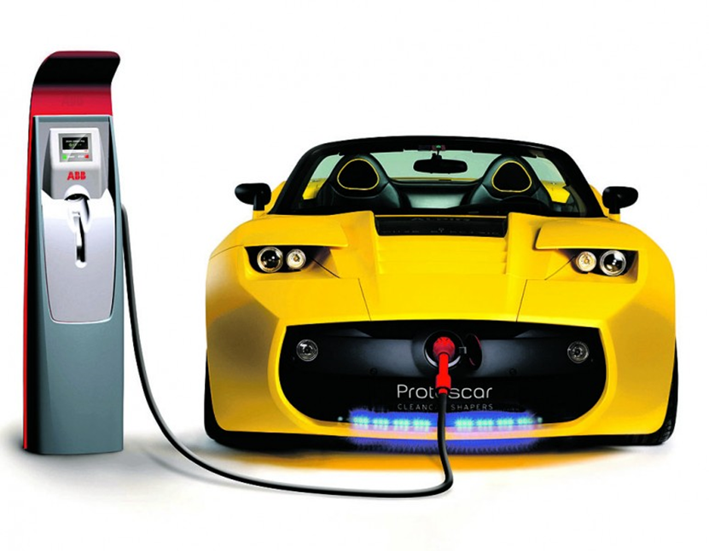
STRUCTURE OF THE PRESENTATION
Motivation
Research Question
Methodology
Charging Methods
Comparasion of CZ & AUT:
Charging Stations
Number of EVs
Projects
Challenges
Conclusion

Slide 3
MOTIVATION
Reduction of CO2 levels
Problems with diffusion of EVs
technical limitations
missing infrastructure
EU - regulations, policy
Notes:
Reduction of CO2 level - EU committed itself to reduce CO2 levels, so the extension of EVs is the good way to reduce it
Good idea - zero emission, fast development
Problems with diffusion - technical limitations: battery - driving range, charging time
infrastructure: mainly aroud big cities, not very developped, needs a lot of investments
policy: EU has ambitious targets, but it´s not consistent in all EU - missing financial support
Charging methods - AC, and builging of DC stations for fast charging

Slide 4
Research Question
Which differences in the development of E-Mobility can be found in the European countries by focusing on comparasion of the Czech Republic and Austria?

Slide 5
METHODOLOGY
Literature review on types of EVs and charging stations (internet)
Exististing charging and Plug standards
Statistical reviews for numbers of EVs & charging stations
Identifying special groups of drivers/regions

Slide 6
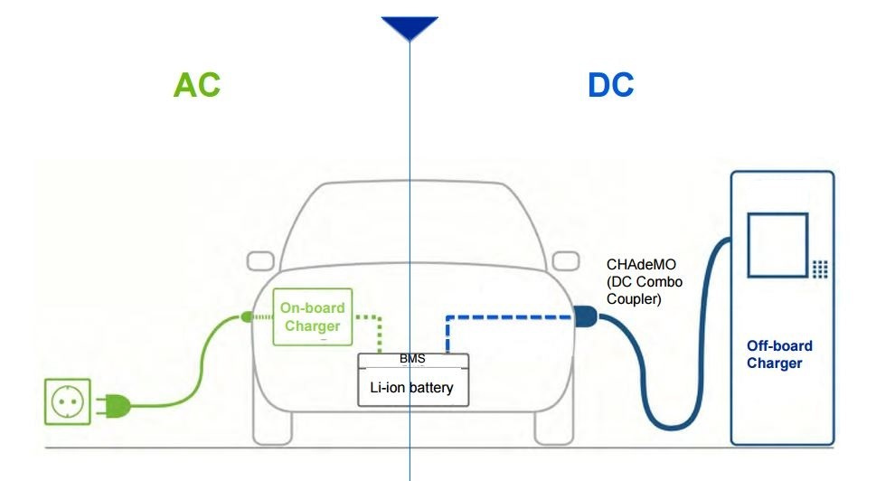
Charging Methods
Level 1 - Standard electrical outlet (Schuko Plug)
Level 2 - Type 2 Plug (Mennekes)
Level 3- DC Combo Coupler
or CHAdeMO
Notes:
level 1 - standard electrical outlet - with charging power of 3,7kW ~6-10hr; Mostly home
level 2 - Standard plug in EU since some years ~up to 40 kW; ~2hr; Home and Public
level 3 - 2 different; ~50 KW ~20 minutes; Public
Difference: AC x DC - AC: on-board charger - socket; DC: off-board charger in the charging station
Most of new EVs have the option to be able to charge both AC and DC

Slide 7
CZECH CHARGING STATIONS
80 charging stations 15% - fast charging
most - AC, max 22 kW
Notes:
In czech - 600 E-cars, 80 charging stations, situated mostly in Prague and around big cities
red - normal AC charging
yellow - fast charging
Main part - AC charging, maximum 22kW per 1 hour of charging

Slide 8
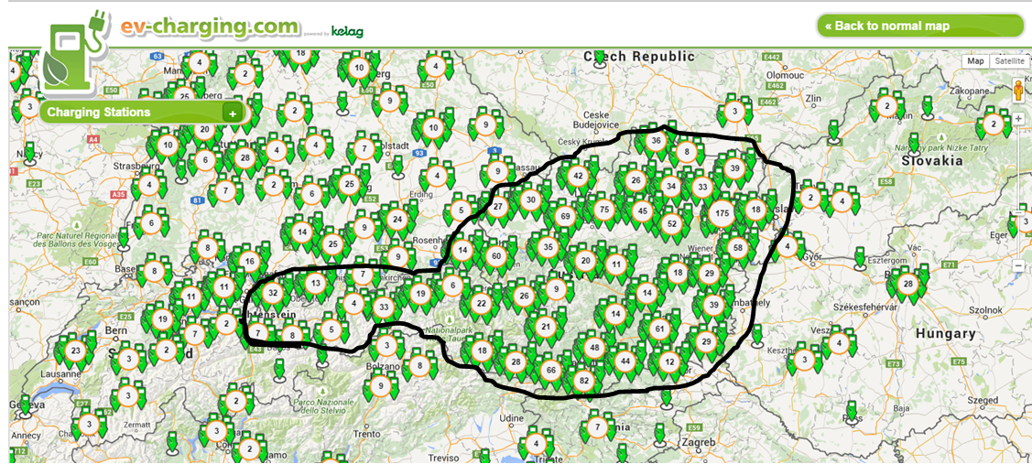
AUSTRIAN CHARGINS STATIONS
Facts
11 Charging station providers
330 Charging stations
~35% Level 2
~10% Level 3
Source: https://ev-charging.com/at/en
Notes:
*) 11 Providers - 6 comming from model region projects
*) Sum ~ 330 Charging stations; about ⅓ Level 2 Charging; and only very few Level 3 because very expensive
*) only one in all of Austria
*) Modell regions cheaper (sometimes for free) but infrastructure not good (mostly only level 1 charging)

Slide 9
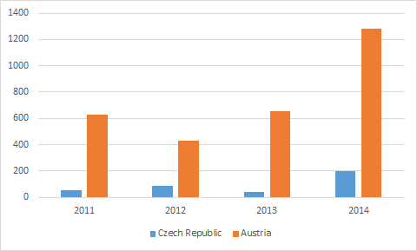
NEW REGISTRED E-VEHICLES
Source: Statistic Autria 2015; Czech statistical Office; 2015
Notes:
*) In AUT bying an EV is subsidized by the Government (up to 5000€)
*) In AUT in 2014 still only 1 percent of new bought cars

Slide 10
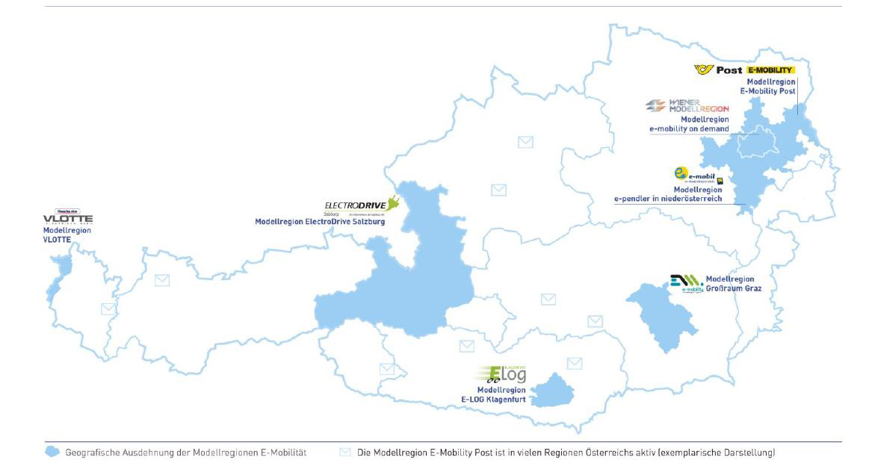
Austria - Projects
Model Regions
Source: http://www.e-connected.at/content/modellregionen-0
Notes:
7 different model regions
VLOTTE - first model region started in 2008, most developed also in cooperation with switzerland and lichtenstein
Lessons learned:
Vehicles are used mostly for short routes between home and work→ no difference between combustion driven cars
Introduction of EVs in the City is more complicated because of space problem and therewith charging problem. (no possibility to charge infront of the flat)
Charging behaviour is on peek hours in the morning and evening→ affects negatively the grid
model regions parallel install PV pannels, to compensate the additional needed electricity for the EVs → “easy way out” Only very few PVs are directly used to charge the cars. PVs are randomly installed
Other projects
Empora: Grid regulation
Smile: App which combines all Transport systems including EV→ Towards a inelligent transport where Private; Semi-Private and Public transpport is combined
Crossing Boarders: Cooperation between DE, AUT & Slovakia: as aim build up an infrastructure for EVs which connects Munich, Salzburg, Vienna and Bratislava so that EV drivers can drive from one end to the other without problems.

Slide 11
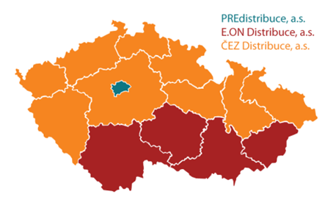
Czech Republic - Projects
ČEZ
PRE
E.ON
RWE
Notes:
ČEZ - pilot project E/MOBILITA - 2009
begining - charging stations in shopping centres
now - nearly 50 charging stations
PRE - mainly in Prague, landing of e-bicycles
E.ON - Smart Mobility - mainly CNG, tested by institutions
RWE - project mainly in Germany, in Czech - monitoring of market

Slide 12
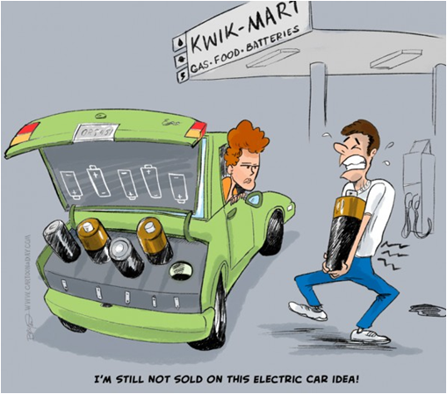
Challenges
Battery·improvments are limited
Recylcing methods for Batteries
EV costs
“Transport Problem” not solved
Overload of the grid
Conductive charging
Charging stations providers
Complexity for EV drivers
Notes:
C harging time-Driving range conflict, safety (impede explosions when there is a crash, especially Lithium batteries are very delicate in this aspect), DC charging reduces Life expectancy
Lithium only found in few countries in the world (esp south America), very few in Europe. Batteries are made from rare earth materials which are limited (lithium)à recycling system of batteries need to go hand in hand with development.
Purchase price – very high (approx. 2*the price of vehicle with combustion engine, The necessity of construction of the network of charging stations – very costly
“Transport Problem” not solved by exchanging combustion engines with electrical onesà Number of vehicles driving on streets will be still rising.
The idea that EV Batteries could be a energy storage if the grid is overloaded won’t work because of the capacity.
Conductive charging may lead to a cable chaos in parking houses since every EV would be charged while working. However the biggest question is how the EVs are going to be charged inside the City. Nowadays cars are everywhere parked. It would not be possible to install for every parking spot a charging station. Also if there is only one charging station per street, how does it work with the cables? → Inductive Charging as a future solution
Charging stations providers: too many RFID; Apps; Semi parking problem; charging power; fast charging
Complexity for EV drivers: Too many charging power types; too many different plugs.

Slide 13
Conclusion
E-Mobility development in each EU country varies strongly
Installing charging stations is not the only solution to raise the number of EVs
Challenges are the same for each country regardless of the development grade in e-mobility
Notes:
E- mobility situation depends mostly on government support - projects for financaly support the owners
Eg. Norway - E-mobility is very developped and supported by government, 5% of all E-cars in the world
EU - 20-20-20: untill 2020, reduction of emissions by 20%, increase the share of reneweables to 20%
For the bigger diffusion, it´s needed to do some technical improvements - battery life, price reduction

Slide 14
Thank you!
Questions????

