Slide 1
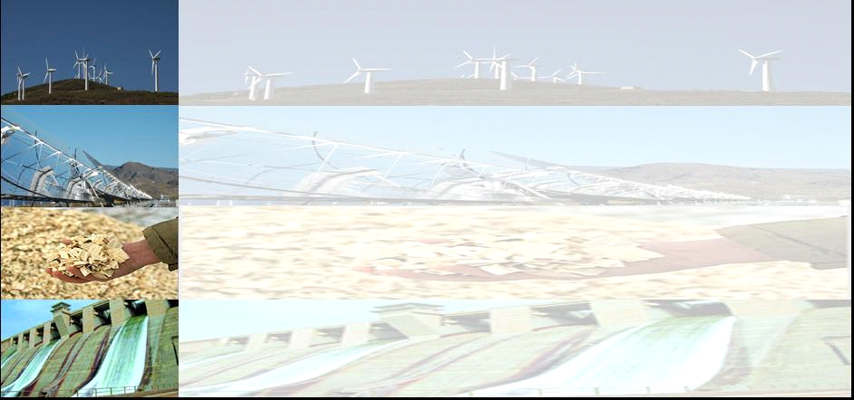
ELECTRICITY MARKETS, AND THE ROLE OF RENEWABLES & NUCLEAR
Reinhard Haas
Energy Economics Group,
Vienna University of Technology
PRAGUE 3.2.2015

Slide 2
SURVEY
1. Introduction: Historical background
2. How prices come about (theory)
3. Environmental issues: CO2-prices
4. How prices developed in Europe
5. Electricity generation costs
6. Recent developments of nuclear
7. The role of Renewables
8. Conclusions

Slide 3
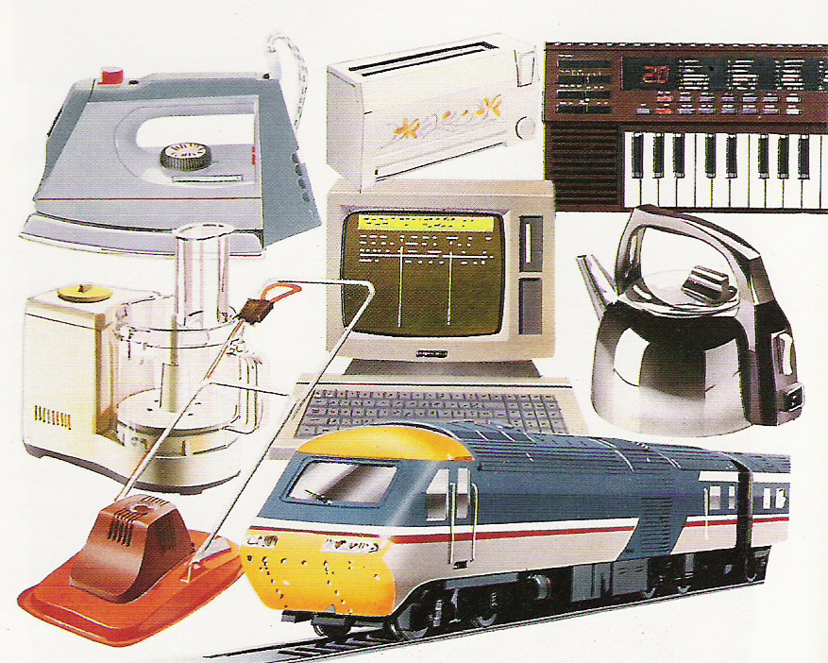
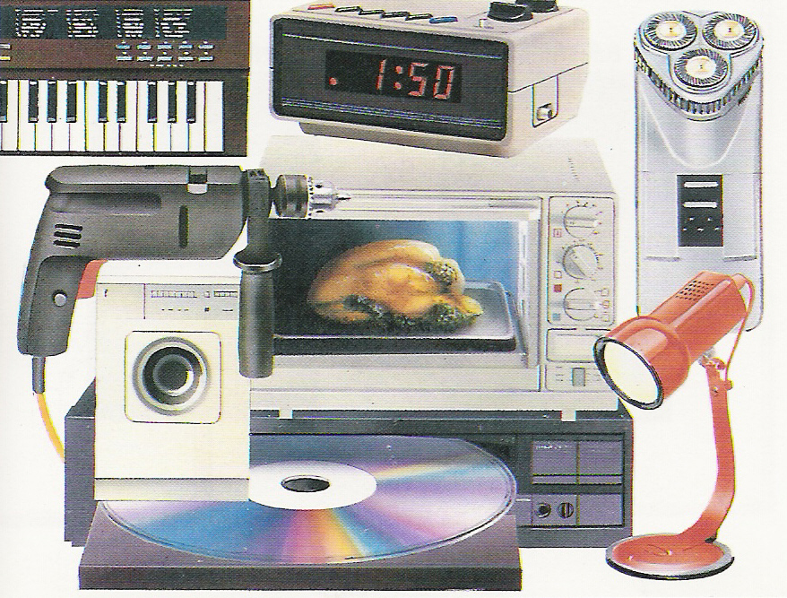
OUR LIFE:
PERMANENTLY UNDER
ELECTRICITY
Electricity – THE universal technology for providing energy services

Slide 4
1. INTRODUCTION:
CORE OBJECTIVE
How to provide access to electricity „optimal“ from societies point-of-view?
What is the optimal political „structure“? Private, price (de-)regulation ….
How to bring about a transformation to a sustainable energy system?

Slide 5
THE EU-DIRECTIVE(S) 1
The European Commission’s main expectation …. was the belief that
“market forces [would] produce a better allocation of resources and greater effectiveness in the supply of services”
Intentions of the EC directive:
Competitive markets
lower electricity prices
more environmentally benign

Slide 6
2 HOW PRICES COME
ABOUT (SOME THEORY)
before liberalisation
after liberalisation
Strategic prices
Average
costs
Price, costs (EUR/MWh)
Long-term
marginal costs
Short-term
marginal costs
time

Slide 7
THE MERIT-ORDER
CURVE OF SUPPLY
based on short-term marginal costs (MC)
Coal (old)
Supply curve S:
marginal costs
Costs (EUR/MWh)
Natural gas (new)
Nuclear
Hydro, Wind
MWh

Slide 8
BASIC PRINCIPLE OF
COMPETITION:
PRICE = MARGINAL COSTS
Demand D
Coal (old)
p_{t1}
Natural gas (new)
Price = „System“-marginal costs
Supply
curve S
Costs,Price (EUR/MWh)
Nuclear
Hydro, Wind
MWh

Slide 9
BASIC PRINCIPLE OF COMPETITION:
PRICE = MARGINAL COSTS
Demand
D_{t1}
Demand
D_{t2}
p_{t2}
Price = „System“-marginal costs
p_{t1}
Supply
curve S
Costs,Price (EUR/MWh)
MWh

Slide 10
LONG-TERM
VS
SHORT-TERM
MARGINAL COSTS

Slide 11
What are marginal costs (MC)?
MC= C‘(X) = dC(x)/dX
Marginal costs are the increment of costs due to a generation of one additional unit of kWh
P=MC
Short-term marginal costs (STMC):
STMC= Fuel costs + CO2 costs
Long-term marginal costs (LTMC):
LTMC= STMC + Capital costs + O&M costs

Slide 12
LONG-TERM MARGINAL
COSTS
1.
2.
3.
Cheapest:
Nuclear
Coal
Wind
Costs (EUR/MWh)
Capital costs
Operation/Fuel costs
CO2 costs

Slide 13
SHORT-TERM MARGINAL
COSTS
3.
2.
1.
Cheapest:
Coal
Costs (EUR/MWh)
Nuclear
Wind
Operation/Fuel costs
CO2 costs

Slide 14
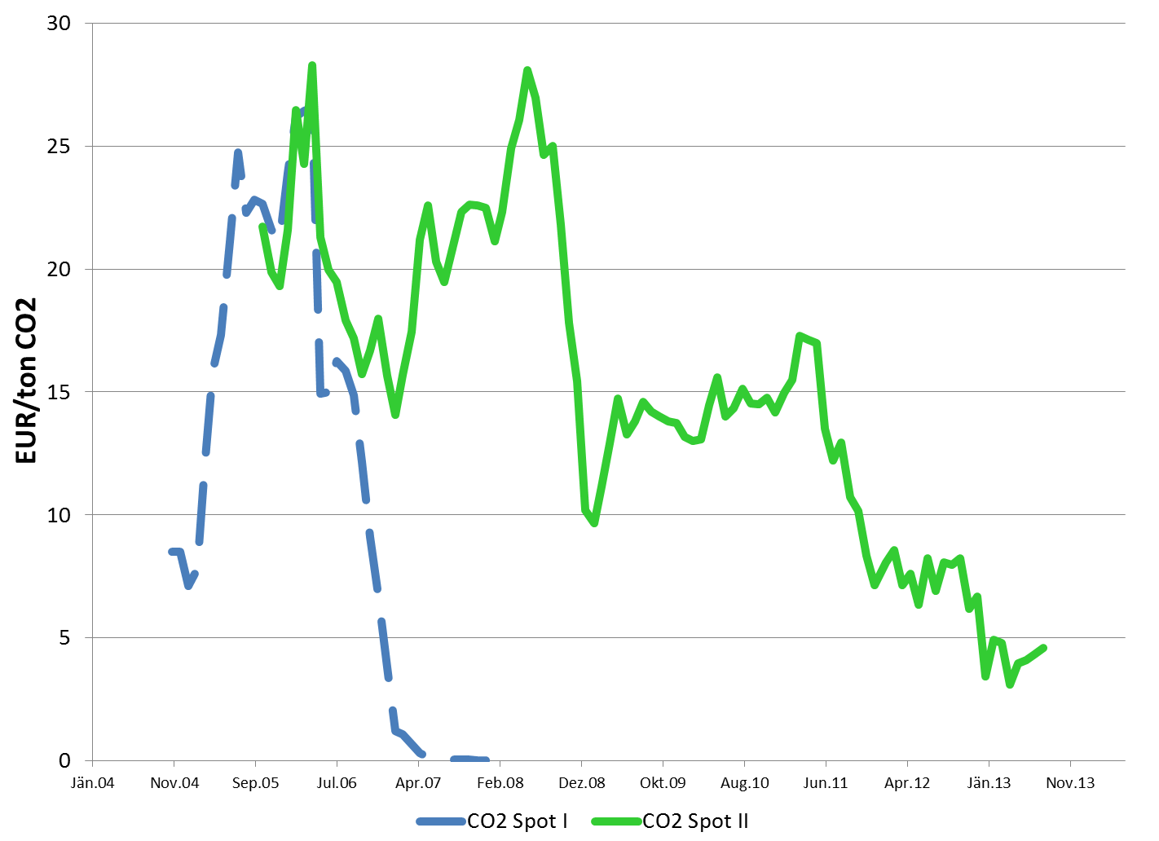
3 ENVIRONMENTAL
ASPECTS – THE CO2-PRICE

Slide 15
EMISSION TRADING‘S
BENEFIT FOR ELECTRIC UTILITIES
CO2-certificates
purchased on the
market
Market price with ET
P_{Cert}
„Windfall profits“!
Market price without ET
Total producer
surplus electricity
CO2-certificates
allocation plan
EURO/kWh
Cost curve
D
Hydro
Nuclear
Gas
Coal
kWh

Slide 16
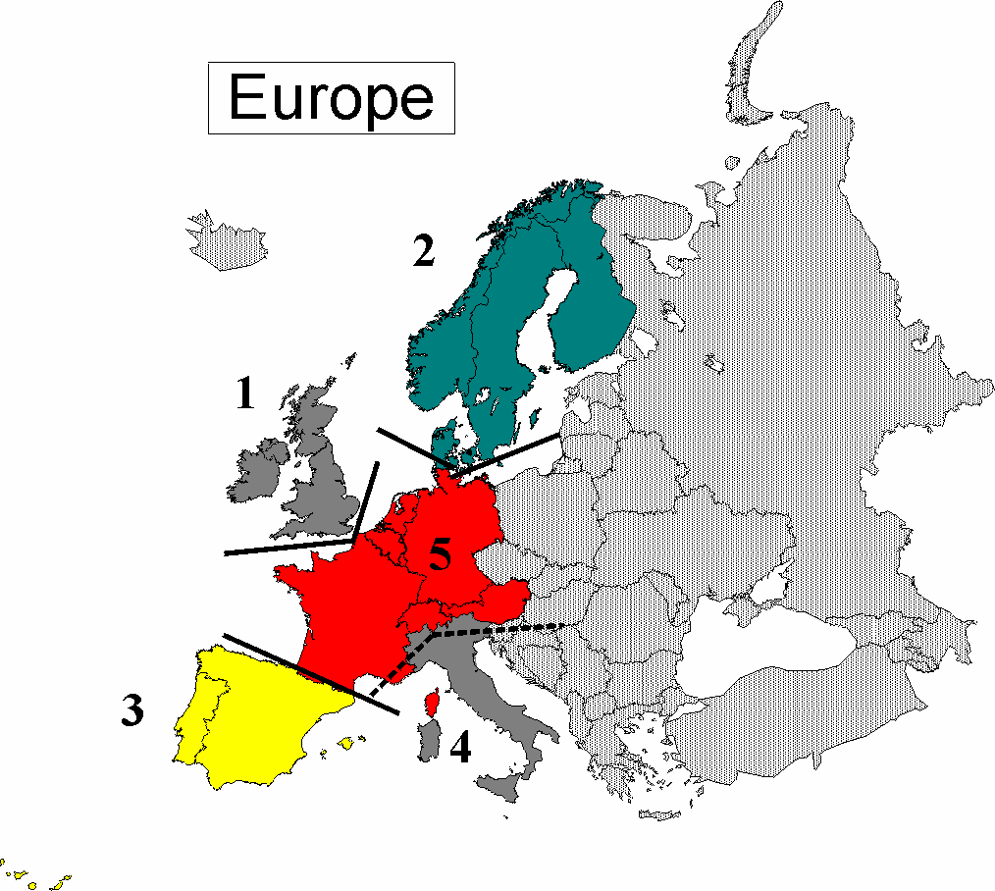
4 HOW PRICES
DEVELOPED IN EUROPE
EUROPEAN ELECTRICITY SUB-MARKETS
1. UK & Ireland
2. Nordic countries
3. Iberian peninsula
4. Italy
5. Western Europe
6. Eastern Europe
7. South-Eastern Europe
6
5
7

Slide 17
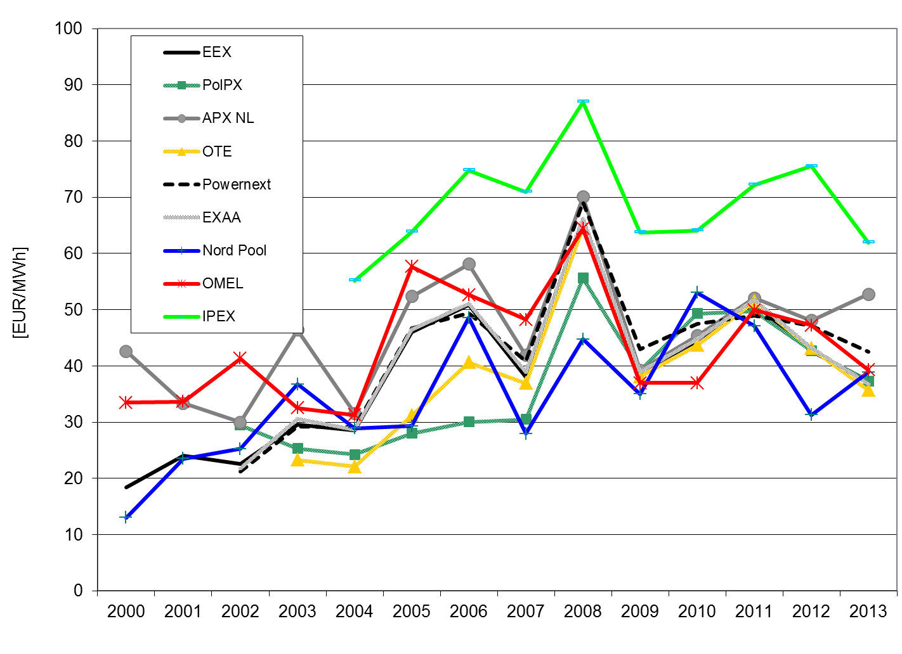
SPOT MARKET PRICES IN EUROPE
AT, DE, FR, CZ, PL →
One market!

Slide 18
5 ELECTRICITY
GENERATION COSTS
ANNUITY METHOD
Distribute investments to annuities
(annual payback amounts)
I
A
A
A
A
0
1
2
3
. . . . . . .
n

Slide 19
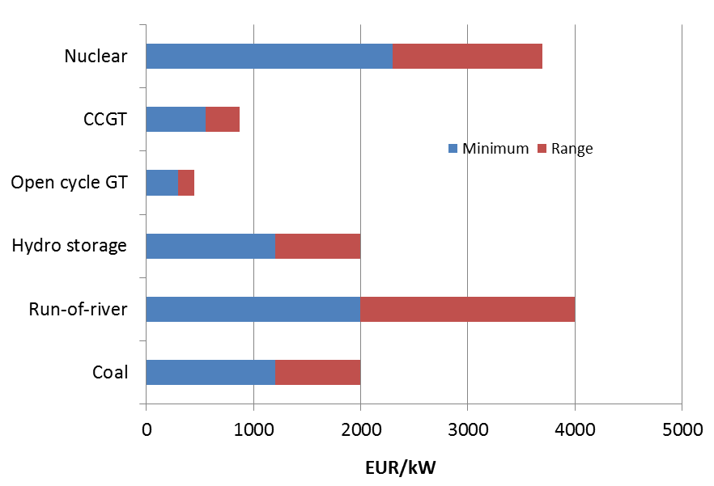
Investment costs
Electricity generation Conventional 2014

Slide 20
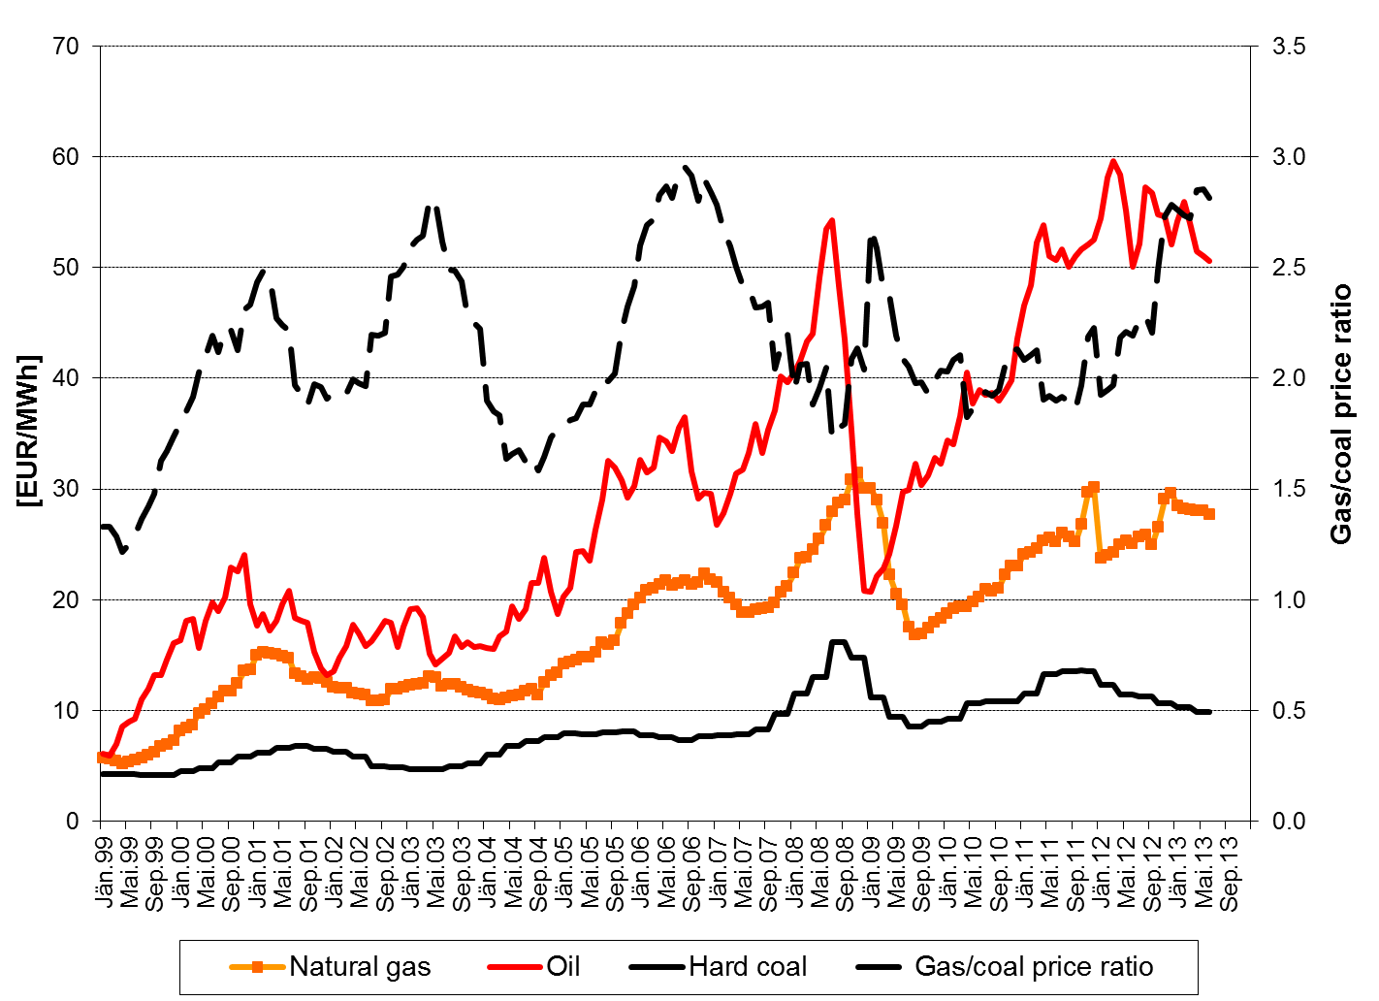
FUEL PRICES 1999-2013
Gas/coal price ratio
Natural Gas
Hard coal

Slide 21
Costs of electricity generation
I α +C_{O&M} p_{f} C_{CO2} f_{CO2} cent
C = C_{F} + C_{V} = ———— + —— + ———— [——]
T H η η kWh
where:
C …Total costs of electr. Generation (cent per kWh)
C_{F} …Fix costs (cent per kWh)
C_{V} … Variable costs (cent per kWh)
C_{O&M}…Operation & maintenance costs (EUR/kW)
I ….Investment costs (EUR/kW)
… C.R.F. (Capital recovery factor, e.g. 0.1 for 15 years, 5% WACC)
T ….Full load hours (hours per year)
p_{f} …Fuel price (cent/kg or m³)
H …Caloric heat content (e.g. 10 kWh per m³ for gas)
η …Efficiency of power plant
C_{CO2} …Price of CO2 (e.g. 5 EUR/ton Carbon)
f_{CO2} … CO2-factor of fuel (0.2 kg Carbon/kWh)

Slide 22
Example: Costs of
electricity generation from CCGT
I ….Investment costs = 600 EUR/kW
… C.R.F. = 0.1 for 15 years and 5% interest rate
T ….Full load hours = 5000/1000 hours per year
C_{O&M}…Operation & maintenance costs = 20 EUR/kW
p_{f} …Fuel price (e.g. 25 cents/m³ natural gas)
H …Caloric heat content (e.g. 10 kWh per m³ for gas)
η …Efficiency of CCGT plant = 0.58
C_{CO2} …Price of CO2: 5 EUR/ton Carbon)
f_{CO2} … CO2-factor of fuel (0.2 kg Carbon/kWh)

Slide 23
Example: Costs of
electricity generation from CCGT

Slide 24
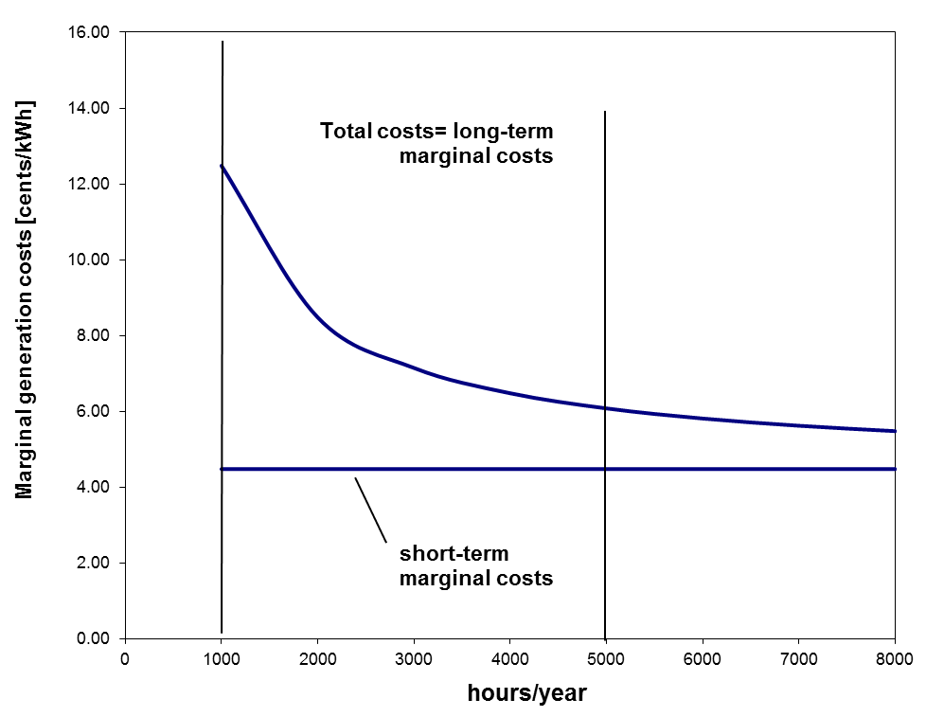
Example: Costs of
electricity generation from CCGT

Slide 25
Investment costs
Electricity from new renewables 2010

Slide 26
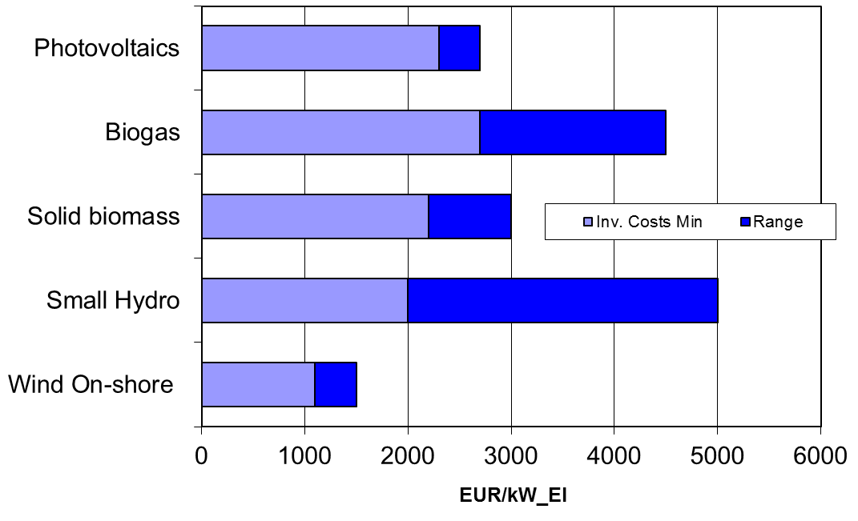
Investment costs
Electricity from new renewables 2013

Slide 27
Generation costs
Electricity from new renewables 2010

Slide 28
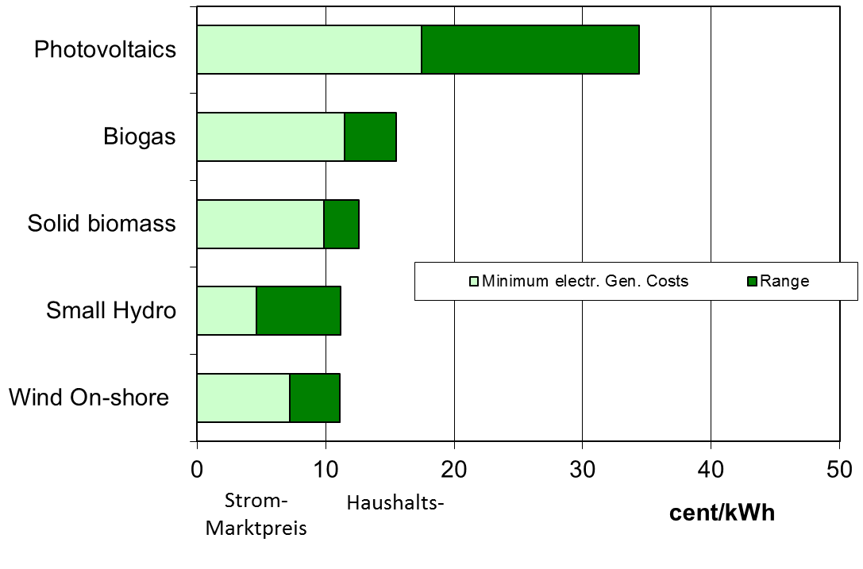
Generation costs
Electricity from new renewables 2012
Wholesale
electricity price
Household
electricity price

Slide 29
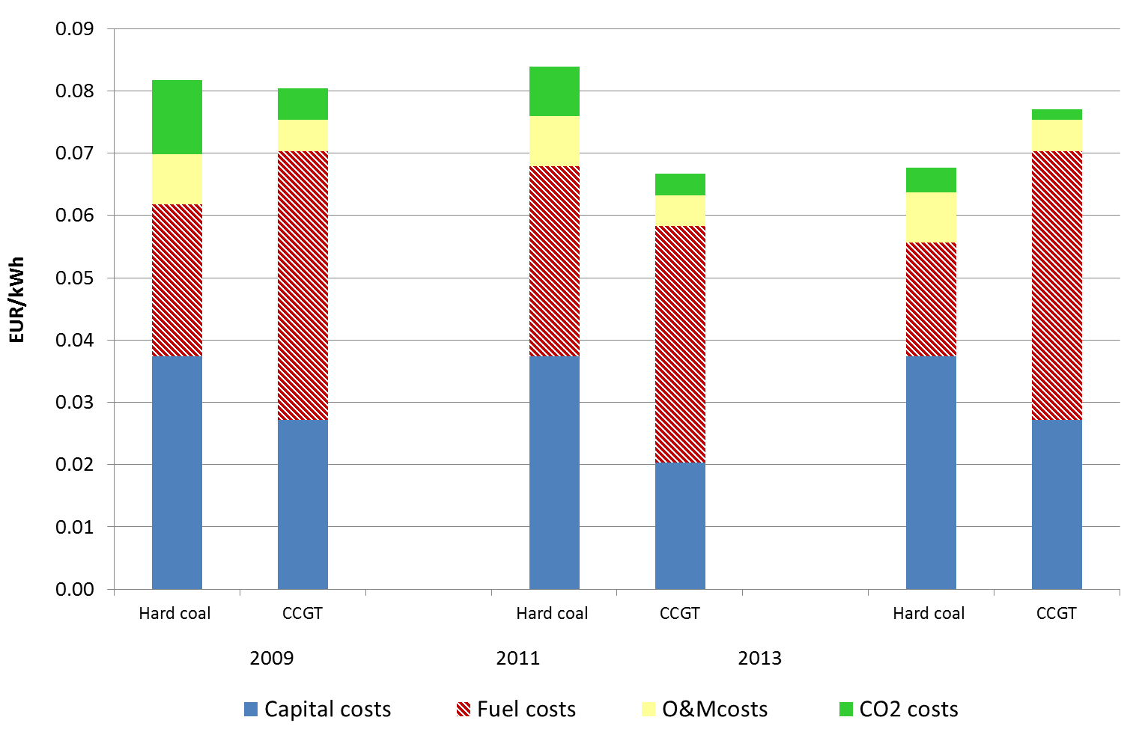
TOTAL ELECTRICITY GENERATION
COSTS 2009-2013

Slide 30
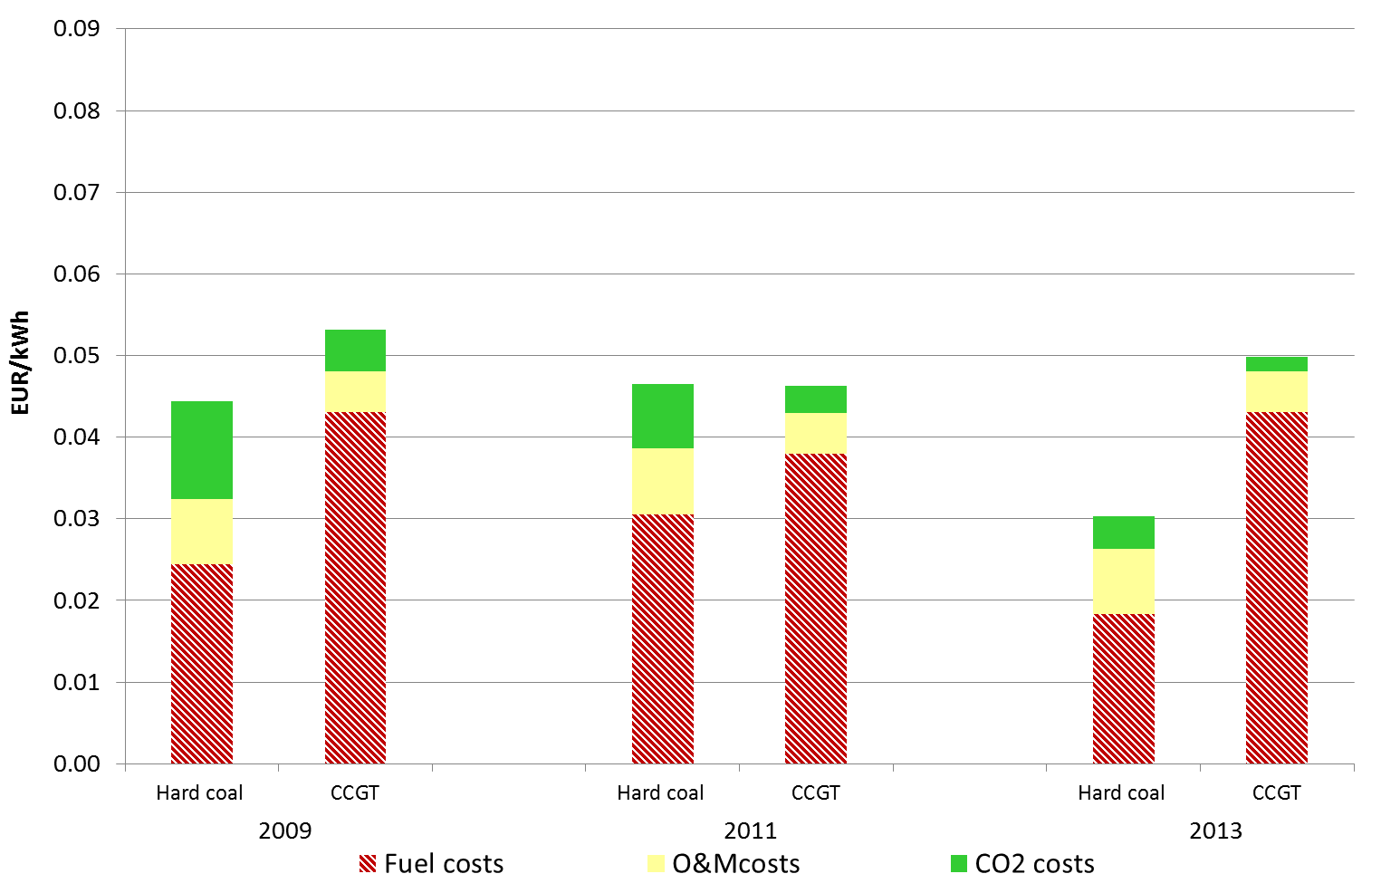
VARIABLE ELECTRICITY GENERATION
COSTS 2009-2013

Slide 31
6. RECENT DEVELOPMENT OF NUCLEAR COSTS
Olkiluoto-3 (Finland): Construction started in 2004, now
expected to be completed 2016 (originally: 2009); 1600 MW
Flamanville-3 (France): Construction started in 2006, now
expected to be completed 2016 (originally: 2011); 1600 MW

Slide 32
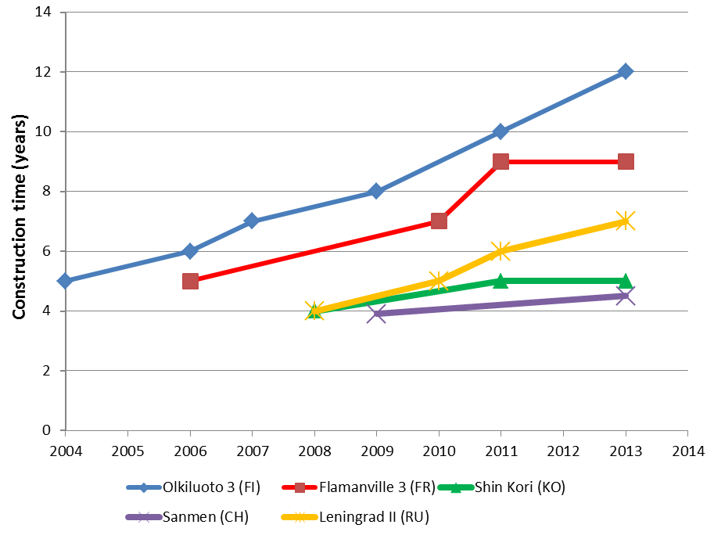
Construction times

Slide 33
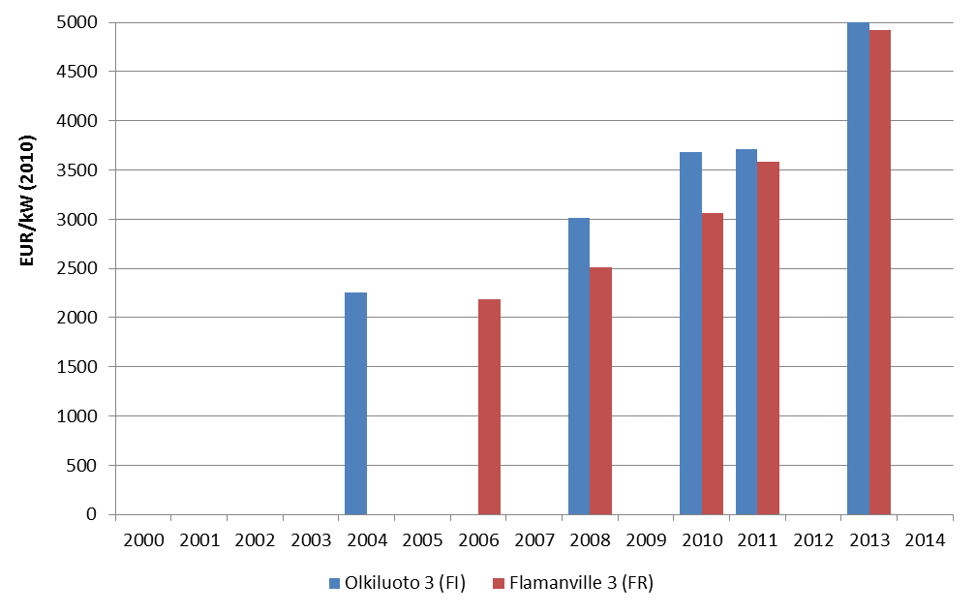
Investment cost development
Olkiluoto 3 vs Flamanville 3

Slide 34
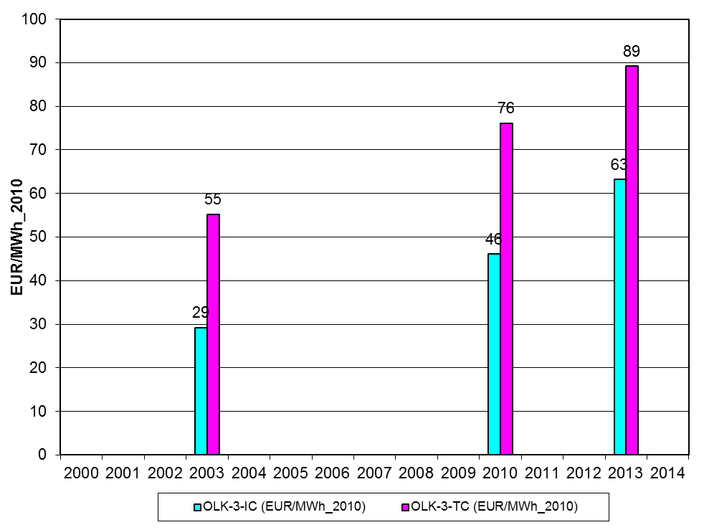
„Total“ Cost development
Olkiluoto
No insurance costs considered!

Slide 35
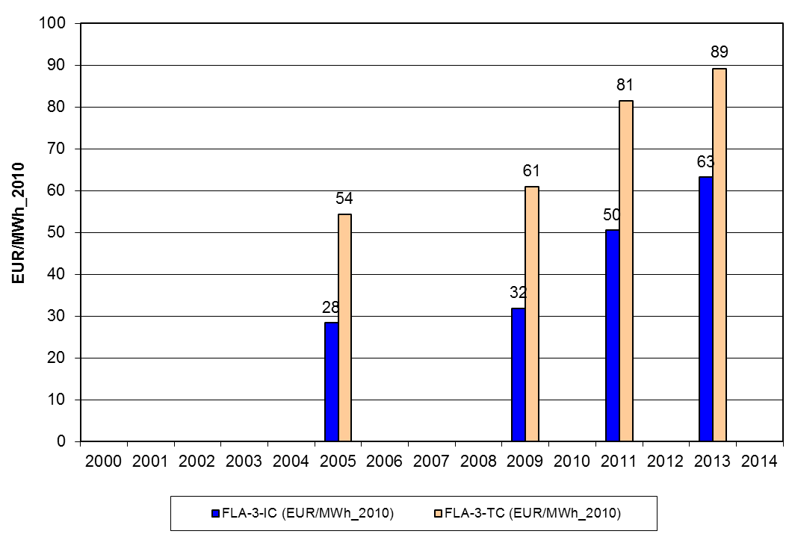
„Total“ Cost development
Flamanville-3
No insurance costs considered!

Slide 36
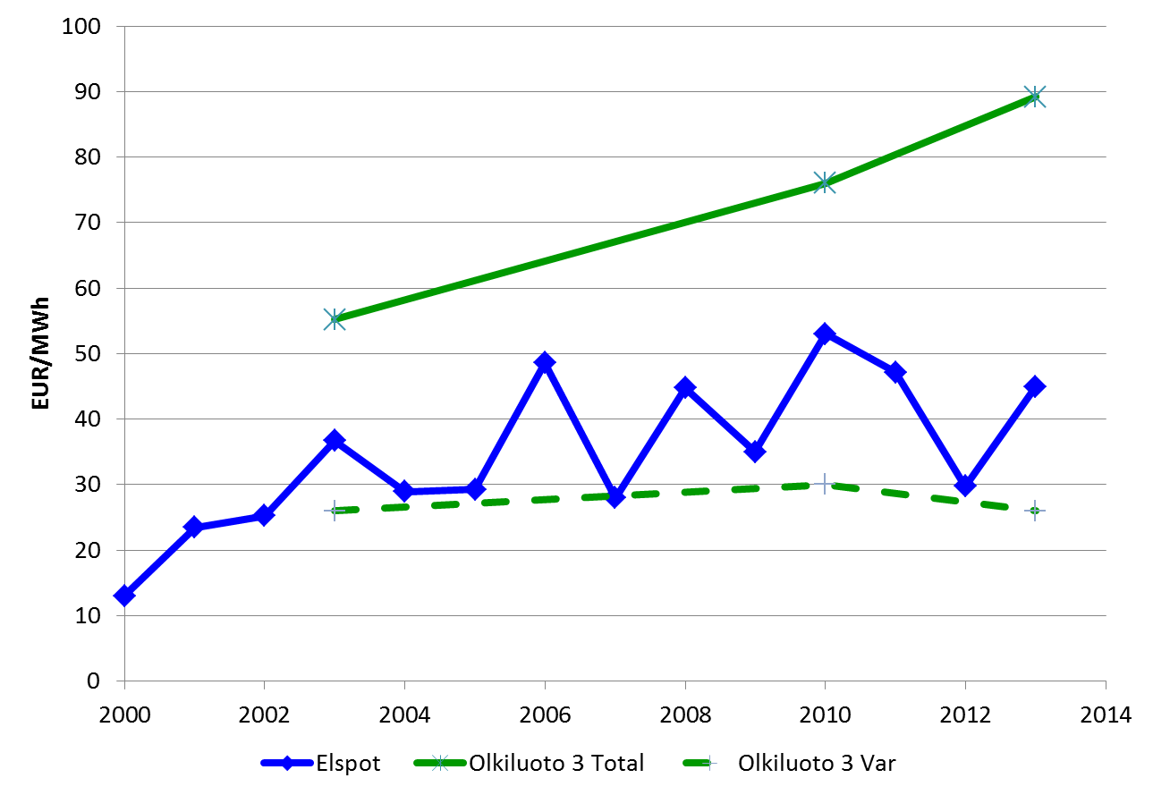
Costs vs market
prices in Nordic countries
„Total“ costs Olkiluoto
Electricity price
NORDPOOL
Variable costs Olkiluoto

Slide 37
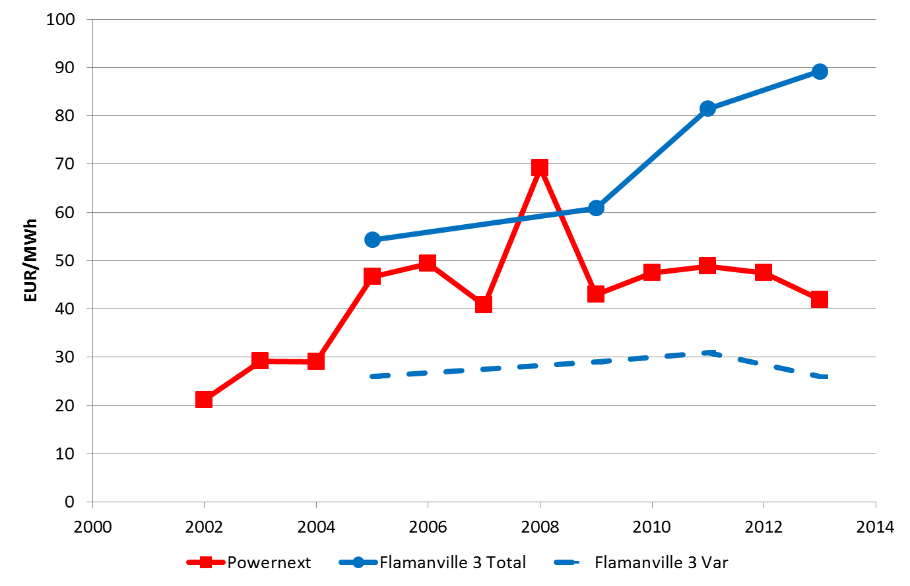
Costs vs market
prices in France
„Total“ costs Flamanville
Electricity price
FRANCE
Variable costs Flamanville

Slide 38
7. THE ROLE OF
RENEWABLES
CORE MOTIVATION:
Policy targets for an INCREASE of RES-E!
e.g. 2020/20/20/20 targets
RES-E directive: increase share of RES-E from 12% 1997 to 22% in 2010)

Slide 39
RES targets for 2020:
Source: Based on European Commission (COM(2008) 19)

Slide 40
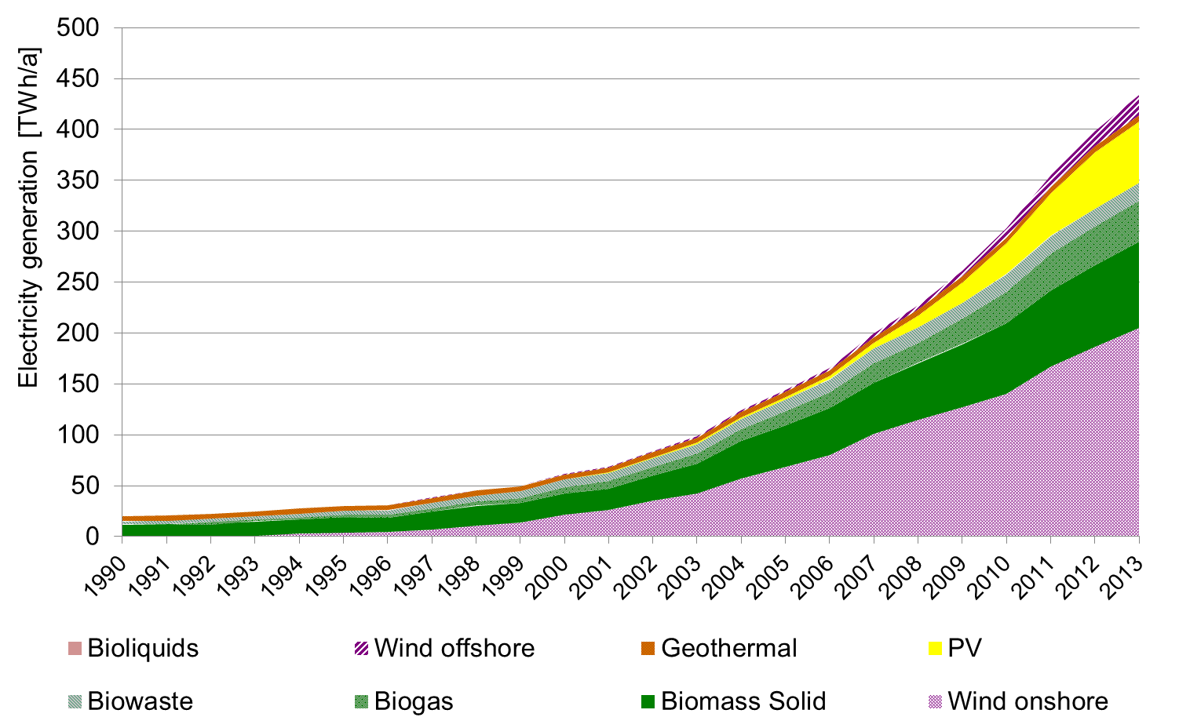
EU-27: Electricity generation
from „new“ RES
2013: 13 %
(preliminary)
1997: 1 %
Source: EUROSTAT, own estimations

Slide 41
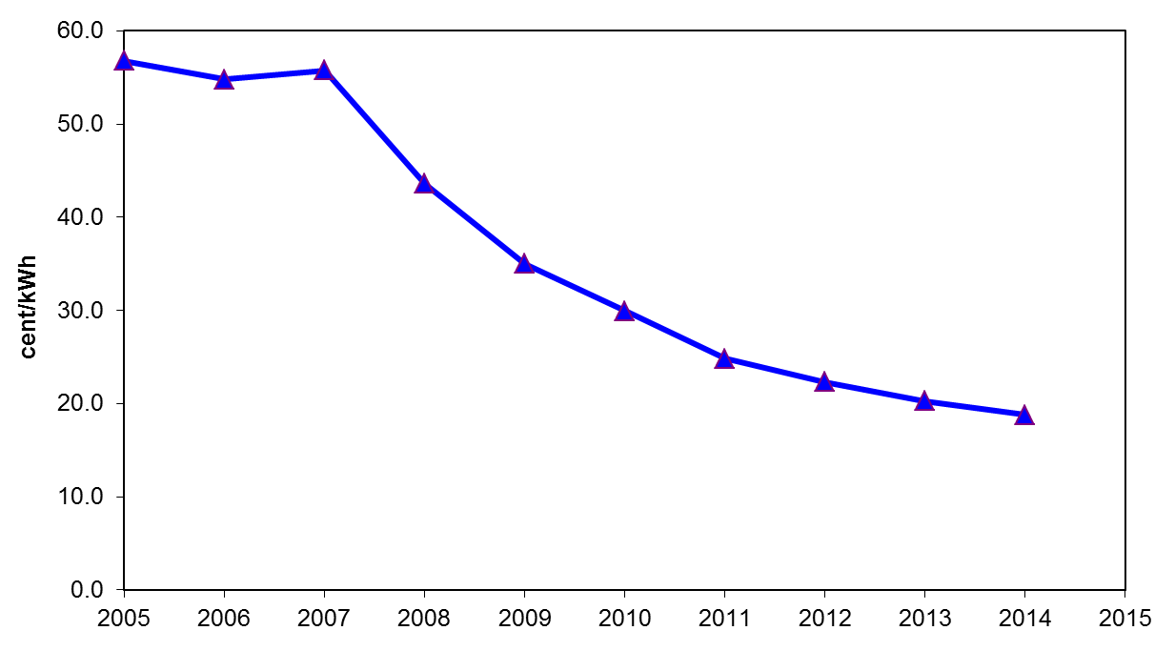
Development of
PV generation costs

Slide 42
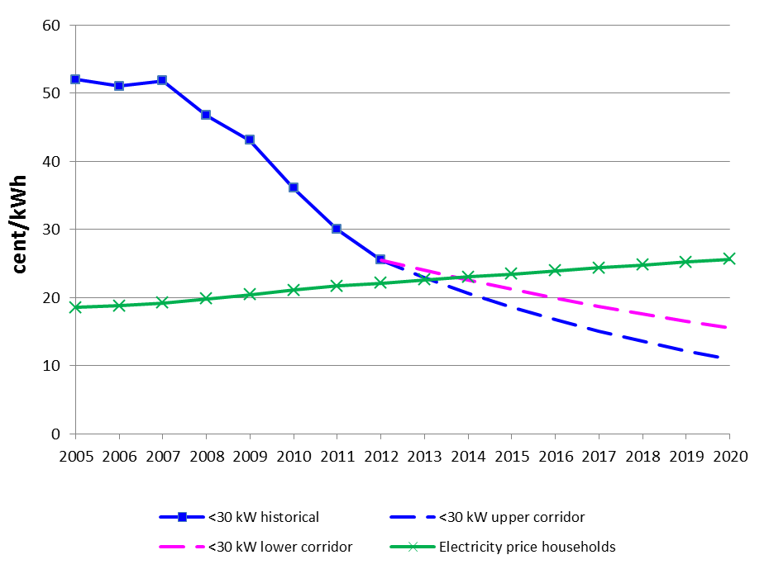
Development of PV generation
costs vs household electricity prices
Grid parity ?

Slide 43
8. CONCLUSIONS:
Markets are in a period of transition
towards volatility;
Nuclear: long lead time, uncertain costs → high promises, low fullfilments;
Renewables: next very interesting phase:
after PV-Grid parity!
More details: Summer school

Slide 44
Example: Costs of
electricity generation from CCGT
5000 h/yr:
C = 1.20 + 0.40 + 4.31 +0.17 = 6.08 cent/kWh
1000 h/yr:
C = 6.0 + 2.0 + 4.31 +0.17 = 12.48 cent/kWh

