Slide 1
New challenges in electricity markets
Reinhard HAAS
Energy Economics Group, TU Wien
Summerschool, June 2015

Slide 2
CONTENT:
1. Introduction: Recent developments
2. How prices come about in electricity
markets
3. Impact of variable renewables on prices
4. Supply security and dimensions of
electricity markets
5. The role of storages
6. A need for new market models?
7. Conclusions

Slide 3
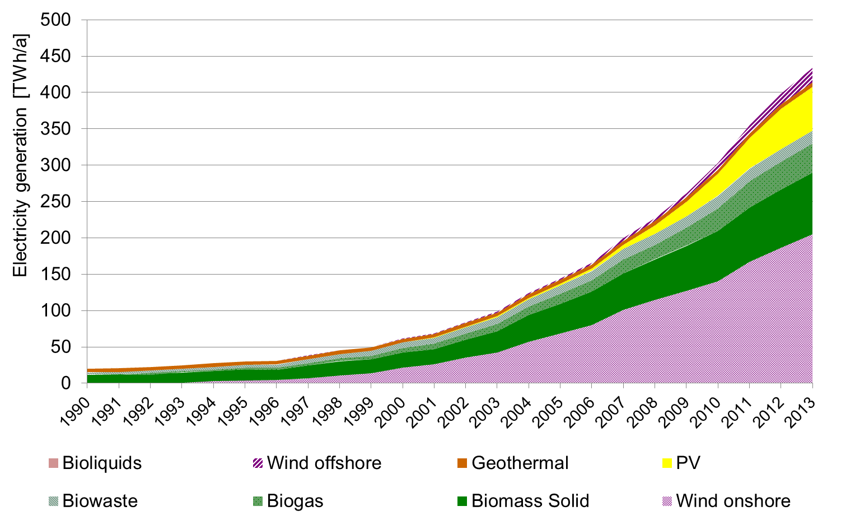
1. INTRODUCTION
EU-27: Electricity
generation from „new“ RES
2013: 13 %
(preliminary)
1997: 1 %

Slide 4
2. HOW PRICES COME
ABOUT (SOME THEORY)
before liberalisation
after liberalisation
Strategic prices
Average
costs
Price, costs (EUR/MWh)
Long-term
marginal costs
Short-term
marginal costs
time

Slide 5
OLD THINKING
Genera-
tion
Grid
Supply
Demand
Flexibility options
Storage

Slide 6
THE MERIT-ORDER
CURVE OF SUPPLY
based on short-term marginal costs (MC)
Coal (old)
Supply curve S:
marginal costs
Natural gas (new)
Costs (EUR/MWh)
Coal (new)
Nuclear
Hydro, Wind
MWh

Slide 7
BASIC PRINCIPLE OF COMPETITION:
PRICE = MARGINAL COSTS
p_{t2}
Demand
D_{t1}
e.g. Natural
gas new
Demand
D_{t2}
Costs,Price (EUR/MWh)
Price = „System“-marginal costs
e.g. Coal
new
p_{t1}
Supply
curve
Nuclear
Hydro, wind
MWh

Slide 8
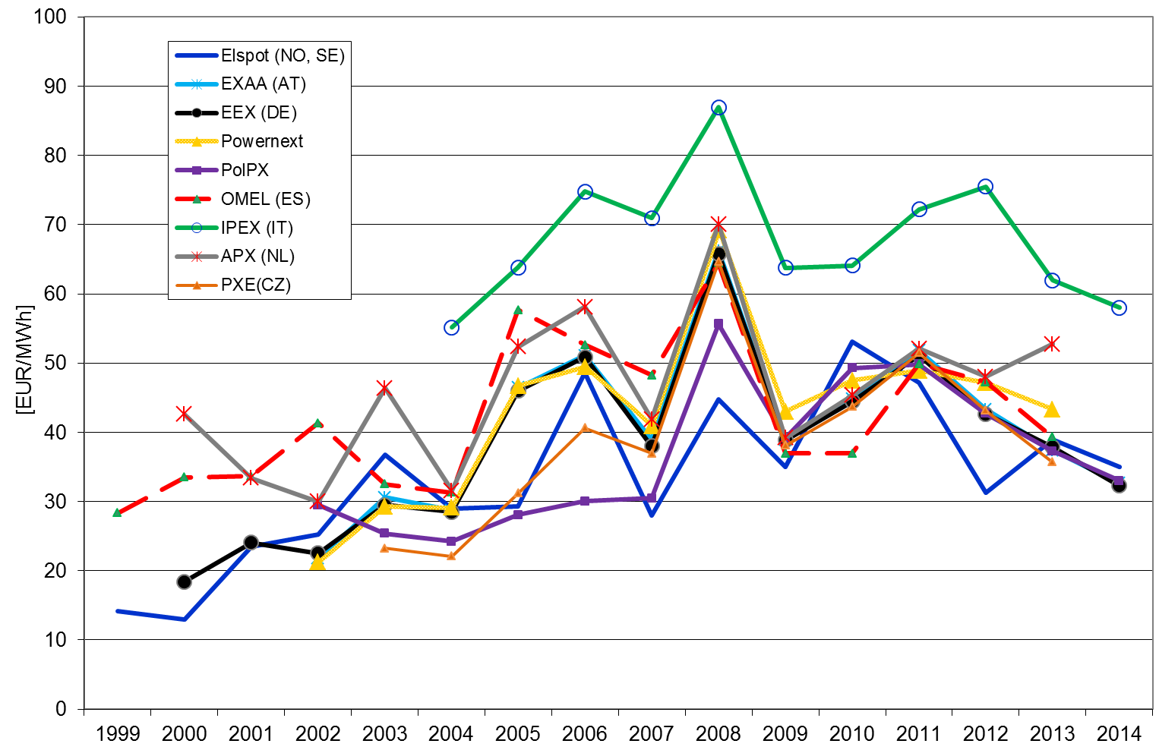
INTERNATIONAL DIMENSION
DEVELOPMENTS AT SPOT MARKETS
AT, DE, FR, CZ, PL
→ One market!

Slide 9
LONG-TERM
VS
SHORT-TERM
MARGINAL COSTS

Slide 10
What are marginal costs (MC)?
MC= C‘(X) = dC(x)/dX
Marginal costs are the increment of costs due to a generation of one additional unit of kWh
P=MC
Short-term marginal costs (STMC):
STMC= Fuel costs + CO2 costs
Long-term marginal costs (LTMC):
LTMC= STMC + Capital costs + O&M costs

Slide 11
LONG-TERM MARGINAL
COSTS
1.
2.
3.
Cheapest:
Nuclear
Coal
Wind
Costs (EUR/MWh)
Capital costs
Operation/Fuel costs
CO2 costs

Slide 12
SHORT-TERM MARGINAL
COSTS
3.
2.
1.
Cheapest:
Coal
Costs (EUR/MWh)
Nuclear
Wind
Operation/Fuel costs
CO2 costs

Slide 13
Expectation of:
prices = Short-term marginal costs:
(Short-term marginal costs = fuel costs)
due to huge depreciated excess capacities at the beginning of liberalisation!

Slide 14
3 HOW VARIABLE RENEWABLES IMPACT
PRICES IN ELECTRICITY
MARKETS

Slide 15
PRICES WITHOUT AND
WITH PV
Demand D_{t}
Costs,Price (EUR/MWh)
Price = System marginal costs
Supply
curve
w/ PV
Price with PV!
Supply
curve w/o PV
PV
MW

Slide 16
PRICE SETTING UNDER
EXCESS CAPACITY
Demand
coal
(new)
Marginal
costs
Costs,Price (EUR/MWh)
Hydro, Wind, PV
RES_{max}
MWh
Negative price = excess price
X
MWh

Slide 17
CATEGORIES OF „PROBLEMS“:
1. Prices decrease to Zero (or below) at a number of days;
2. Lacking contribution margin to fixed costs
3. On how many days will we face high and on how many dayslow prices?

Slide 18
PV AFFECTS THE ELECTRICITY MARKET PRICE IN GERMANY 2012
On-peak time: Low
electricity prices!
Photovoltaics
Spot market price electricity Germany
Structure of electricity generation over a day

Slide 19
  Prices under scarce
  capacities
Strategic
bidding
Price = strategic bid
LTMC
Costs,Price (EUR/MWh)
Price = long-term marginal costs
STMC
e.g. Natural
gas new
Price = short-term marginal costs
Supply
curve
Run-of-river hydro,
wind
Nuclear
D_{t1}
D_{t2}
MW

Slide 20
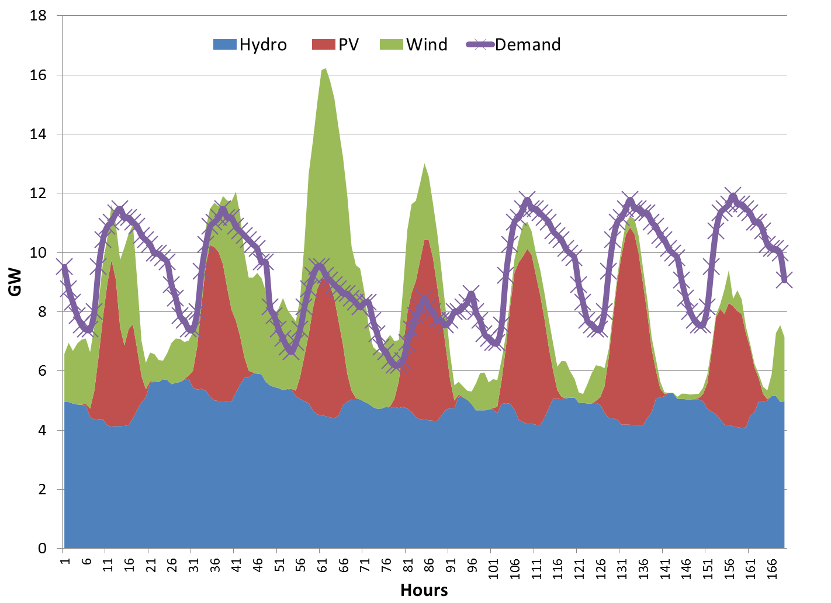
  Example: Supply and
  Demand
RES Production
> Demand
RES Production
< Demand
Demand

Slide 21
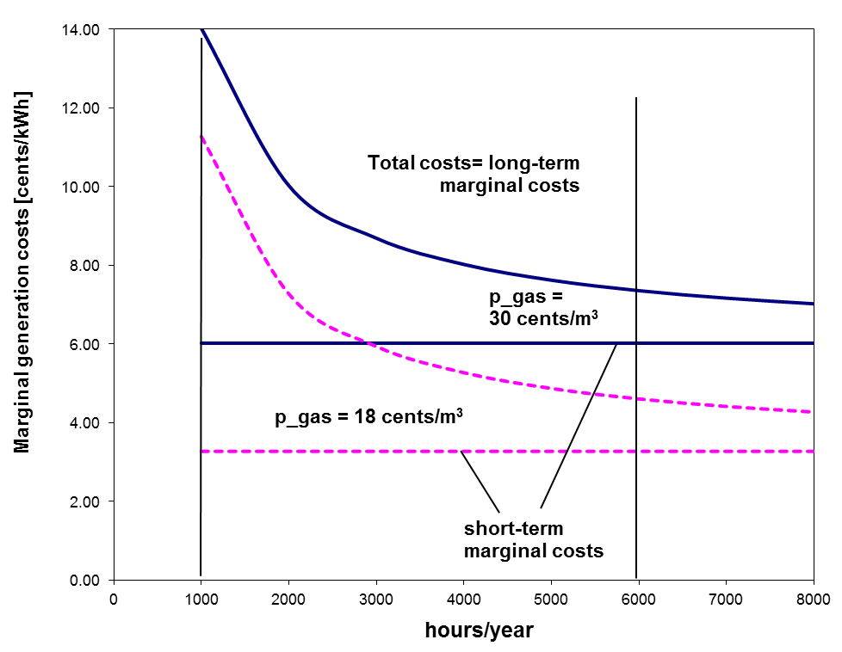
  Auswirkungen auf GUD-Kraftwerke
Fixe Kosten
je kWh
Fix costs per kWh
1000
6000

Slide 22
  Preisbildung: knappe Kapazitäten
Strategic
bidding
Price = strategic bid
LTMC
e.g. Natural
gas new
Costs,Price (EUR/MWh)
Price = long-term marginal costs
STMC
Price = short-term marginal costs
Supply
curve
Run-of-river hydro,
wind
Nuclear
D_{t1}
D_{t2}
MW

Slide 23
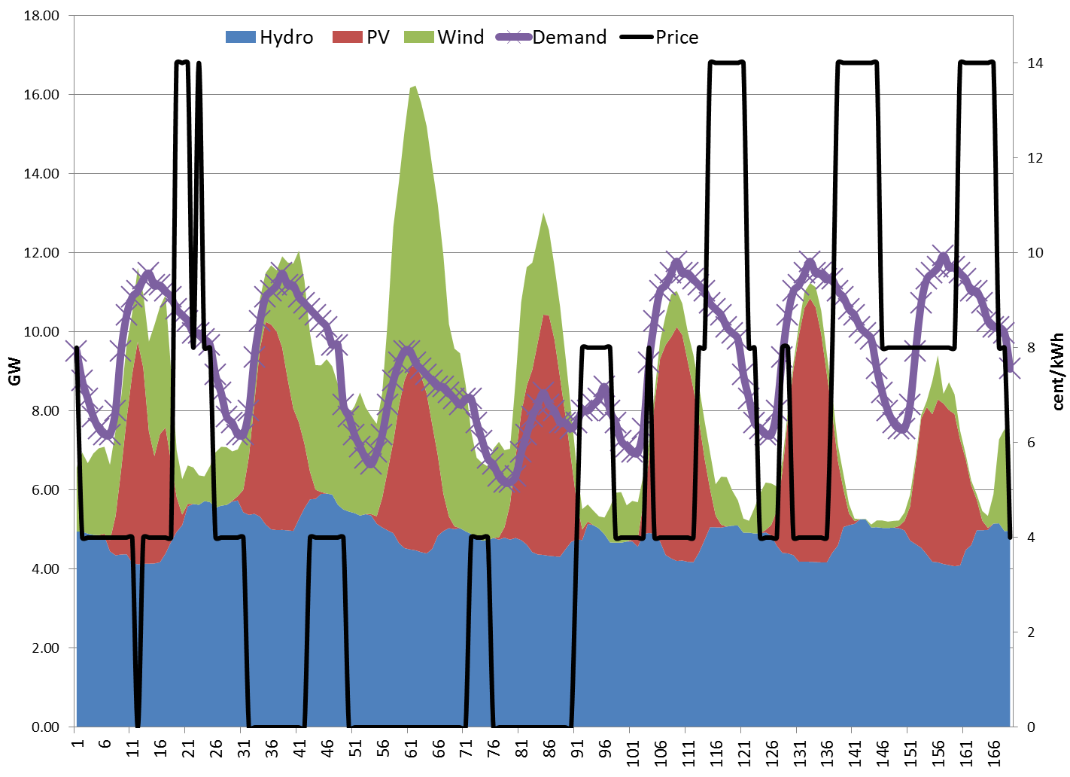
  Temporarily high prices
Electricity price
= high !
Electricity price = 0
(or negative)

Slide 24
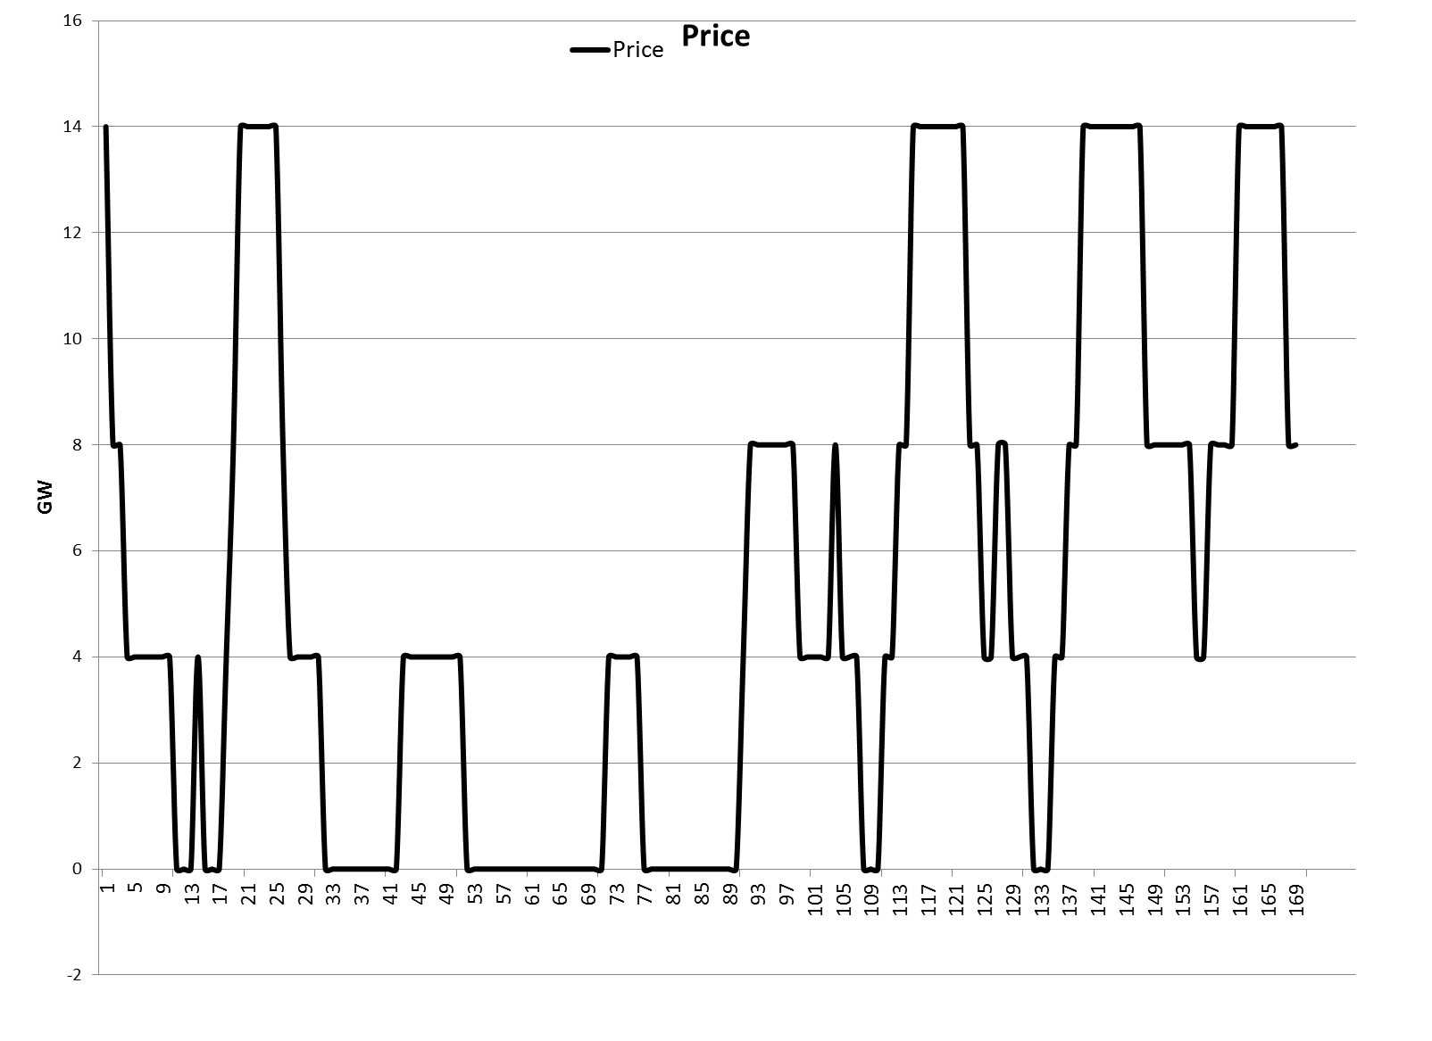
ARE THESE PRICES
TOO HIGH?
p_{t1}
New price spreads
cent/kWh
p_{t2}

Slide 25
Given this price pattern it would be
attractive for (some) power plant operators
to stay in the market
→
REVISED ENERGY-ONLY MARKET

Slide 26
4. SUPPLY SECURITY AND
DIMENSIONS
Historical (anachronistic) definition:
At every point-of-time every demand
has to be met regardless of the costs!
(Note:
Supply security is an energy economic term!
Supply security = system reliability!)

Slide 27
HISTORICAL SUPPLY
SECURITY
D_{t_SS}
Conditions:
S_{t_SS} > D_{t_SS}
P_{t} = Average costs
Costs,Price (EUR/MWh)
Supply curve S_{t_SS}
D_{t_SS}.....Maximal observed or forecasted demand
MW

Slide 28
Historical SS + Centralized Capacity Payments (CCP)
=
New market DESIGN!
(=planned economy)

Slide 29
A MARKET DESIGN
WTP
At times of lowest WTP costs of supply are highest!!!
Costs,Price (EUR/MWh)
MC
Price: WTP=MC
MW
MW_Market
MW_Current
PhD thesis Praktiknjo: A wide range of WTP on the demand-side!

Slide 30
DIMENSIONS OF ELECTRICITY MARKETS
SUPPLY
DEMAND-SIDE
MANAGEMENT
(TECHNICAL)
STORAGES
GRID EXTENTION
DEMAND
RESPONSE
(PRICE SIGNALS)
SMART GRIDS

Slide 31
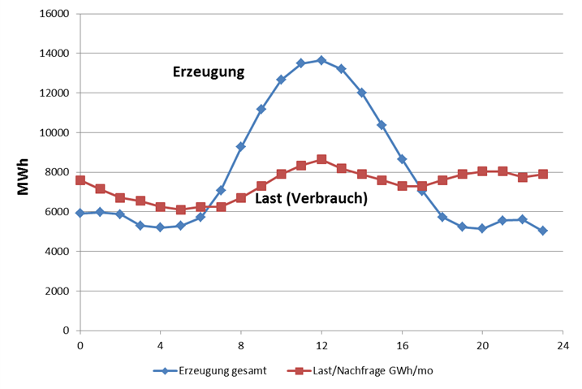
EXAMPLE: RESIDUAL LOAD
Generation
Residual load
Load
Hours over a day
Residual load = Load – non-flexible production

Slide 32
5 THE ROLE OF STORAGES

Slide 33
2. The costs of storage
C … Storage costs (EUR per kWh)
C_{E} … Energy costs (EUR per kWh)
C_{OM} … O&M costs (cent per kWh)
IC … Investment costs (EUR/kW)
… Capital Recovery factor
T … Fullloadhours (hours per year)
η_{SP} … Efficiency of storage
Key factors:
T (Fullloadhours)!
C_{E} (electricity price)

Slide 34
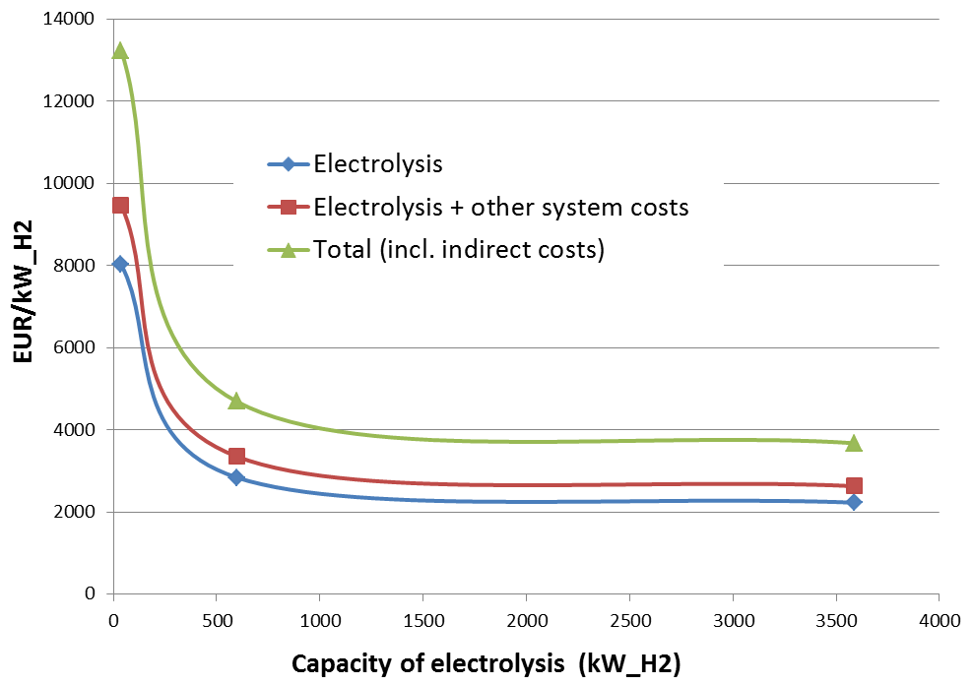
Investment costs of hydrogen production 2014
→ High economies-of-scale !

Slide 35
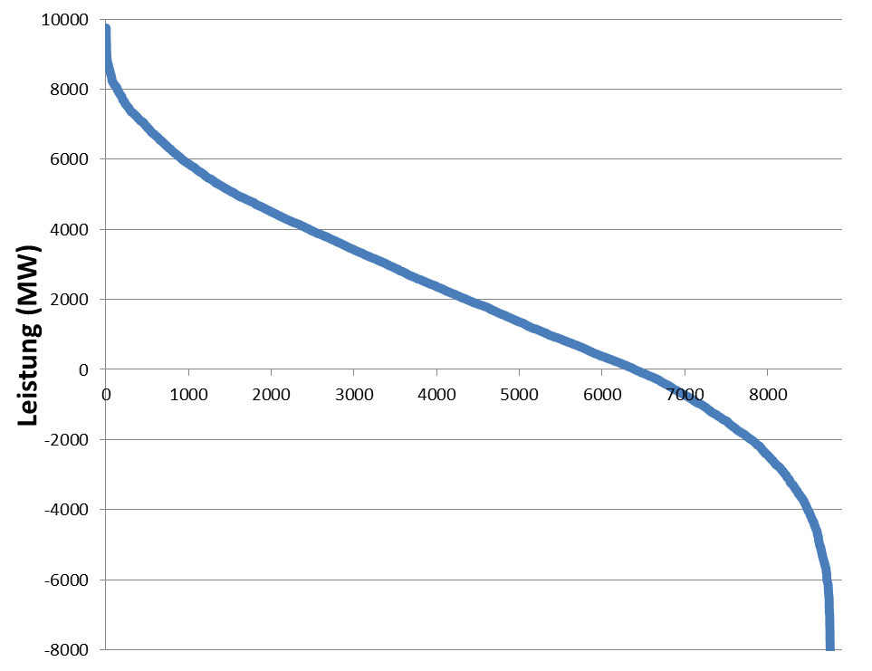
Decreasing full-load hours of
storages
FLH Storage 2
Storage 2
Storage 1
FLH Storage 1
Residual load
Under coverage
excess
generation

Slide 36
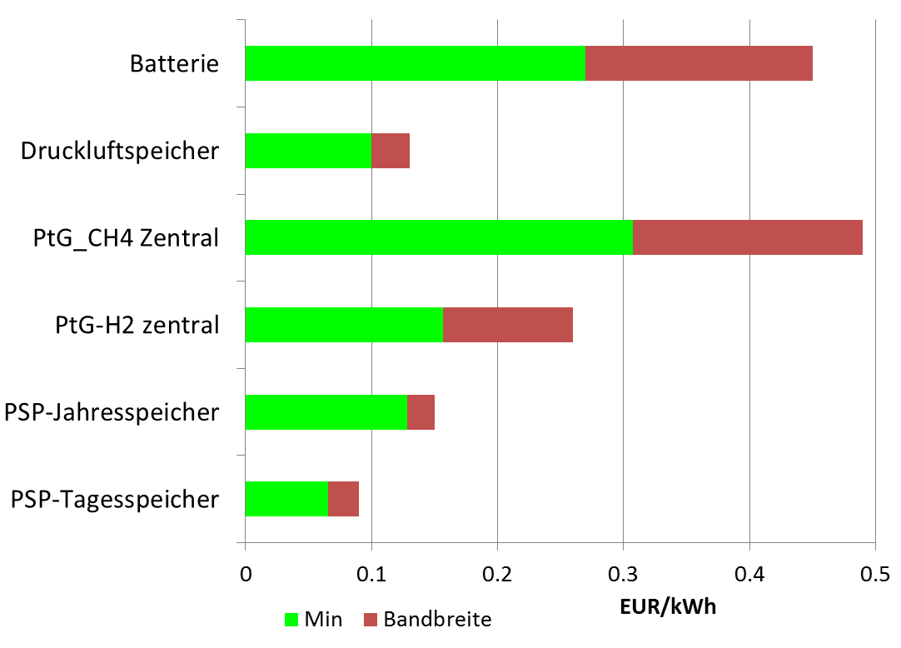
Range of costs 2014
Battery
CAES
PtG-CH4 central
PtG-H2 central
Pumped Hydro year
Pumped Hydro day
Household
electricity price
Range
Minimum
Price spread wholesale market 2014

Slide 37
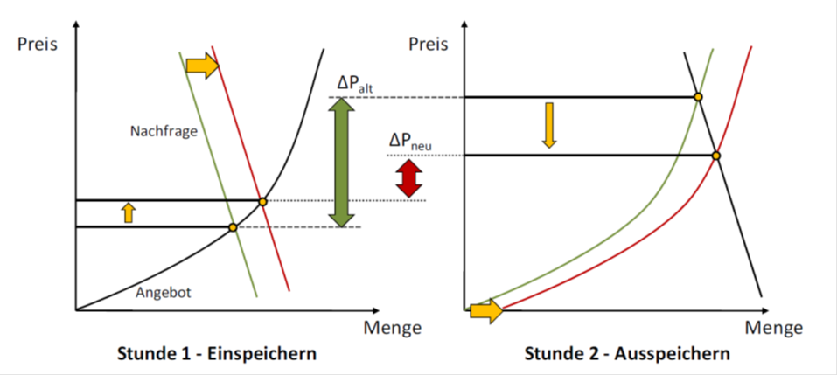
The impact of new storage
on price spreads
Neuer price spread!
Stunde 1: Einspeichern
Stunde 2: Ausspeichern
Quelle: Ehlers 2011

Slide 38
Costs scenarios for long-term storage technologies

Slide 39
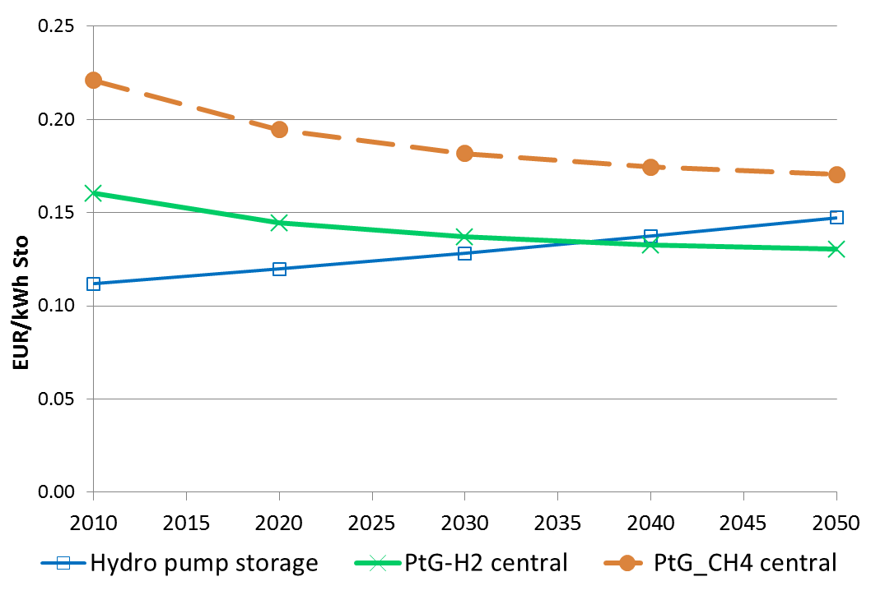
Storage costs optimistic 2010 - 2050
(Electricity costs = 0, T=1800 hours/year)
Methane
Hydrogen
Pumped Hydro year
Electricity price spread

Slide 40
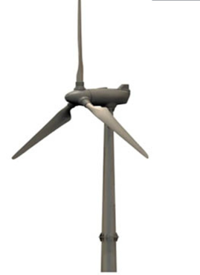

Hydrogen: storage and roundtrip use for electricity generation
Very low roundtrip efficiency for electricity!
η= 27-35%
η=27-38%
η ≈90%
η=50-60%
η=60-70%
Compressor
Combined cycle
Electricity
H₂
Electricity
Electrolyser
G
H₂
H₂
H₂-Storage

Slide 41
Using hydrogen and methane
in transport

Slide 42




Hydrogen: storage and fuel
η=27-38%
η ≈90%
η=50-60%
η=60-70%
Compressor
Combined cycle
Electricity
H₂
Electricity
Electrolyser
G
H₂
H₂
H₂-Storage
Energy supply chains: Storage and/or use of RES for mobility

Slide 43
6. NEED FOR NEW MARKET MODELS

Slide 44
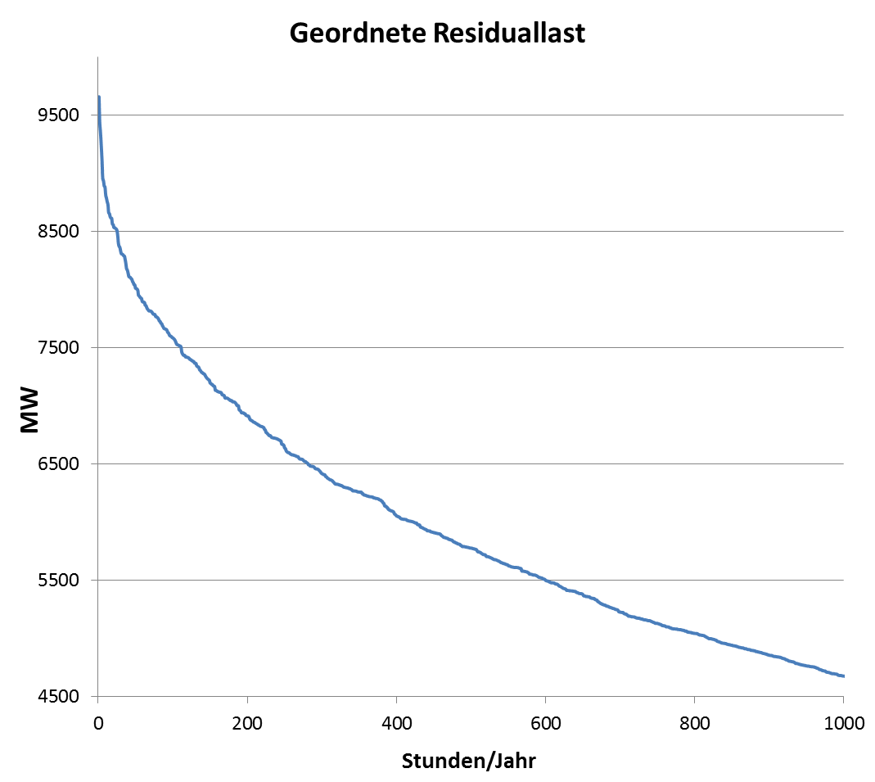
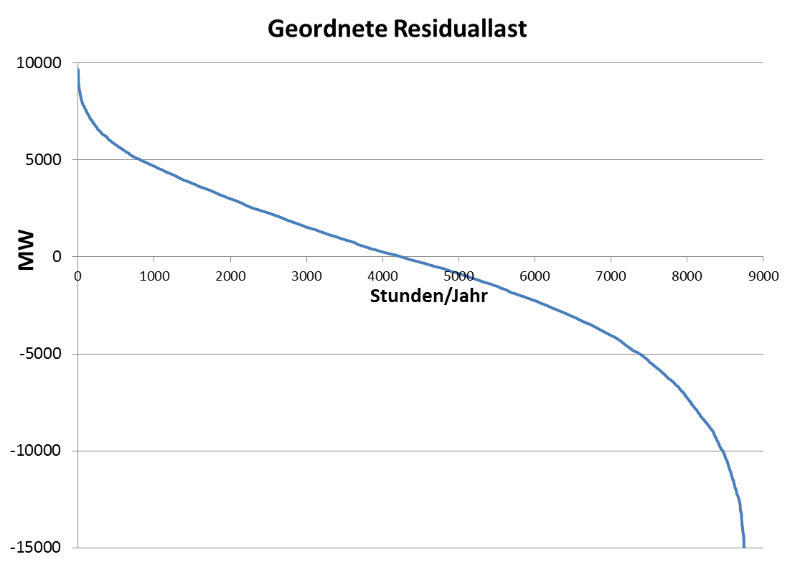
Classified residual load
Under coverage
How to cover?
Excess
production

Slide 45
By a regulated capacity „market“ ?
or
By competition between supply-side and demand-side technologies (incl. storages and grid)?

Slide 46
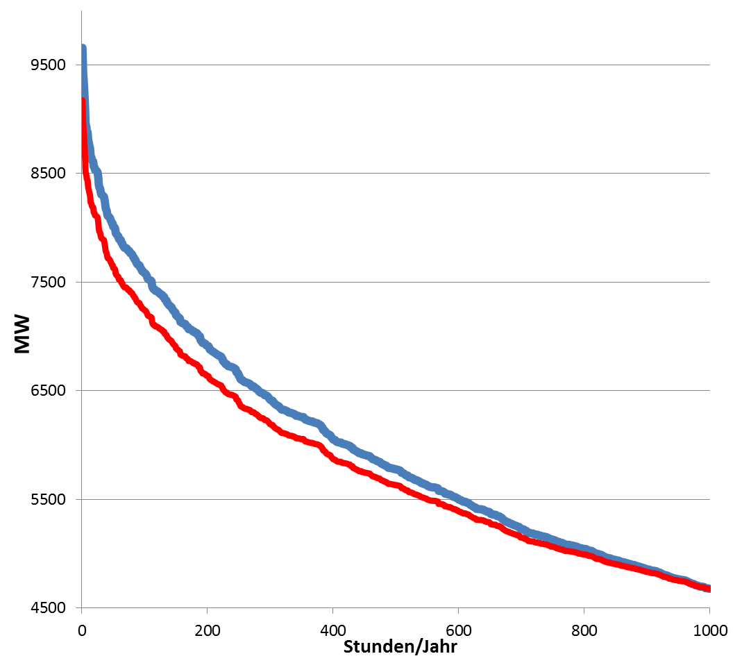
FLEXIBLE COVERING OF RESIDUAL LOAD
Extention of Transmission grid
Prices
very high
(200 EUR/MWh!
Load reduction due
to demand response
Demand-side management
Smart Grids
Storages
Flexible power plants

Slide 47
Open questions regarding
CCP (Centralized
capacity payments):
Which quantity of capacity where?
How to tune with grid extention?
Who plans? On national or international level?
Capacity MARKETS??? How should competition take place in a specific region with one supplier?

Slide 48
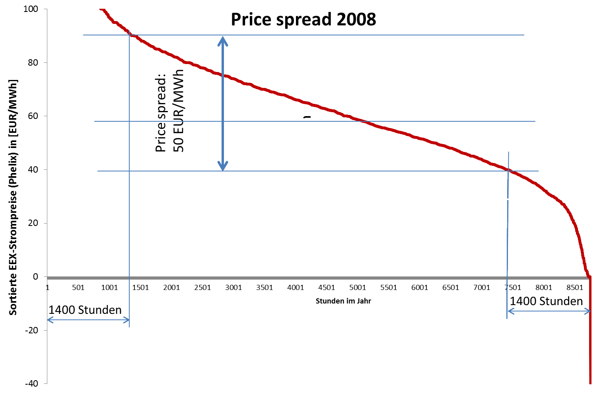
ECONOMIC INCENTIVES
Price spread:
50 EUR/MWh

Slide 49
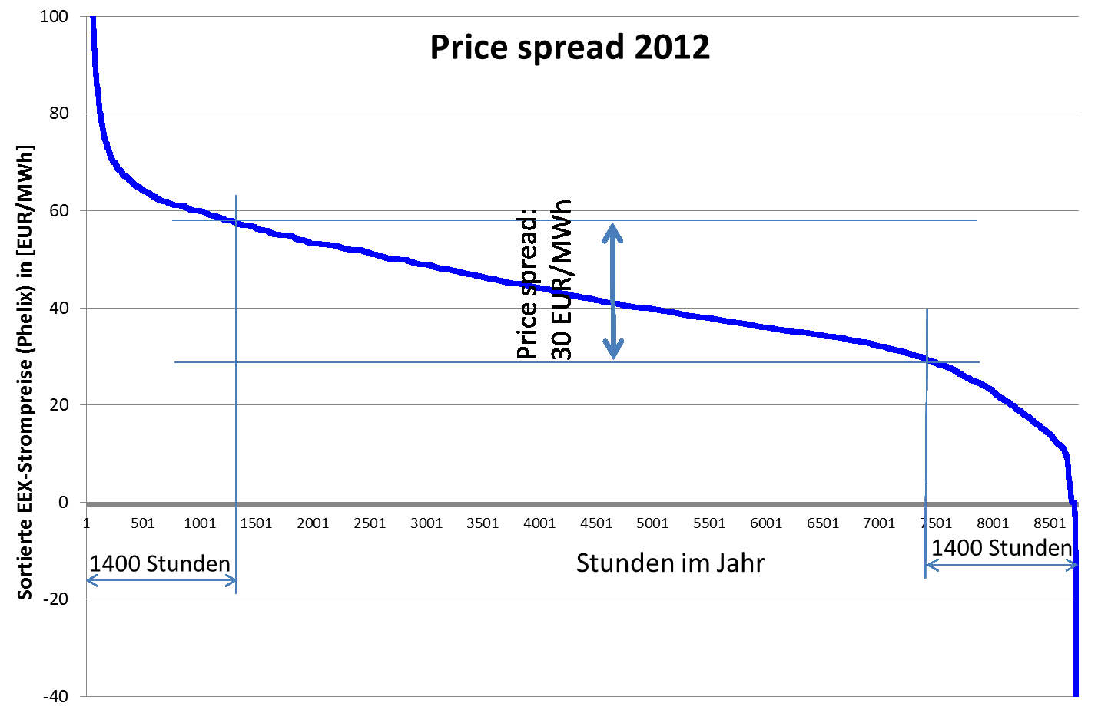
Price spread:
30 (!!!) EUR/MWh
→ There is no incentive today to launch flexibility
measures (except in the control power market)!

Slide 50
6. A NEED FOR NEW
MARKET MODELS?
P=
STMC
P=
LTMC
DS
contracts
Exist.
cap.
New
cap.
EOM classic
X
EOM revised
X
EOM + DCM
X
X
Compreh. CCP
X
X
Focused CCP
X
X
X
EOM…Energy-only market
CCP…Centralized capacity payments
DCM…Demand-side capacity market

Slide 51
OPEN QUESTIONS
REGARDING CCP:
Which quantity of capacity where?
How to split in existing and new capacity?
How to tune with grid extention?
Who plans? On national or international level?
E.G. CCP in DE influence operation of Austrian and Swiss hydro storages
Capacity MARKETS??? How should competition take place in a specific region with one supplier?
Or in France???

Slide 52
THE PLANNING SPIRAL
CCP Inter-national
Financing inter-national?
CCP
National
Grid extention Nat./Int.
Storage Internat.
Central European planning commission!
Conclusion: Increasing planning!

Slide 53
Regional decentral
capacity „MARKETS“ ???
Capacity problems on regional level!
Statement EWI Cologne, in favour of CCP:
“If we introduce capacity markets they must ensure full supply security. That is to say the capacities we need must at least to some extent be higher than expected demand, including a security margin” (Energy&Management, March 2013)
Now imagine which excess capacity comes about if all European REGIONS do this on there level…
→ Huge additional costs!

Slide 54
NEW THINKING
Supply
Demand
Grid
Generation
Flexibility options
Storage

Slide 55
7. CONCLUSIONS
A sustainable electricity system is not a
technological winner-picking problem!
It is a question of integrating a broad portfolio of
technologies and demand response options!
Very important: correct price signals!!!
The key: Flexibility! currently no economic
incentives but activities started → very promising!
most important now: exhaust the full potential of
the creativity of all market participants especially
of the demand-side!

