Slide 1
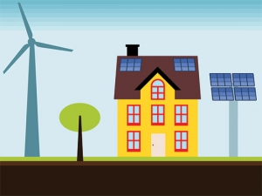
DISTRIBUTED GENERATION IN AUSTRIA AND CZECH REPUBLIC
Oxana Demina
Sebastian Mosshammer
Prague and Vienna, 2014

Slide 2
Content:
Research question
Introduction
What is DG
Main benefits
Main issues
Situation in Austria
Situation in Czech Republic
Conclusions
References

Slide 3
1. Research questions
What are the benefits of DG, how is the present situation of DG and which support mechanisms exist in Czech Republic and Austria?

Slide 4
2. Introduction
Historically: from small-scale to large-scale;
Increasing consumption of energy worldwide cause problems such as overload of power grids, blackouts and has a massive environmental impact;
Modern tendency: use of local power sources;
Tendency of CO2 emissions reduction;
RES enlargement.

Slide 5
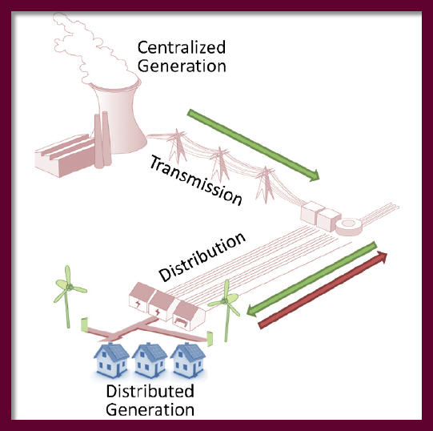
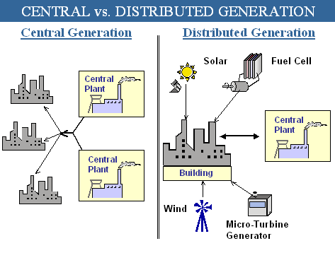
3. What is distributed generation?
The term distributed generation refers to the production of electricity near the consumption place – use of local power sources.
connected to the central grid
on-site
Notes:
The term distributed generation refers to the production of electricity near the consumption place. The power plant in this case can serve a customer on-site or providing support to a distribution network, connected to the grid at distribution or transmission voltage levels

Slide 6
4. Main benefits
Useful part of national power system
Stand-alone(decentralized) applications
Small sizing
Possibility of cogeneration or heat energy generation
Decreasing of power losses
Unloading of central grid
Security of supply
Investment benefits
Environmental benefits

Slide 7
5. Main issues
Technical feasibility
Economic feasibility
Power quality issues
Different legal issues
Case of connection to the central power grid

Slide 8
6. Situation in Austria
Grid Levels:
Maximum voltage level
In western Europe it is 230kV or 400kV; used for feeding high-power transformer; connected to the international power-grid.
- High voltage:
110kV, regional distribution grid, covers power demand from 10 to 100MW
- Middle voltage:
1kV to 30kV, especially used in rural regions, used to feed in the electricity of smaller power plants
- Low voltage:
230V or 400V, used for private households or smaller industry companies, also used for feeding of electricity produced e.g. from photovoltaic systems

Slide 9
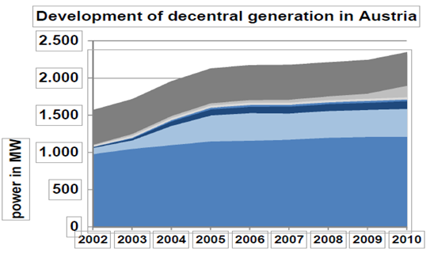
The composition and development of DG
Thermal fossil power
Photovoltaic
Dumpgas
Biomass liquid
Biomass solid
Small hydro power plants (~50%)
∑ ~ 11TWh – 16% of Austria´s production
Wind power plants are not part of this figure! To be considered as central
power generation.

Slide 10
Support mechnism – The Ökostromgesetz
  Exists since 2002, few novels
  Law regulated compensation for power grid feeding – espec. for small producers
  Guaranteed for 13-15 y (ress. dep or ind.)
  Investment incentives
  Novel 2012: increase of subsidies from 21mln to 50 mln Euro per year
  Amount of government-funded power stable since 2004
  Shares are varying, hydro decreases / biomass,biogas,photovoltaic
  (157% from 2011 to 2012) increasing
  13512 contract-partners who received subsidies, 11056 were photovoltaic-facilities
  6152 GWh where fed in to the grid in 2012 from promoted facilities - : 2386 GWh wind, 1983 GWh solid biomass, 554 GWh biogas, 101 GWh photovoltaic

Slide 11
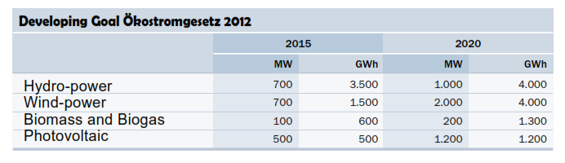
Development goals
Subsidies for particular technologies
siginificant reliefs for low-income households and energy-intensive coperations
independency of nuclear power until 2015 and a share of 15% promoted production from the total electricity demand

Slide 12
Micro-Grids: Application for DG
regenerative power generation systems are usually smaller generation systems
idea to create autonomous micro or mini-grids, in which production and consumption are predominantly in the same area. DG and micro-grids are highly linked
Advantages: high share of RES, minimization of transport losses, safetiness
Austria´s attempt: ADRES - Autonomous Decentral Regenerative Energy-System:
Data-Analysis of electricity consumption of households in Winter and Summer > balance of energy-system (production – consumption) > well planned mix of RES + storage size.
Showed that it is technically possible to create an autonomous micro-grid > more efficiency + energy saving needed to work economically

Slide 13
7. Situation in Czech Republic
General data:
Member of UCTE;
The national transmission system operator is ČEPS;
The total installed capacity of power sources in CR is 20073 MV, the number of electricity generation license holders 13301;
The standardized voltage levels : LV (up to 1000 V), HV (1 kV – 52 kV) and VHV(over 52 kV).

Slide 14
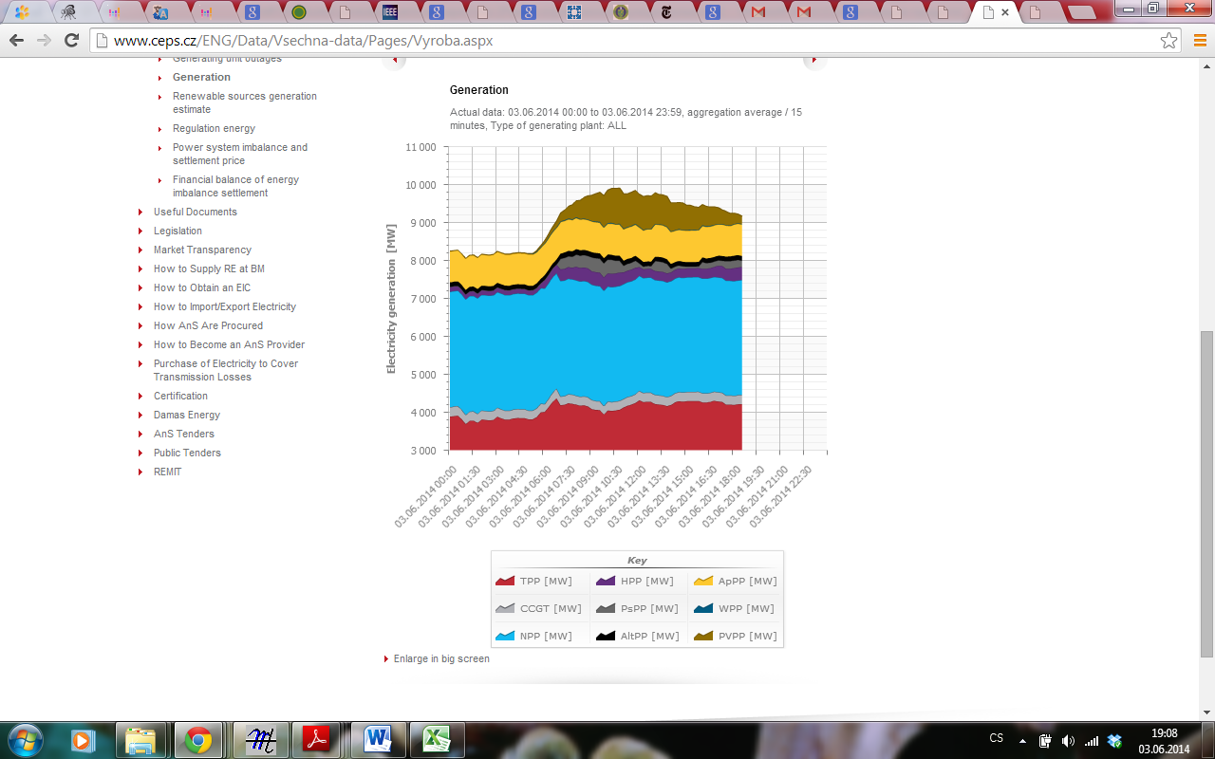
Total gross electricity generation within the Czech power system according to individual power plant type:
Thermal Power Plant (TPP)
Combined-Cycle Gas Turbine Power Plant (CCGT)
Nuclear Power Plant (NPP)
Hydro Power Plant (HPP)
Pumped-Storage Plant (PsPP)
Alternative Power Plant (AltPP)
Autoproducer Power Plant (ApPP)
Photovoltaic (PvPP)
Wind Power Plant (WPP).

Slide 15
Map of the Czech transmission system:
Most of country’s territory is covered by central electrification

Slide 16
DG in Czech Republic:
Power sources:
- Coal-fired CHP plants operated by district heating companies;
- Combined cycle gas turbine and gas-fired CHP plants operated by district heating companies;
- Small and medium-sized hydro power plants;
- Other RES sources.
The majority of power sources are connected to the LV, but more important are the facilities connected to the HV.
The share of DG in total net electricity generation is about 32%

Slide 17
Existing support measures:
1. Fixed feed-in tariffs
the buyer is a distribution or a transmission company;
15 years payback period of investments is guaranteed;
price adjustments related to inflation.
Long term financial guarantees during the lifetime of RES for investors
2. Green bonuses
the buyer is a trader or a customer;
distribution or transmission ;
companies pay green bonuses to producers;
no long- term price guarantees;
higher risk for the producer but higher profit is possible.
3. Specific investment costs of technologies per kW
4. Utilization period at maximum capacity of the unit
5. Typical lifetime of each technology
6. Last revision of parameters in 2009 for all RES-new installations and in 2010 only for PV power plants

Slide 18
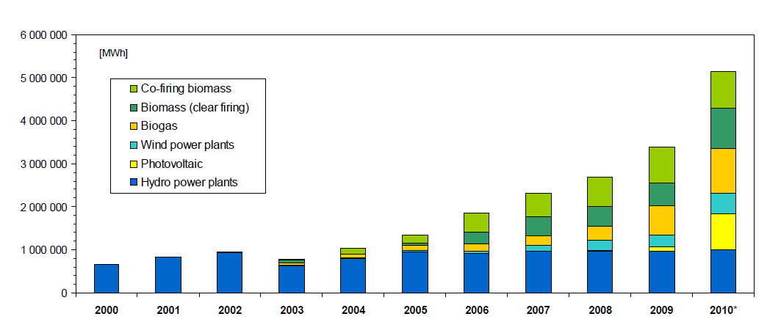
Development of micro grids/RES during the last years:

Slide 19
8. Conclusions
Both Czech Republic and Austria are members of UCTE;
In most cases use distribution voltage level for connection of DG;
Both countries offer subsidies, regulated by law for power generation systems which use RES;
DG has a share of 32% from total net electricity production in the Czech Republic and only 16% in Austria;
The amount of DG from RES is about 5 TWh in the Czech Republic and nearly 9 TWh in Austria;
Czech Republic has a much higher share of fossil energy in DG;
Austria has the advantage: more small hydro-power-plants could be constructed;
Power plants using PV, biomass and wind-power have potential for the future in both countries.

Slide 20
9.References
[1] Towards a future with large penetration of distributed generation: Is the current regulation of electricity distribution ready? Regulatory recommendations under a European perspective - Rafael Cossent, Tomas Gomez, Pablo Frıas, Instituto de Investigacion Tecnologica, Escuela Tecnica Superior de Ingenierıa, Universidad Pontiﬁcia Comillas, C/ Quintana 21, 28008 Madrid, Spain
[2] Distributed generation technologies and optimization - Lucian Ioan Dulăua,*, Mihail Abrudeanb, Dorin Bicăc, The 7th International Conference Interdisciplinarity in Engineering,2013
[3] ADRES – Autonome Dezentrale Regenerative Energie Systeme, DI Alfred EINFALT et al., 2008, 10. Symposium Energieinnovation Graz
[4] DISTRIBUTED GENERATION IN AUSTRIA, Christine MATERAZZI-WAGNER, 2012, CIRED Workshop Lisbon
[5] GROW-DERS: Grid reliability and operability with distributed generation using flexible storage, Petra de Boer et al., 2010, CIRED Workshop Lyon
[6] Impact of Distributed Generation on Power Distribution Systems, K. Balamurugan, Dipti Srinivasan, Thomas Reindl, PV Asia Pacific Conference, 2011
[7] National Renewable Energy Laboratory, web-site: http://www.nrel.gov/learning/eds_distributed_energy.html
[8] Review of the Distributed Generation Concept: Attempt of Unificatio, F. Gonzalez-Longatt1, C. Fortoul.
[9] Policy and Regulatory Roadmaps for the Integration of Distributed Generation and the Development of Sustainable Electricity Networks, R. Čížek, M. Malý - Review of technical options and constraints for integration of distributed generation in electricity networks, SUSTELNET project
[10] Distributed Generation: Definition, Benefits and Issues, Pepermans G., Driesen J., Haeseldonckx D., D’haeseleer W., Belmans R., K.U.Leuven - Energy Institute, 2003
[11] E-Control, Regulative authority in Austria, Ökobericht 2013
[12] The national transmission system operator in Czech Republic ČEPS, official web-page: http://www.ceps.cz/
[13] E-Control, Regulative authority in Austria, Dezentrale Erzeugung in Österreich, 2012
[14] E.Mgaya , Z.Muller – Impact of Connecting Distributed Generation to the Distribution System, Acta polytechnica vol.47, 2007.

Slide 21
Thank you for attention!

