Slide 1
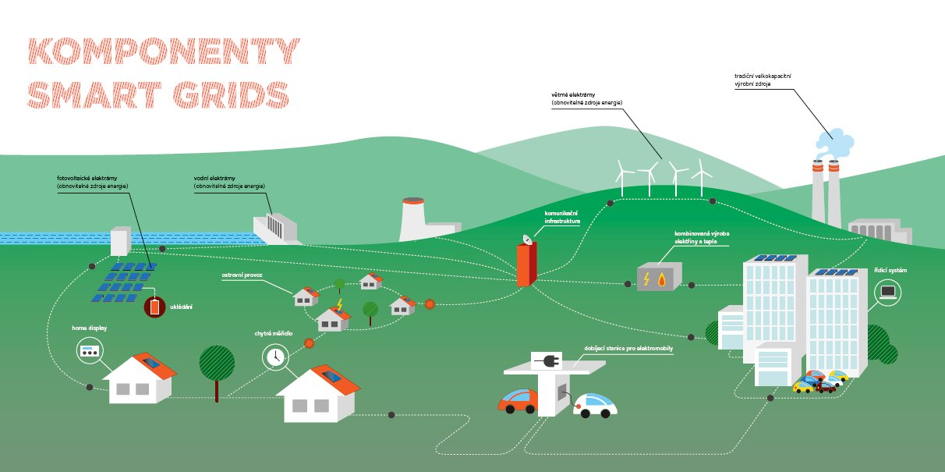
Economic evaluation of smart grids and smart metering
Adéla Holasová
Sebastian Forthuber

Slide 2
Content:
General Introduction and Approach
Concept of Smart Grids and Smart Metering
Implementation of Smart Grids with focus on Smart Metering
- Czech Republic
- Austria

Slide 3
Introduction and Approach
Research Task:
„Economic evaluation of smart grids and smart metering“
Appropriate definition
Literture review
Roadmaps and guidelines
Smart grid status in czech republic / austria
Study review Smart Metering rollout

Slide 4
Concept of Smart Grids
The Smart Grid ?
Definition:
„A Smart Grid is an (electrical) network that intelligently connects activities of all parties involved in production or consumption of electricity, in order to effectively ensure sustainable, economic and secure electricity supply. "

Slide 5
Smart Grids concept
Goal?
Actual pricing of electricity
Increase efficiency
Reliability and security of supply
Automatic regulation
production / consumption balance

Slide 6
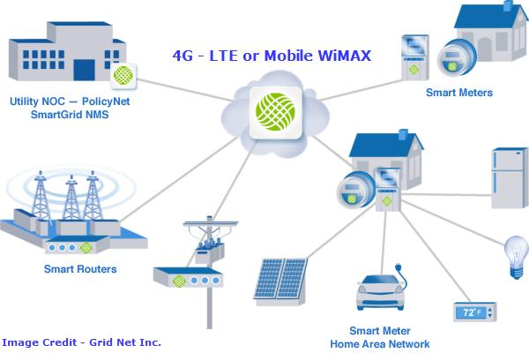
Smart Grids concept

Slide 7
Smart Grids in Czech republic
Document AMM
NOT to implement the smart meters.
Power Management in the Czech Republic is currently applying HDO system that allows power control at the level of 400-700 MW (about 6-9% load).

Slide 8
Smart Grids in Austria
Transmission Grid: already smart
Distribution Grid: Research and demo-projects
Smart Metering: actual implementation plan
Cost-benefit-analysis
EIWOG
Rollout Roadmap

Slide 9
Smart Metering in Austria
Economic Institutions: „Green ICT in Austria“
Savings: 676 GWh/a–1229 GWh/a, 100 to 184 mio. Euro
Field test Linz AG, E-Control:
Savings: 4.3% - 6%, 3.5%
E-Control: PricewaterhouseCoopers cost-benefit-study
Positive overall net effect: ~ 0.3 billion euro
National economy value added increase
FEEI: Capgemini cost-benefit-study
Negative overall net effect: 1.7-2.4 billion euro
Two studies, different methods, two results

Slide 10
Smart Grids v Evropské unii
Report SRA 2035 (6 areas of research topics)
Retail and consumer
Integrated Systems (observability and control, storage, ...)
Transmission and distribution systems (monitoring and control technologies)

Slide 11
Economic evaluation of smart grids and smart metering
[1] MINISTERSTVO ŽIVOTNÍHO PROSTŘEDÍ. Klimaticko-energetický balíček [online]. [cit. 2013-10-17]. Dostupné z: http://www.mzp.cz/cz/klimaticko_energeticky_balicek
[2] BERAN, Jaromír. Summary of priorities for Smart Grids research topics, Conference Smart Grids & Metering – Aktuální trend v energetice, Cyklus seminářu 2014, Praha 23. 4. 2014
[3] ČEZ, a.s. 2012. Smart Grids. FUTUR/E/MOTION. [Online] 2012. [Cited: Říjen 17, 2013.] http://www.futuremotion.cz/Smart Grids/cs/index.html.
[4] ABB. 2013. Úvod do problematiky inteligentních sítí. [Online] 2013. [Cited: listopad 17, 2013.] http://www02.abb.com/global/czabb/czabb018.nsf/0/a5a3d03331846f55c125773d004a5ede/$file/Smart+grids_cz.pdf.
[5] European technology platform for the electricity networks of the future. 2010. Strategic Deployment Document for Europe's electricity networks of the future. [Online] 2010. [Cited: Listopad 17, 2013.] http://www.Smart Grids.eu/.
[6] SITU, Lixin. 2012. Electric Vehicle Development: The Past, Present & Future. 3rd International Conference on Power Electronics Systems and Applications. [Online] 2012. [Cited: listopad 23, 2013.] http://80.ieeexplore.ieee.org.dialog.cvut.cz/stamp/stamp.jsp?tp=&arnumber=5228601.
[7] KILIAN, Dominik. 2012. Competitiveness of the EU Automotive, Final Report. Chair of General Business Administration and International Automotive Management. [Online] Prosinec 19, 2012. [Cited: Listopad 22, 2013.] http://ec.europa.eu/enterprise/sectors/automotive/files/projects/report-duisburg-essen-electric-vehicles_en.pdf.
[8] AJANOVIC, Amela. 2013. Promoting environmentally benign electric vehicles, 2013 ISES Solar World Congress. Vienna University of Technology , Austria, Gussgausstr.25-29-370-3 : s.n., 2013.
[9] European technology platform for the electricity networks of the future. 2010. Strategic Deployment Document for Europe's electricity networks of the future. [Online] 2010. [Cited: Listopad 17, 2013.] http://www.Smart Grids.eu/.
[10] ČEZ a.s. Seriál - 3. Chytrý domov. Futur emotion energie zítřka. [Online] [Cited: Prosinec 6, 2013.] http://futuremotion.cz/cs/serial/3-chytry-domov.html.
[11] ČEZ a.s. 2012. Smart Grids. FUTUR/E/MOTION. [Online] 2012. [Cited: Říjen 17, 2013.] http://www.futuremotion.cz/Smart Grids/cs/index.html.
[12] MPO, Sekce 3000. 2012. Ekonomické posouzení přínosů a nákladů při zavedení inteligentních měřicích systémů v elektroenergetice. Ministerstvo průmyslu a obchodu. [Online] Září 4, 2012. [Cited: Prosinec 7, 2013.] http://www.mpo.cz/dokument106754.html.
[13] ROUBAL, Jiří. 2013. Smart Grids v lokálních distribučních soustavách. Energetika, ČSZE, ISSN 0375-8842, Český svaz zaměstnavatelú v energetice. Měsíc, 2013, Vol. 006, 1.
[14] VRBA, Miroslav. Interview. 2013. ČEPS. Praha, Listopad 29, 2013.
[15] MPO, Sekce 3000. 2012. Aktualizace státní energetické koncepce. Praha : s.n., Únor 2012.
[16] HABRYCH, R., JAROLÍMKOVÁ, G. 2013. Implementace Smart Grid v lokálních distribučních soustavách průmyslových podniků. Energetika, ČSZE, ISSN 0375-8842, Český svaz zaměstnavatelú v energetice. Měsíc, 2013, Vol. 001.
[17] APG, Austrian Power Grid: Masterplan 2030, 2013
[18] Paul van den Oosterkamp et al.: The role of DSOs in a Smart Grid environment, 2014
[19] European Technology Platform SmartGrids: SmartGrids SRA 2035 Strategic Research Agenda Update of the SmartGrids SRA 2007 for the needs by the year 2035, 2012
[20] Andreas Lugmaier et al.: Roadmap Smart Grids Austria, FEEI – Fachverband der
[21] Elektrizitätswirtschafts- und –Organisationsgesetz 2010 – ElWOG 2010, BGBLA 23.12.2010
[22] PWC, PRICEWATERHOUSECOOPERS GMBH: Studie zur Analyse der Kosten-Nutzen einer österreichweiten Einführung von Smart Metering, 2010
[23] CAPGEMINI, CAPGEMINI CONSULTING ÖSTERREICH AG: Analyse der Kosten – Nutzen einer österreichweiten Smart Meter Einführung, 2010
[24] Intelligente Messgeräte-AnforderungsVO 2011 – IMA-VO 2011, BGBL, 25.11.2011
[25] Energieinstitut der Wirtschaft GmbH, IWI Industriewissenschaftliches Institut: Green ICT in Österreich, Potenziale und Möglichkeiten zur Steigerung der Energieeffizienz und Reduktion von klimarelevanten Emissionen, BRZ Bundsrechenzentrum GmbH, FEEI - Fachverband der Elektro- und Elektronikindustrie, Vereinigung der Österreichischen Industrie (IV), 2013
[26] Michael Holzinger, Masterarbeit: Smart Metering und sein Einsatz in Österreich, 2011
[27] Broschüre: Intelligente Energiesysteme der Zukunft: Smart Grids Pioniere in Österreich, Bundesministerium für Verkehr, Innovation und Technologie (bmvit), 2010
[28] David Reiter, Masterarbeit: Intelligente Effizienzsteigerung in Anbetracht zukünftiger dezentraler und volatiler Stromerzeugung in Österreich, 2013

