Slide 1
Alternative ways of transport in the cities of Prague and Vienna
Eva Stárková
Edith Schroll

Slide 2
Content
Introduction
Situation in Prague
Situation in Vienna
Comparison
Conclusion

Slide 3
The White paper 2011
by 2050, key goals will include:
  no more conventionally-fuelled cars in cities
  40% use of sustainable low carbon fuels in aviation; at least 40% cut in shipping emissions.
  a 50% shift of medium distance intercity passenger and freight journeys from road to rail and waterborne transport

Slide 4
The European Union’s proposal to reduce imported oil is an indirect recommendation to increase of use of alternative transport, as are electric vehicles. Electromobility would make an important contribution to the attainment of climate targets, but also to relieve the living environment from the burden of air pollution.

Slide 5
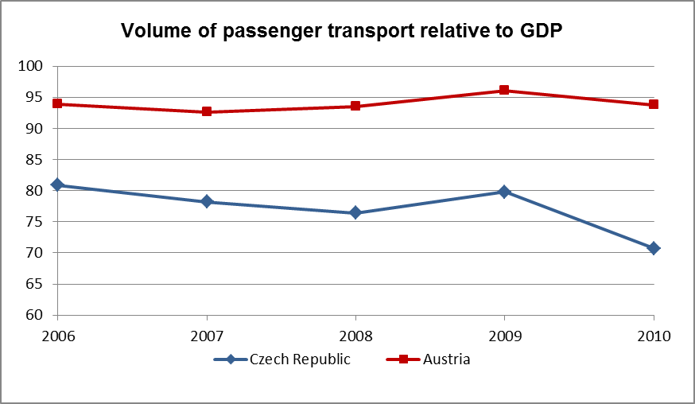
Volume of passanger transport relative to GDP
Source : Eurostat, 31/10/2012

Slide 6
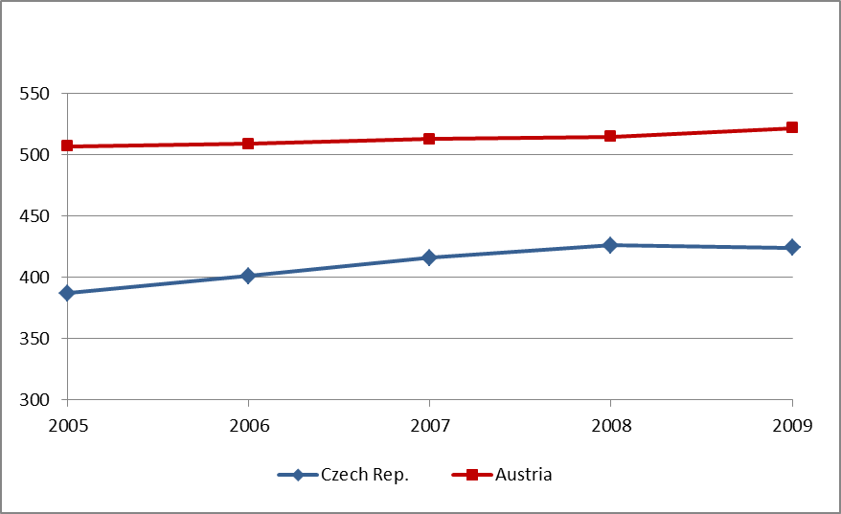
Motorisation rate - Cars per 1000 inhabitants
Source : Eurostat, 31/10/2012
Motorisation rate - Cars per 1000 inhabitants

Slide 7
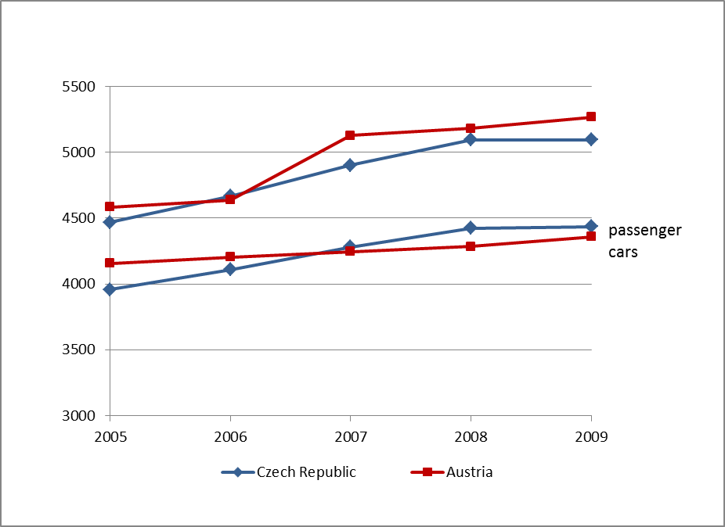
Stock of vehicles in the Czech Republic and Austria
stock of vehicles [thousands]
all vehicles
Source : Eurostat, 23/11/2011

Slide 8
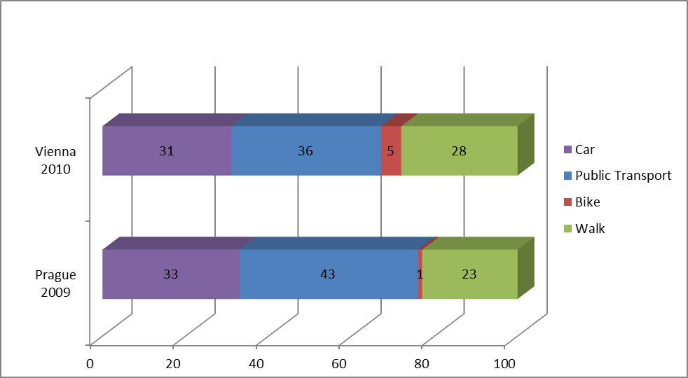
Modal Split in Prague and Vienna

Slide 9
 | Unit | Vienna | Prague
Area | km² | 414.87 | 496.09
Inhabitants 2012 | persons | 1,731,236 | 1,272,690
population density | persons/km² | 4132.0 | 3125.5
vehicle stock 2009 | vehicle | 664,000 | 390,800
vehicle density 2009¹¹ | vehicle/1000 pers. | 390,80 | 508.4
Length of road network | km | 2,809 | 3,874
Length of metro network | km | 74.2 | 59.1
Length of tram network | km | 214.8 | 141.6
Length of bus network | km | 648.4 | 683

Slide 10
SWOT analysis of electric vehicles
 | positive | negative
internal factors | strengths environmentally friendly less CO₂ emissions less air pollution more efficient energy storage | weaknesses infrastructure battery technology high price lack of charging stations
external factors | opportunities Connection with other transport systems (car sharing, …) hybrids | threats Mobility behaviour Integration in traffic system politics oil lobby

Slide 11
Thank you for your attention!

