Slide 1




Achievement of energy efficiency in the households by using PV
Seminarpaper
Veronika Gruberova & Gürkan Saglampinar

Slide 2
Electricty Storage - Introduction
PV panels was mainly designed for stand-alone purposes
storage of part of the solar power for near-term consumption → less dependent from the grid
electricity grid = balance between production and consumption
self-consumption of PV is publicly encouraged in EU countries
owners are remunerated for feeding their electricity into the grid
Notes:
The design of classical electricity storage for PV panels was mainly designed for stand-alone purposes.
In this paper, we concentrate on storage of part of the solar power for near-term consumption within a day or subsequent days
This leads house owners to become more independent from the grid and does pay only for the congestion of his energy.
The electricity grid is used as a help how to achieve the balance between solar energy production and the electricity consumption of the household.
The grid is used as a virtual storage, which means the overproduction during the day is supplied into the grid and a demand in the evening is covered by the electricity network
Since some years, the usage of self-consumption of PV is publicly encouraged in some European countries (e.g. Germany, Austria …) and it can be realized by electric storage. The owners are remunerated for feeding their electricity into the grid

Slide 3
Production and Consumption (1)
Notes:
shows a production profile of solar cells on a day in October and the consumption profile of the household on the same day.

Slide 4
Production and Consumption (2)
Production is not sufficient the whole day
Intra-day storage could solve this problem
Two important criterions for storage systems:
  Power need for charge and discharge current
  Storage capacity
Notes:
➔ It can be identified, that the production is not sufficient the whole day long.
Intra-day storage could solve this problem.
Following two criteria are important for storage systems:
1) Power need for charge and discharge current
The power change occurs within some seconds. As shown in the figure, the power can decrease and be at full power again some seconds later. Therefore the system must respond drastically.
2) Storage capacity
This criteria need not to be precise as the first criteria. According the figure, the consumption can be nearly zero. Therefore the system must absorb the full power of the PV panel.

Slide 5
Production and Consumption (3)
Notes:
shows measurements of power fluxes in seven houses with PV panels
those houses have been measured mainly during a complete year
➔ Following data have been considered to calculate the dwellings consumption:
- measured AC power out of the inverter
- power to the grid
- power drawn from the grid

Slide 6
Production and Consumption (4)
Notes:
typical consumption and production profile on monthly base during a year is shown.
the decrease of energy production and the increase of the consumption in the winter months can be seen easily

Slide 7
Storage (1)
production is not sufficent for the consumption
production-consumption ratio: 30% - 80%
measured houses do not include any storage systems ➔ influence of storage
Notes:
it can be noticed, that production for none of the houses is sufficent for the consumption for every time step or even month
The production-consumption ratio can vary between 30% and 80% on a monthly base. e.g. in the month december, appr. 50 kWh is produced but more than 300 kWh consumed.
Since the measured houses do not include any storage systems, the following figure shows the influence of storage

Slide 8
Storage (2)

Slide 9
Support policy for residential PV in the Czech Republic
Managed by ERO (Energy regulation organisation in the Czech Republic)
Feed- in tarrif scheme
  All production is send to the grid
  Fixed price for 20 years + increasing of inflation rate
Feed – in premium scheme
  Bonus for all produced energy
  Changing of price – gradualy decreasing
Possibility to switch system once a year

Slide 10
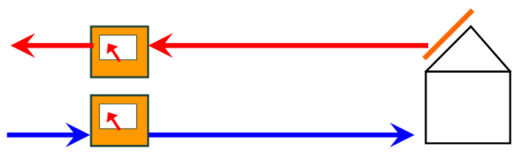
Scheme of operation of solar power station in the mode of Feed-in tariff

Slide 11
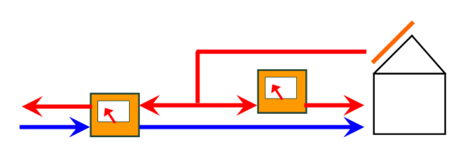
Scheme of operation of solar power station in the mode of Feed-in premium

Slide 12
The Support Policy for residentials in Austria
Green Electricity Act (Ökostromgesetz)
Feed-in tariff system
  Only capacity > 5kWp
  Fixed price for 13 years
Local providers
  Capacity >5kWp
  OeMAG, AAE, Stadtwerke Hartberg
Investment subsidy
Notes:
The price in FIT is currently 18,12 eurocent.
The FIT by OeMAG are sett only for devices with capacity over 5kWp
Subsidy or low cost loan is available. But when the producer use this grants, he can not use the FIT
The price is varying between 4 - 12 cent/kWh.

Slide 13
New subsidy system in Austria
Financed by Climate Energy Fund
budget of €36 million
more than 24,000 power plants
capacity of 115 MW
€300/kWp for rooftop/groundmounted
Notes:
Adopted in April 2013
Only for PV plants with a maximum capacity of 5 kW
Subsidy of €400/kWp for building-integrated PV
framework of the climate and energy funds.
Condicions: Registration till November 30 and finishing the power plant withing 12 mounths after the registration

Slide 14
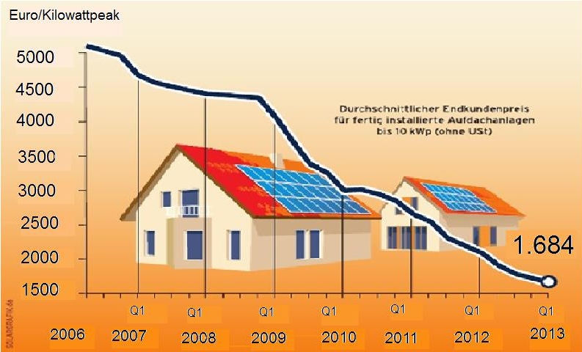
Annual cost on complete installation of PV for households
Notes:
From the year 2006 we can see the slight decline. After 2008 came a dive and the cost started to decrease more significantly
In 2009 typical PV system cost were in the range 2950€/kW_{el} to 4750€/kW_{el}.
cost marks an important departure from the trend of the year 2005-2007, during which cost remained flat, as rapidly expanding global PV markets and a shortage of silicon feedstock put upward pressure on both module prices and non-module costs.
the cost decrease has been stimulated by the increasing globalization of the PV market, especially the stronger market appearance of Asian manufacturers.

Slide 15
Comparison of support systems in Austria and Czech Republic - aplication
Model house
Panel surface (m2)………………………16.7
Installed power (kWp)………………… 2.2
Annual solar production (kWh) ………2107
Annual consumption (kWh)……………2890
Production–consumption ratio (À)……0.7
Notes:
(Grietus Mulder, Fjo De Ridder, Daan Six, 2010)

Slide 16
Calculation in terms of the Czech Republic
For knowing the Return of investment are following information needed:
Annual complete cost on investment………1684 €¹/kWp
Current Feed-in tariff premium………………0,11€2/kWh
Current Feed-in tariff…………………………..0,13 €²/kWh
The price of elektricity (€/kWh,annual)......0,1487€³/kWh
Depreciation of about 1% per year expressed by a coefficient 0,887

Slide 17
Return of investment (ROI) in the Feed-in premium scheme (1)
Investment/((((Production * elektricity price) + (production * premium price) – ((consumption - production) * electricity price)) * depreciation coefficient)

Slide 18
Return of investment (ROI) in the Feed-in premium scheme (2)
Investment = 2,2 kWp * 1684€ = 3705€
ROI = 3705/((2107 * 0,1487) + (2107 * 0,11)-(783 * 0,1487)) * 0,887 = 9,7
ROI value is 9,7
The lifetime of PV is about 20 years
Net profit will be:
10 years *(2107kWh * 0,11€) + (2107kWh * 0,1487€) - (783kWh * 0,1487€) = 4287€
Notes:
ROI value is 9,7, which means it takes about 10 years for returning the investment. After that the unit will generate the net profit. The lifetime of PV is about 20 years so the net profit

Slide 19
Return of investment in the Feed-in tariff scheme – CZ
current Feed-in tariff is 0,1316 €
guaranteed for 20 years
yearly increased by the price index of industrial producer´s (2 %)
ROI = 11 years, the financial balance in 2034 = 3864,49 €
Total result = 3864,5 - (2890* 0,1487) = 3298 €

Slide 20
Calculation in terms of Austria (1)
1) Tarrif provider: OeMAG
Annual complete cost on investment….1684 €/kWp
Subsidy from new Climate Energy Fund program 300 €/kWp
Current Feed-in tariff (OeMAG)……………0,0452 €/kWh
The price of elektricity from the distributor(€/kWh,annual)........................0,20103€3/kWh
Financial balance after 20 years = - 445,14 €
Notes:
OeMAG = Abwicklungsstelle für Ökostrom AG

Slide 21
Calculation in terms of Austria (2)
2) Tarrif provider: Stadtwerke Hartberg
Annual complete cost on investment……1684 €¹/kWp
Subsidy from new Climate Energy program…300€/kWp
Current Feed-in tariff (OeMAG)……………0,0925 €/kWh
The price of elektricity from the distributor (€/kWh,annual)…0,20103€³/kWh
Financial balance after 20 years = 1242,75 €
Notes:
Considering participation in Climate Energy Fund program
We also have to deduct the own need of electricity for consumption from the income again. So the result is 1242,75€ - (2890kWh * 0,20103€/kWh) = 662€
In the Czech Republic the amount of saved money was almost five times higher

Slide 22
Conclusion
the storage of part of the solar power for near-term consumption within a day or subsequent days for grid connected PV can be helpfull to achieve the best benefit
In comparison to the classic large storage sizes, an optimal size for being less dependent from the grid can be calculated
Bridging a period of several days without sunshine was not the focus of this paper
Owners of rooftop PV systems have better profitability and the higher certainty of return of the investment in the Czech Republic
In the CR is no investment subsidy provided
In the future the convergion of systems is expected

