Slide 1

Implementation potential of photovoltaic in Austria and the Czech Republic
Czech-Austrian Winter and Summer School

Slide 2
The main parts of the work
  The use of PV in electricity production
      Czech Republic vs. Austria
  Energy potential of PV
      Czech Republic vs. Austria
  Simulation - replacement of SP block by PV
  Influence of PV to power systém
  Analysis and discussion of results

Slide 3
Research questions
  Renewable Energy Sources
      Non-fosil sources
      Without greenhouse gases emision (ec. biomass)
      Primar source of elektrical energy - WHY NOT ???
  Consuption trends
      High level of automation - industry, household
      Growing demand for reliable power supply quality
      Increase of consumption electricity

Slide 4
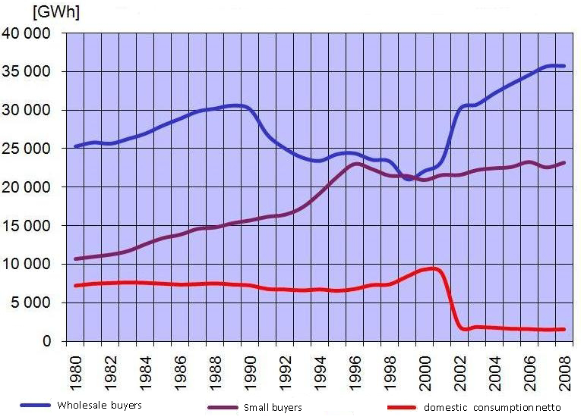
Research questions

Slide 5
PV in the Czech Republic

Slide 6
PV in the Czech Republic

Slide 7
PV in the Czech Republic
  Support for RES
      Minimum purchase price
        All electricity sold to the distribution system operator or transmission system operator
        Guaranteed purchase => lower discount
      Green bonus
        The manufacturer must find a customer itself or electricity trader
        The possibility of higher profit

Slide 8
      Minimum purchase price in the Czech Republic

Slide 9
      Green bonus in the Czech Republic

Slide 10
PV in Austria

Slide 11
Green Power plants in Austria

Slide 12
Energy potential of PV
  Technical potential
    Hypothetical potential
  Useable potential
    Part of technical potential
  Available potential
    Part of useable potential
  Economic potential
    Part of available potential

Slide 13
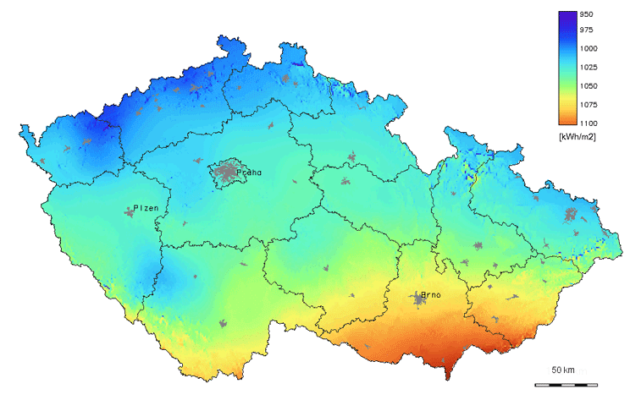
Energy potential of PV in the CR
  Technical energy potential of solar power plants in CR - 5 500GWh/year

Slide 14
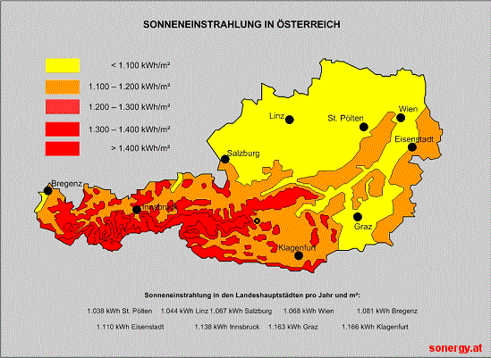
Energy potential of PV in Austria

Slide 15
Potential of PV in Austria
 |  | Roofs |  | Building facades | Surface | Noise protection walls | Total
 |  | flat roof | sloping roof
Theoretical potential | PWh/a |  |  |  |  |  | 92
Theoretical potential of produced electricity | PWh/a |  |  |  |  |  | 26
Theoretical surface potential | km² | 155 | 479 | 809 | 983 | 1,53 | 2427
Technical surface potential | km² | 35 | 79 | 52 | 136 | 0,46 | 303
Istalled capacity | GW | 2,4 – 5,5 | 5,6 – 12,7 | 3,6 – 8,3 | 9,5 – 21,8 | 0,03 – 0,07 | 21,2 – 48,5
annual yield | kWh/kW | 950 | 900 | 650 | 950 | 650
Technical supply potential | TWh/a | 2,3 – 5,3 | 5 – 11,4 | 2,4 – 5,4 | 9,1 – 20,7 | 0,02 – 0,05 | 18,8 – 42,9

Slide 16
Simulation - replacement of steam power block by PV
  Installed capacity in the steam power station in CR - 10 623 MW (year 2012)
  Block of steam power station - 200MW
  After calculation - 811 MW in PV instead 200 MW in steam power station
  Price of 1W of installed capacity of PV - cca 3,6€
  Size of chosen PV panel with capacity of 130W - 1,1m²
    Price of 811 MW of installed capacity of PV 2 919 600 00€
    Size of area with PV panel (installed cap. 811MW) 6,862km² (2,6 x 2,6km)

Slide 17
Influence of PV to power system
  Fully dependent on the strength and regularity of solar radiation
    The instability of power supply
    Need to ensure the value of installed capacity in other sources
  Phase voltage asymmetry
  Harmonics
    Use od system the pulse width modulation
  Unintentional islanding
  Jumps and drops in voltage and power in the PCC to the DN

Slide 18
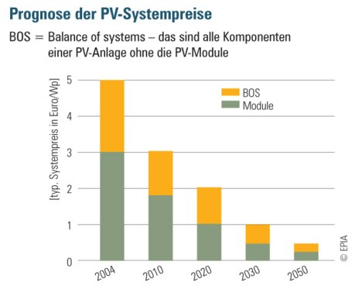
Prognose der PV-systempreise

Slide 19
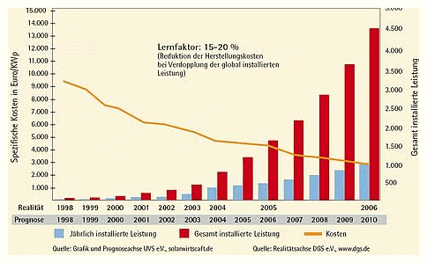
PV USe

Slide 20
Future szenario
  Huge potential both in Austria and the Czech Republic for PV
  Grid parity in 2015 – 2017 years
  Independent of subsidies
  Storage technologies?
  PV production will rise

Slide 21
prepare our energy systems
  Control energy
  Austria: existing pumped storage power plants
  Czech Republic: gas-fired power plants
  Energy systems are not confined to individual countries
  Liberalization of European energy markets
  Import and export of EE with the corresponding transmission capacity
  New power plants for balancing power and storage options
  Compensation: volatility of PV

Slide 22
Sources
http://www.chemiereport.at/lobbying-fuer-pv-heimmarkt-oesterreich
http://philosophenstuebchen.wordpress.com/2010/01/27/der-streit-um-die-einspeisevergutung-fur-photovoltaik-strom-ii/
Tarifabschläge. Abgerufen am 23. 04 2012 von http://www.lea.at/lea2011!/wp-content/uploads/Tarifabschlaege_OESG2012.jpg
Faninger 2007/, /BMVIT 2009. (2009). In Kaltschmitt, Regenerative Energien in Österreich. © Vieweg+Teubner | GWV Fachverlage GmbH, Wiesbaden.
E-control. (2011). Ökostrom-Einspeisemengen und Vergütungen. Abgerufen am 27. 12 2011 von http://www.e-control.at/de/statistik/oeko-energie/oekostrommengen
E-control. (2011). Statistik Ökostrom. Abgerufen am 25. 12 2011 von http://www.e-control.at/de/statistik/oeko-energie/anlagenstatistik/anerkannte-oekostromanlagen
E-control. (2011). Strompreiszusammensetzung. Abgerufen am 24. 12 2011 von www.e-control.at
Sonergy. (2011). Die Zeit ist reif für Photovoltaik. Abgerufen am 23. 12 2011 von http://sonergy.at
Kaltschmitt, M. (2009). Regenerative Energien in Österreich. Wiesbaden: © Vieweg+Teubner | GWV Fachverlage GmbH, Wiesbaden.

