Slide 1
How reliable are RES- New storage possibilities
Radka Fabianova
Gerold Muggenhumer

Slide 2
Content
Introduction of RES
  Potential of irradiation
  Consumption x Production
  Austrian x Czech Legislation
A comparison of storage systems
Installation model – An island house
Notes:
Radka

Slide 3
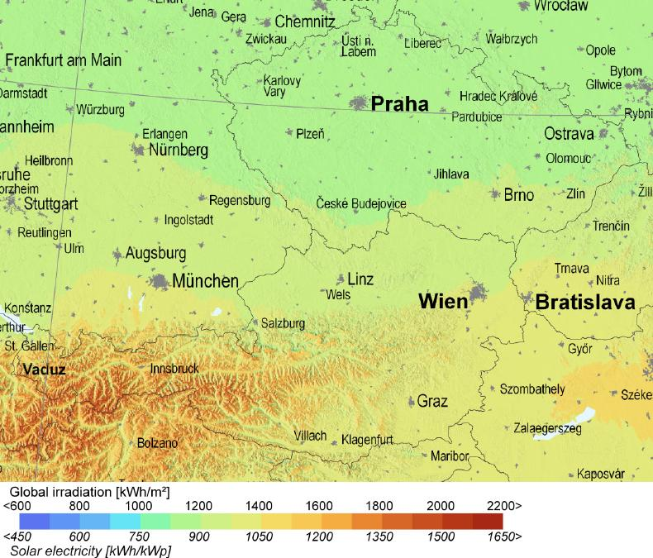
RES - Photovoltaic
    Potential of irradiation in Czech Republic and Austria

Slide 4
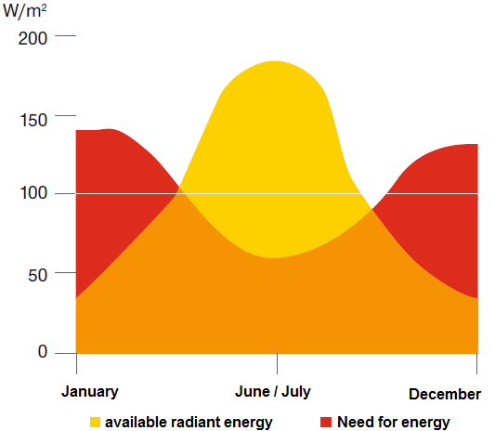
RES - Photovoltaic
Consumption x Production

Slide 5
Austrian legislation
Nationally within the scope of the „Elektrizitätswirtschafts- und Organisationsgesetz (EIWOG)
    Regulates the construction
    Announcement
    Application for permit
Ökostromgesetz
  8 mill. Euros for 2012
  Reside with the respective states
➔Styrian model

Slide 6
Austrian legislation
-Requirements for funding
PV- installation has to suffice § 7 Ökostromgesetz 2012
Installation from a permitted expert company
Assignment of a expert company before application for permit
Only on-grid PV-systems
More than 50% of the building must belong to private use
Latest technique
Only one application per person
Application for permit before delivery of the PV- system

Slide 7
Styrian PV-funding
Photovoltaic systems up to 5 kWp
Photovoltaic systems greater than 5 kWp

Slide 8
Styrian funding- model:
PV- system up to 5 kWp
Number of accomodation unit | conveyable power in kWp | Funding amount in Euro
 |  | funding without KLIEN | funding with KLIEN
 |  | total | total
Rebuilding or expansion of PV-systems up to 2 accomodation units | 2 extended | 500,- | 375,-
 | 2 new | 750,- | 562,5
 | 2,5 extended | 625,- | 468,75
 | 2,5 new | 875,- | 656,25
 | 3 | 1.000,- | 750,-
 | 3,5 | 1.125,- | 843,75
 | 4 | 1.250,- | 937,5
 | 4,5 | 1.375,- | 1.031,25
 | 5 | max 1.500,- | max 1.125,-
Rebuilding or expansion of buildings from 3 accomodation units | 2 | 750,- | KLIEN only from 2 to 5 kWp!
 | per extended 0,5 kWp | 125,-
 | max. 15 | 4.000,-
surcharges
Rebuilding | additional basic amount | 500,- | 375,-

Slide 9
Styrian funding- model:
PV- system >5 kWp
Subsided with a continuously feed-in tarif for 13 years

Slide 10
Czech Legislation
for off-grid installation you do not need any permission
for on-grid installation you need several permits
  apply for the connection to the local distribution system
  a license by the Energy Regulatory Office
  if an installed capacity exceeds 20 kWp another prerequisite is the assumption of competence

Slide 11
Czech Legislation
If the excess energy supplied to the network, its purchase price is favored
Two types of benefits
  Green bonus
  Guaranteed purchase price

Slide 12
Energy storage systems
Energy storage system techniques can be classified as follows:
According to the type of application: permanent or portable
Storage duration: short or long term
Type of producion: maximum power needed

Slide 13
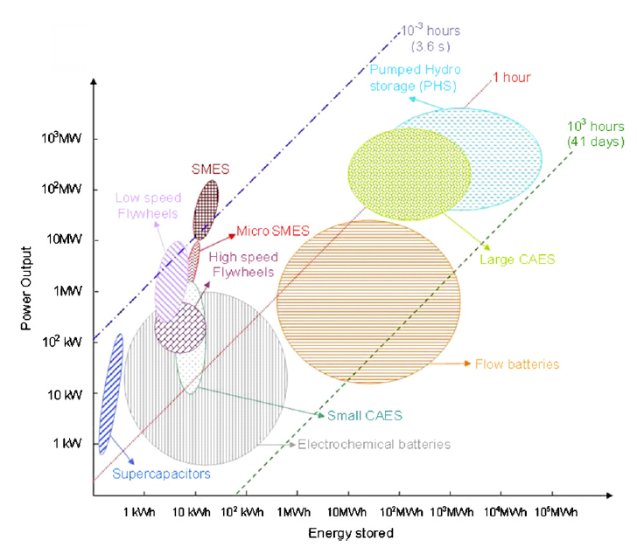
Energy storage systems

Slide 14
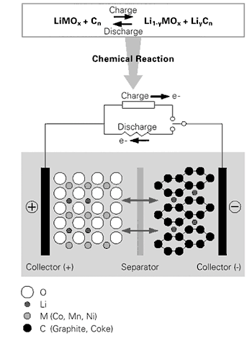
Energy storage systems
-Lithium-Ion batteries
Advantages compared to predecessor technologies:
high lifetime up to 20 years without maintenance
discharge depth up to 100%
high energy density (less weight, less volume)
Source: Conergy Energiespeicher- Strom bei Tag und bei Nacht, Varta- Development of the battery

Slide 15
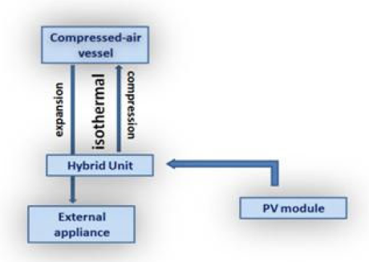
Energy storage systems
-Compressed air energy system
Source: Villela D. et. al (2010)

Slide 16
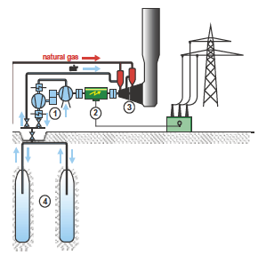
Energy storage systems
-Compressed air energy system
Large- scale CAES: Huntdorf (D)
  Compressed air storage/ gas turbine power station
  Efficiency is about 60%
  High energy density
Small-scale: especially for residentail PV-systems
Source: Crotogino F. (2001)
Notes:
1: compressor train
2: motor-generator unit
3: gas turbine
4: underground compressed air storage

Slide 17
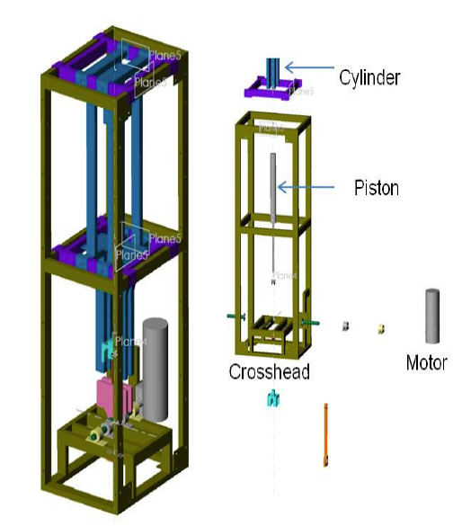
Energy storage systems
SS- CAES
Compressor characteristics:
Single-stage
Displacement-based
Piston-driven
Small-scale
Low-cost
Rpm= 10-60
Efficiency up to 70%
Source: Villela D. et. al (2010)

Slide 18
Installation model
-An island house
The electricity production from panels cover a three-member household consumption
The size of the system
  should be set to at least to the 90% of consumption in the winter but not higher
Special requirements for appliances
  install the most possible saving appliances
  replace electricity wherever it generates heat

Slide 19
Example of a reliable off-grid electricity system with Lithium-Ion batteries
15 LED lights with 18W each and operation time of 4hours
TV with 60W and an operation time of 3 hours
Computer with 60W and an operation time of 4 hours
Fridge with 0,0026 kWh*
Washing machine 0,40 kWh (every second day, else 0,8 kWh)**
* Miele K 9252i-1 (152 l)
** Miele W 1904 Eco Active

Slide 20
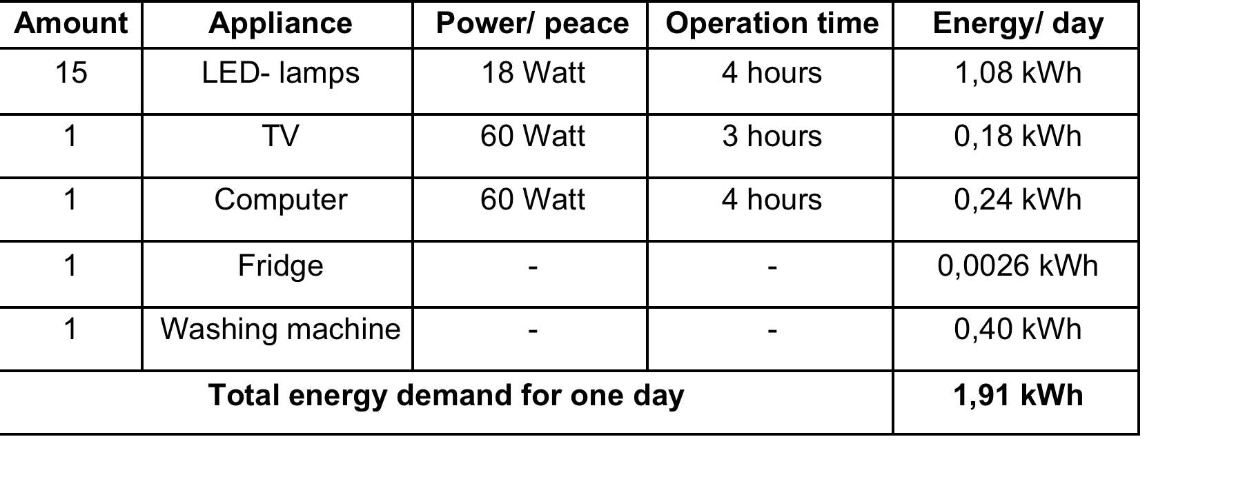
Calculation of the required battery capacity

Slide 21
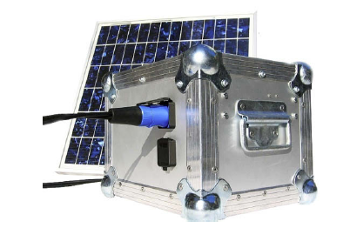
Calculation of the required battery capacity
1,91 kWh x 5 days = 9,55 kWh
9,55 kWh : 0,7 = 13,65 kWh
13,65 kWh : 24V = 569 Ah

Slide 22
Result
8 Lithium- Ion batteries a 75 Ah, 24 Volt
4 batteries parallel connected
These each 4 parallel connected batteries finally switched in series
➔ 600 Ah, 24 Volt

Slide 23
Thank you for your attention!

